Slide 1
Hoist Ropes: Nondestructive
Testing and Inspection by
Michael Snyder, Mining Engineer, PE
MSHA Technical Support
Mine Electrical Systems Division
Notes:
Good Afternoon,
Brief Intro – Work History
Appreciate the opportunity to speak with you today.
Agency Go-To person for information concerning Wire ropes, elevators and hoisting issues. Today I have a brief presentation on NDT and Inspection of wire ropes.

Slide 2
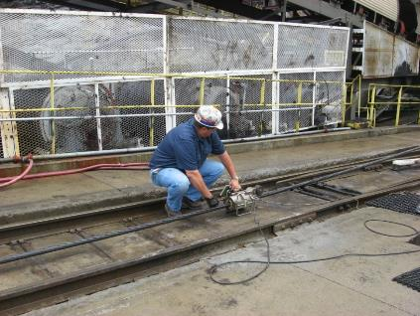
Hoist Ropes: Nondestructive
Testing and Inspection
LMA Channel
LF Channel
Notes:
Example of an examination being conducted on a slope rope.
Chart shows generically the type of output produced

Slide 3
Overview – Hoist Ropes: Nondestructive Testing and Inspection
Wire Rope Regulations for Metal and Non-Metal (MNM) and Coal mines – Finalized November 25, 1983
    MNM - Parts 56.19021-19030 and 57.19019 – 19030
    Coal - Parts 75.1429-1438 and 77.1430-77.1438
MSHA NDT Equipment
Review Field Investigations – Conducted through Wire Rope NDT, 2 Case Studies
Notes:
The wire rope regulations have been in the CFR since 1983.
They are unique in that they are the same for Surface/Underground MNM/Coal
Non an extensive amount here, but we will touch on the inspection and testing requirements.
Present MSHA’s equipment
Discuss two Case studies involving inspection and testing.

Slide 4
Scope – Regulations Apply to
Wire Rope used to:
Hoist persons in shafts or slopes underground;
Hoist persons with incline hoists on the surface; or
Hoist loads during shaft or slope development where persons must work below suspended loads
These standards do not apply to wire ropes used for elevators
Notes:
These Regulations apply to three distinct situations.
REGS DO NOT APPLY TO: To production hoists used to hoist persons for examination or inspection or maintenance. Nor to Draglines, elevators equipped with a governor rope or cranes used to lift materials other than cranes used in shaft and slope operations.
ASME A17.1 Safety Code for Elevators and Escalators
For MNM – their application of the personnel hoisting standards include a regulation that “Emergency hoisting facilities should conform to the extent possible to safety requirements for other hoists, and should be adequate to remove the persons from the mine with a minimum of delay.

Slide 5
Wire Rope Examinations
56/57.19023(a) – 75/77.1433(a)
At least once every fourteen calendar days, each wire rope in service shall be visually examined along its entire active length for visible structural damage, corrosion, and improper lubrication or dressing.
Notes:
Prior to November 25, 1983, Coal Mines had a daily exam for hoist ropes and MNM had a monthly exam.
LOOKING FOR VISUAL STRUCTURAL DAMAGE, CORROSION AND IMPROPER LUBRICATION OR DRESSING.
Wear and Broken Wires at stress points
Near attachments
Sheaves
Where the rope leaves the drum
Drum crossovers and change of layer regions
"Crossover points" are "locations on a wire rope which is spooled on a drum crosses over the previous layer. This also takes place at each flange of the drum (change of layer) as the rope is spooled onto the drum, reaches the flange, climbs up and begins to wrap back in the opposite direction."

Slide 6
Wire Rope Examinations (Cont.)
30 CFR § 56/57.19023(a) – 75/77.1433(a)
  In addition, visual examination for wear and broken wires shall be made at stress points, including the area near attachments, where the rope rests on sheaves, where the rope leaves the drum, at drum crossovers, and at change-of-layer regions. When any visible condition that results in a reduction of rope strength is present, the affected portion of the rope shall be examined on a daily basis.
Notes:
A visual exam every 14 days along the entire active length for
structural damage
Corrosion
Improper lubrication
Wear and Broken Wires at stress points
Near attachments
Sheaves
Where the rope leaves the drum
Drum crossovers and change of layer regions
"Crossover points" are "locations on a wire rope which is spooled on a drum crosses over the previous layer. This also takes place at each flange of the drum (change of layer) as the rope is spooled onto the drum, reaches the flange, climbs up and begins to wrap back in the opposite direction."

Slide 7
Wire Rope Examinations (Cont.)
30 CFR § 56/57.19023(c) – 75/77.1433(c) Examinations
At least once every six months, nondestructive tests shall be conducted of the active length of the rope, or rope diameter measurements shall be made
  Wherever wear is evident;
  Where the hoist rope rests on sheaves at regular stopping points;
  Where the hoist rope leaves the drum at regular stopping points; and
  At drum crossover and change-of-layer regions.
Notes:
If electromagnetic Nondestructive Testing is not used, caliper measurements (diameter) are acceptable. Ask class about their home state, ex. WV requires NDT of all hoist ropes.
Where do you want to take the diameter measurement?
At the stresspoints in paragraph (a)
Wherever wear is evident.
Diameter measurements are not intended to be repeat measurements of the baseline. They should be taken at the stresspoints in the system described above.

Slide 8
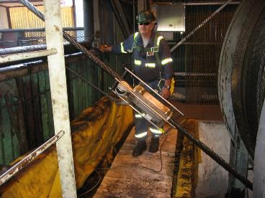
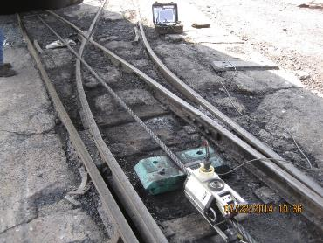
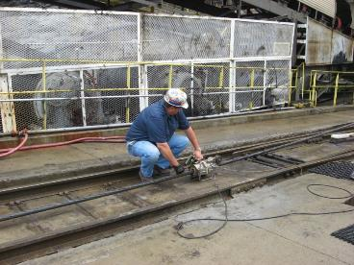
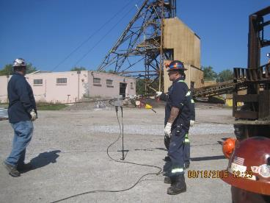
MSHA Recommends Wire Rope NDT
Evergreen Resources – Manograph
Acuren Inspection
Rotesco – Rotescograph
MSHA – NDT Technologies
Ketchum Const., Frontier Kemper, RG Johnson
Silver State Wire Rope - Rotescograph
Notes:
These are the contractors that I know of…

Slide 9
Examination Reporting Requirements
30 CFR § 56/57.19023 – 75/77.1433
(d) At the completion of each examination required by paragraph (a) of this section, the person making the examination shall certify, by signature and date, that the examination has been made. If any condition listed in paragraph (a) of this section is present, the person conducting the examination shall make a record of the condition and the date. Certifications and records of examinations shall be retained for one year.
(e) The person making the measurements or nondestructive tests as required by paragraph (c) of this section shall record the measurements or test results and the date. This record shall be retained until the rope is retired from service.
Notes:
Reporting requirements
Records from the 14 day exam and the conditions found are required to be kept for 1 year
Records from the 6 months NDT or rope diameter measurements in addition to the BASELINE measurements are kept until the rope is retired from service.

Slide 10
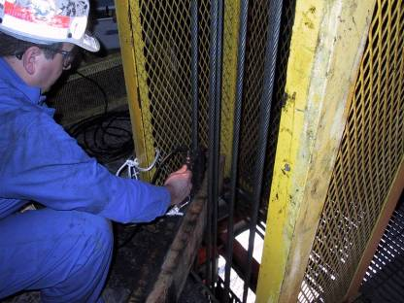
Retirement Criteria
30 CFR § 56/57.19024 – 75/77.1434 (h) Loss of more than ten percent of rope strength as determined by nondestructive testing.
LMA Channel
LF Channel
Notes:
Our final Criteria is a loss of 10% rope strength as determined by NDT.
The word STRENGTH in this criteria could present some problems if we tested a rope and found it to be on the borderline because MSHA’s equipment measures Loss of Metallic Area (LMA) and we do not estimate strength. However MSHA’s equipment doesn’t apply any correction factors and if an assumption is made on a 1:1 relationship between strength and LMA.
General statement: From our experience, when we identify a section of rope that has greater that 10% LMA, it has met another one of the retirement criteria previously discussed. i.e. broken wires, corrosion etc.

Slide 11
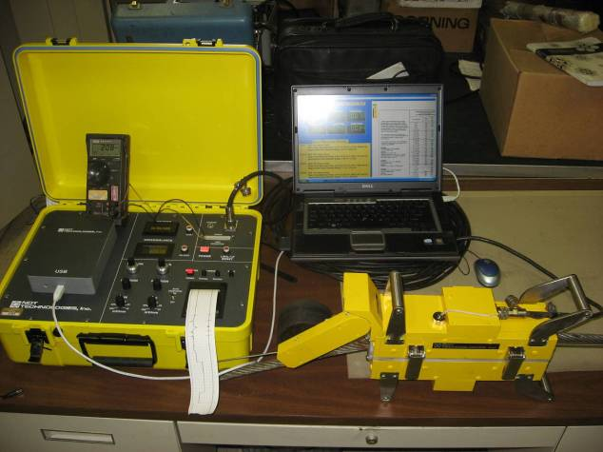
Nondestructive Testing Equipment
Follow ASTM E-1571
USB to
Computer
NDT Controller
Digital
Multimeter
Strip Chart Recorder
LMA 175
Notes:
In the past couple of years, MSHA has upgraded the equipment to a new signal controller with an integrated strip chart controller that also has a data acquisition port to capture the data electronically in conjunction with a standard laptop.

Slide 12
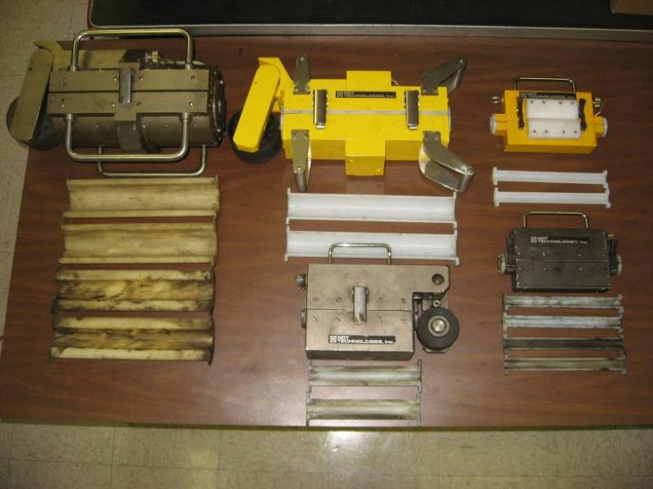
Nondestructive Testing Equipment
Notes:
MSHA has had the capability to NDT ropes since the 1970’s the program originated out of Technical Support and was run out of the Denver Tech Support Center until it closed in the mid 90’s.
A gentleman named Dennis Poffenroth ran the testing program until his retirement in 1999. Poffenroth was brought back on a contract to train several engineers to conduct testing. One of the special considerations Dennis brought to the table was that he was the chairman of the ASTM NDT Committee and was instrumental in developing the standard by which wire rope NDT is conducted.

Slide 13
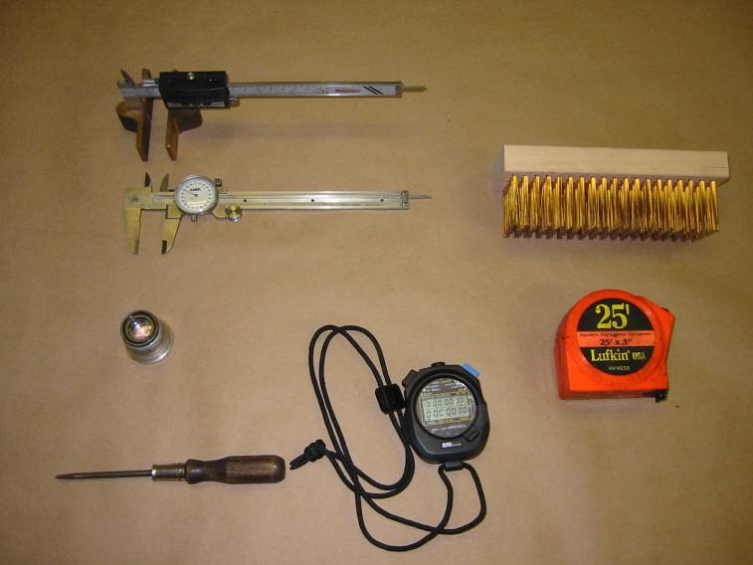
Other Tools Used

Slide 14
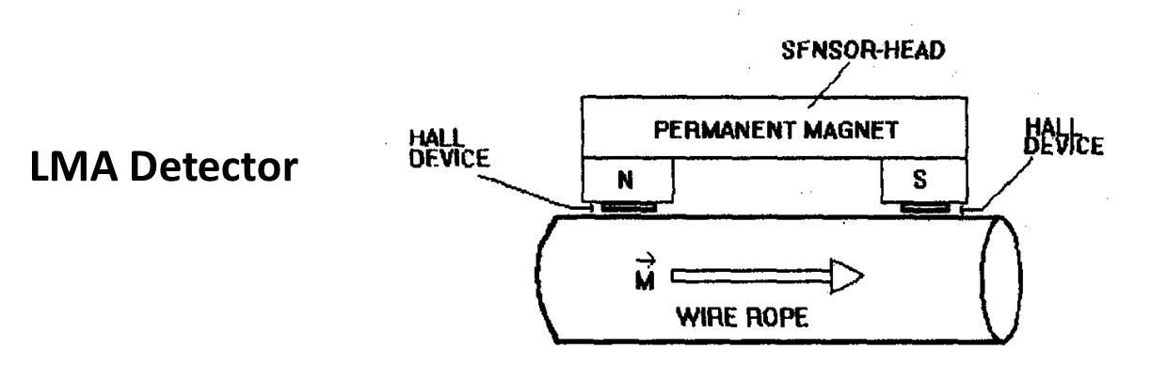
Electromagnetic Examination of Wire Rope
Principle of Operation: A permanent magnet supplies a constant flux that magnetizes a length of rope as it passes through the sensor head.
Either Hall effect sensors or an encircling sensing coil measures the change in total axial magnetic flux in the rope. We record changes in this total axial flux as Loss of Metallic Area (LMA). LMA is quantitative.

Slide 15
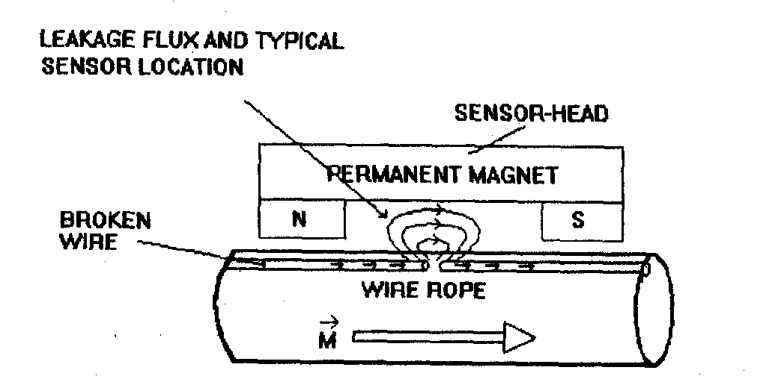
Electromagnetic Examination of Wire Rope
A separate differential sensor detects discontinuities, such as corrosion or broken wires by measuring magnetic flux leakage. The system processes the output and records the flux leakage as Local Flaws (LF). LF is qualitative.
LF Detector

Slide 16
Electromagnetic Examination of Wire Rope
MSHA’s NDT Equipment
Dual Function Instrumentation (Simultaneous LF, LMA)
Test heads with numerous inserts for various rope sizes from ¼” diameter through 2 ½” diameter
Portable, rechargeable, signal processing console and strip chart recorder with data collection to a PC
Notes:
Dual function instrumentation Mid 1980’s

Slide 17
Electromagnetic Examination of Wire Rope - Standardization
Determine rope diameter and construction.
Standardized the equipment by placing both the rope to be tested and the appropriate standardization rod in the test head.
%LMA = Area of Rod X 100
Area of Rope + Area of Rod
Remove standardization rod and adjust the LMA gain potentiometer to read the calculated LMA, or you can post calibrated the signal.
Test is relative, shows best to worst portion of rope.
Notes:
To prepare to conduct a test, First we must know the diameter and construction of the rope. From this information we can determine the total metallic area of the rope from the Wire Rope Users manual and published manufacturer literature.
Then
Depending on the size test head we are using we will use a calibration rod that is either 1/16, 1/8 or 3/16 inch in diameter
Using the equation we determine the amount of metal lost when the rod is removed from the test head and adjust the instrumentation accordingly.
Note: it is a relative test showing the best to worst portion of rope tested. Depending on the conditions, the best portion of rope tested can’t be considered what a new rope would be.

Slide 18
Wire Rope Field Work
2 Case Studies

Slide 19
Case Study No. 1 - Corrosion
Slight to Moderate, Moderate to ???

Slide 20
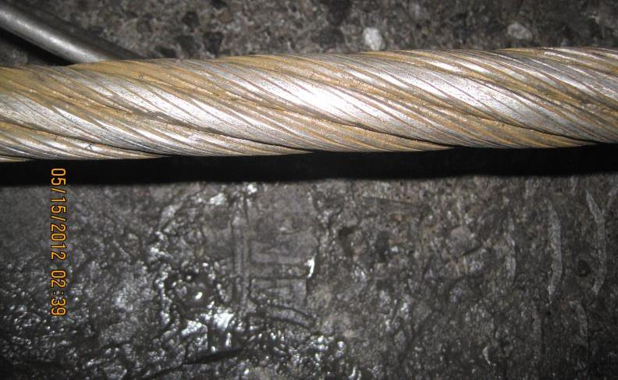
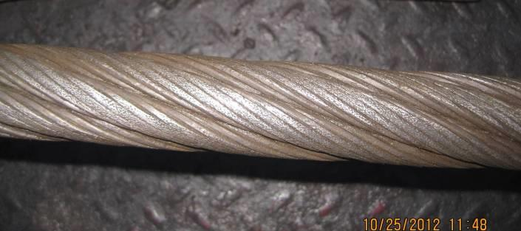
MSHA Test 05/15/2012
Notes:
This information is not designed to make you corrosion experts, but to contrast a situation involving a previously test hoist rope.

Slide 21
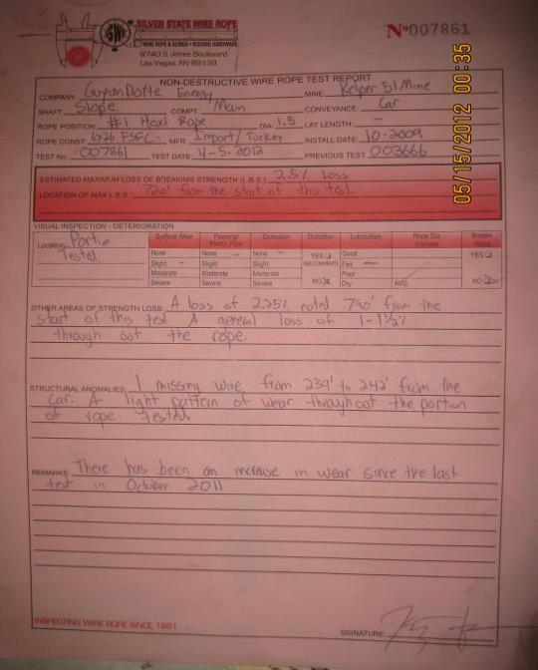
Notes:
Examined rope report from NDT contractor – they indicated about 2.5 % loss in April 790 feet from conveyance.

Slide 22
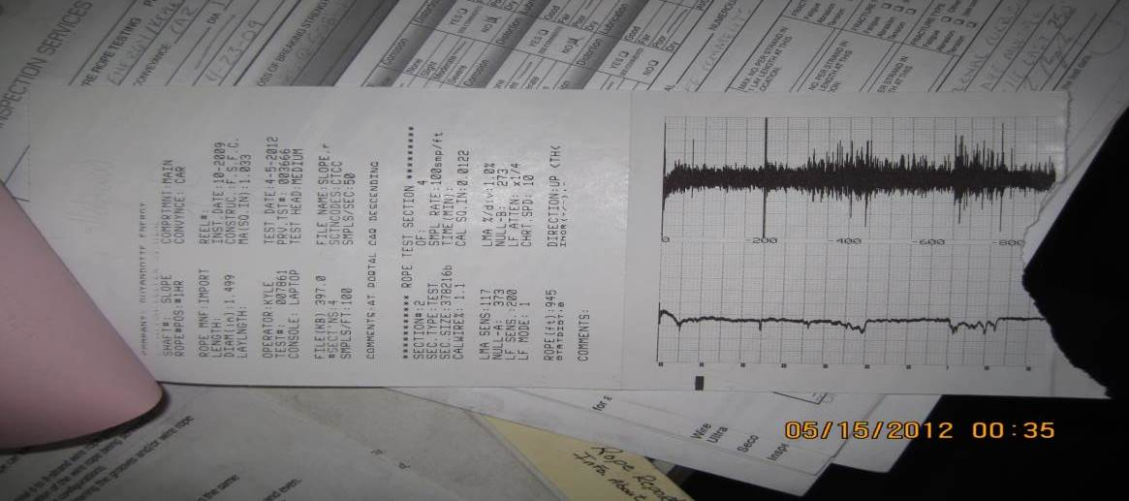

Slide 23
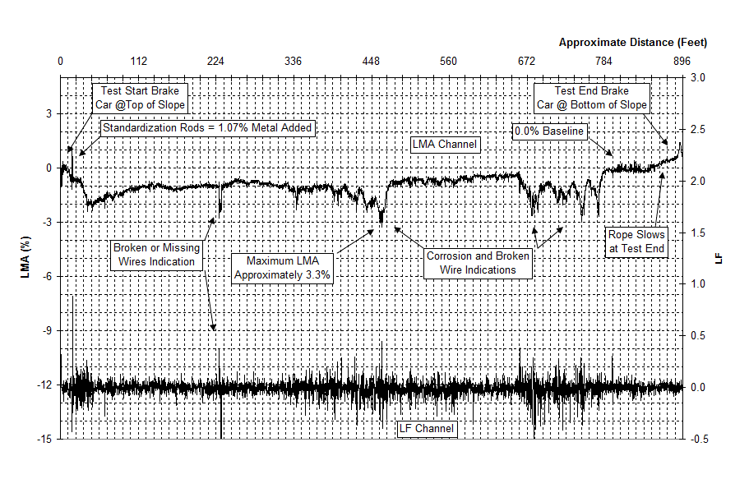
Notes:
Tested rope and identified 3.3% LMA at worst section. Measured diameter at this point and identified about 4.5% loss in diameter.

Slide 24
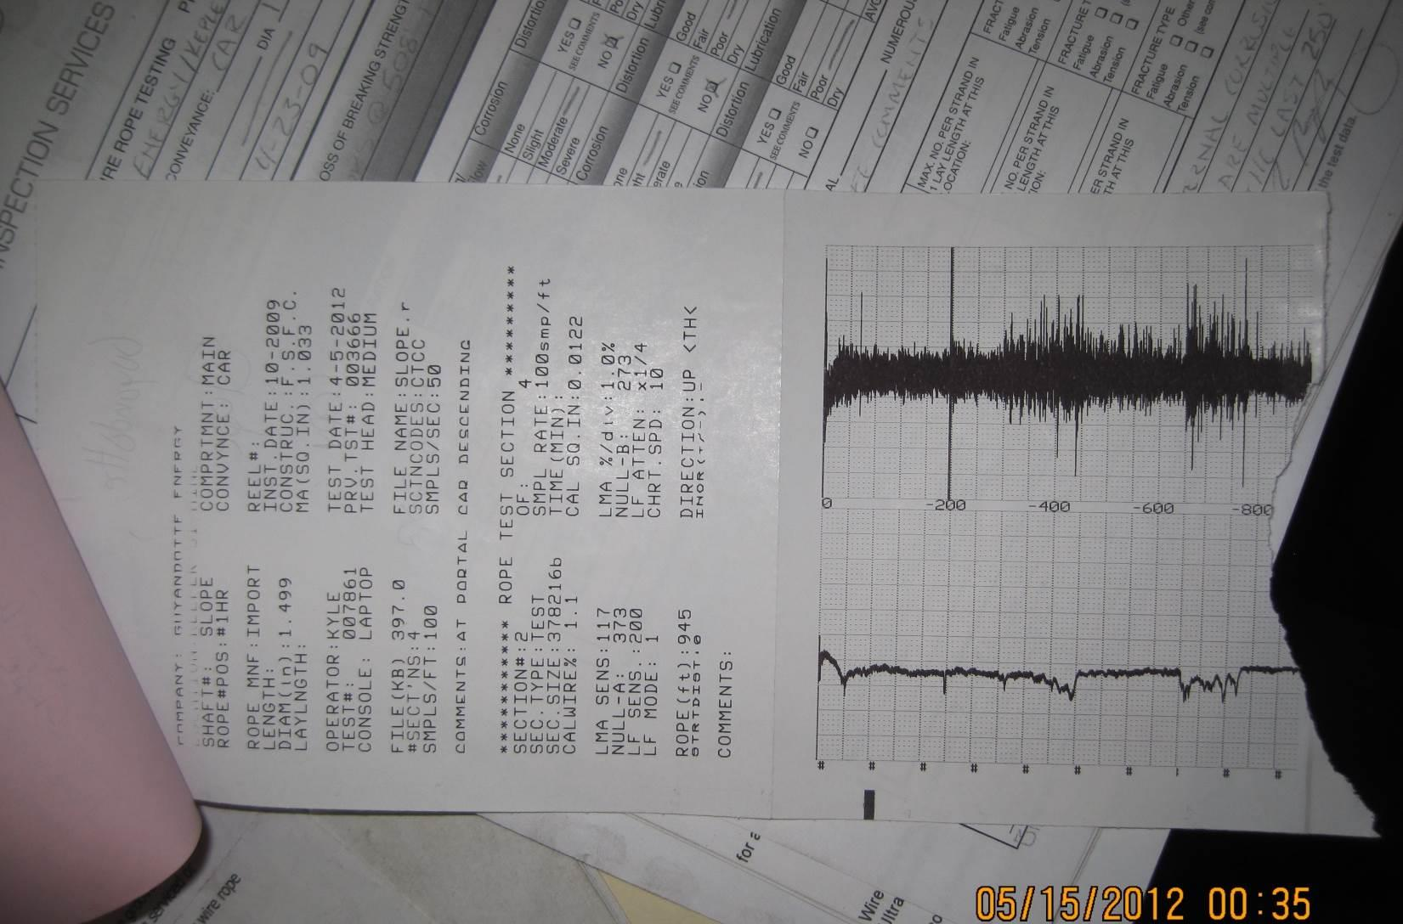

Silver
State
MSHA

Slide 25
Notes:
Six months later NDT contractor tested rope before MSHA and got similar results went to the worst area identified by NDT and measured diameter. Approximately 8% reduction from the baseline, rope was removed from service.

Slide 26
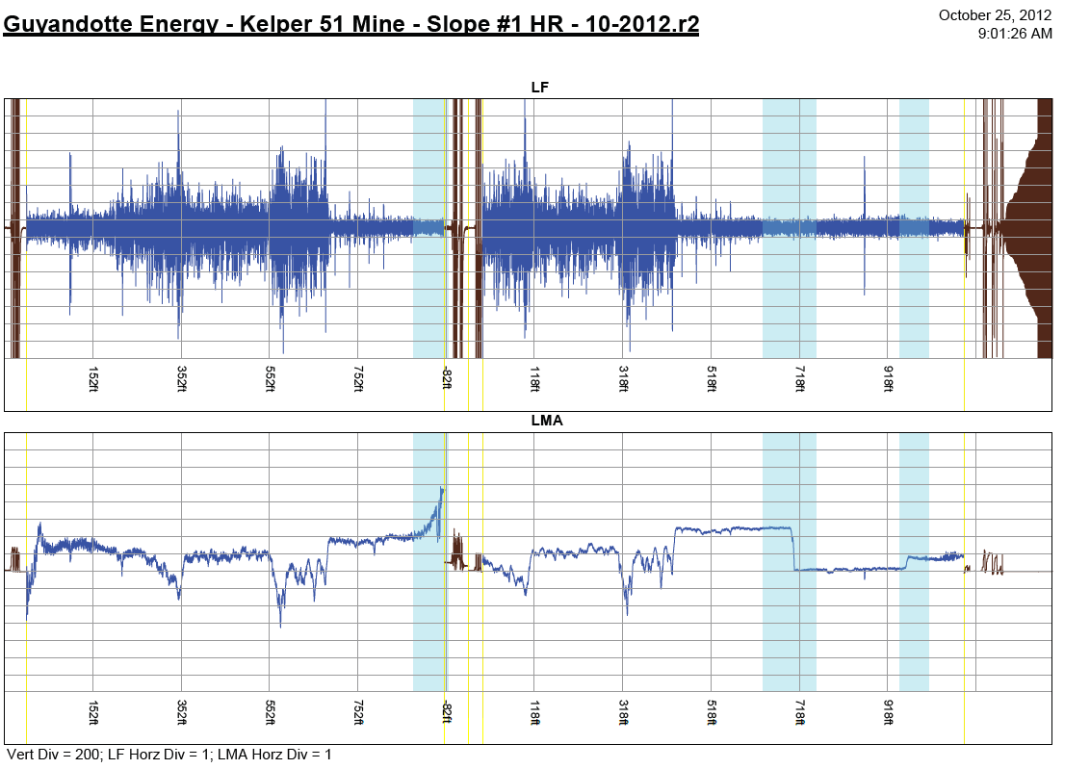
Draft Report received 1/20/21

Slide 27
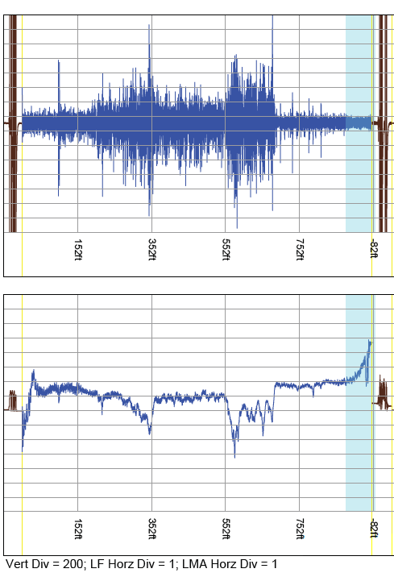
SilverState/MSHA Data 10/25/2012
Silver
State
Figure 1. - Road Fork #51 Mine, MSHA ID 46 - 01544, October 25, 2012, Top of Slope, Car Going Down
Approximate Distance (Feet)
-82
0
83
165
247
329
412
494
576
658
741
823
905
5
LMA Reset
Baseline = 0.0% LMA
3.0
(Null)
0
LMA Channel
2.5
-5
Brakecar at
2.0
Bottom of Slope
MSHA
Standardization
-10
3/16 inch Rod = 2.9% LMA
1.5
LMA (%)
LF
-15
Maximum LMA
1.0
Approximately 11%
-20
LF Channel
0.5
-25
0.0
-30
-0.5

Slide 28
Case Study No. 2 – Anthracite Mine

Slide 29
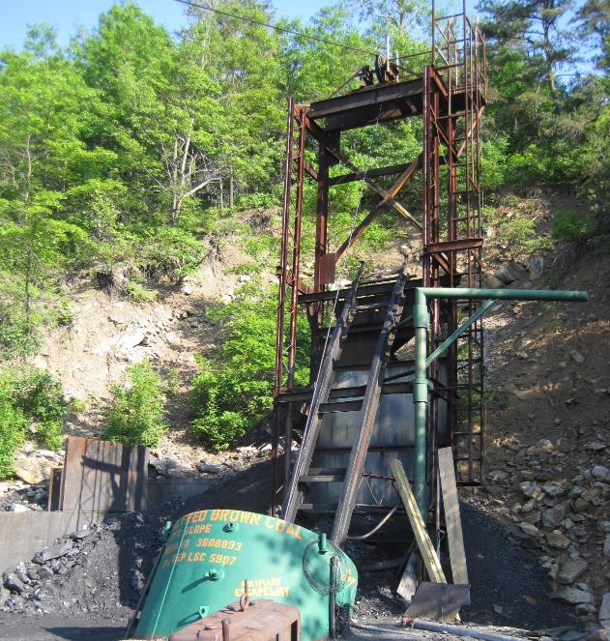

Slide 30
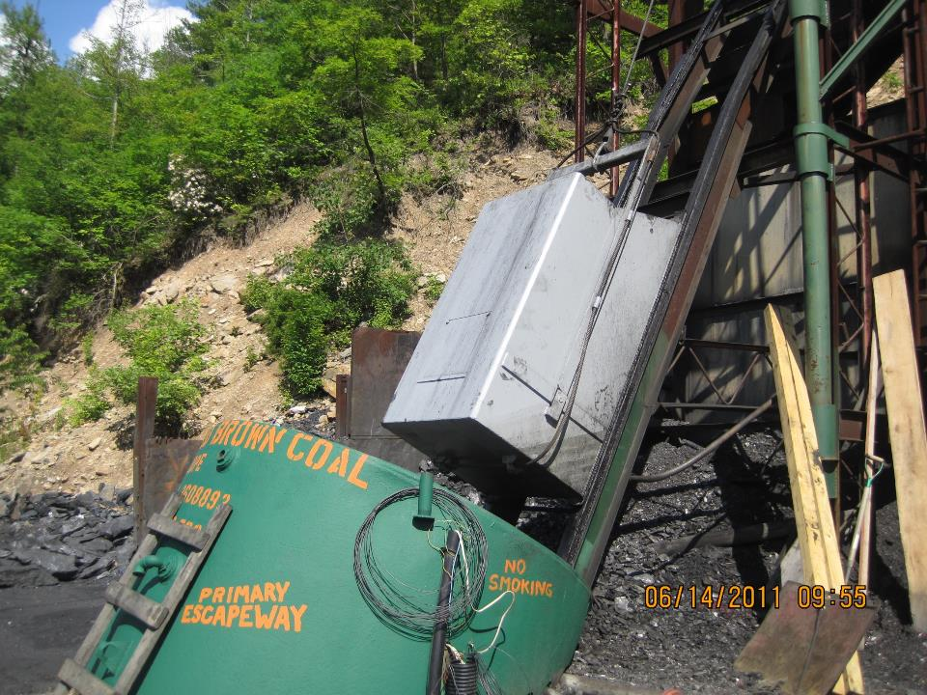

Slide 31
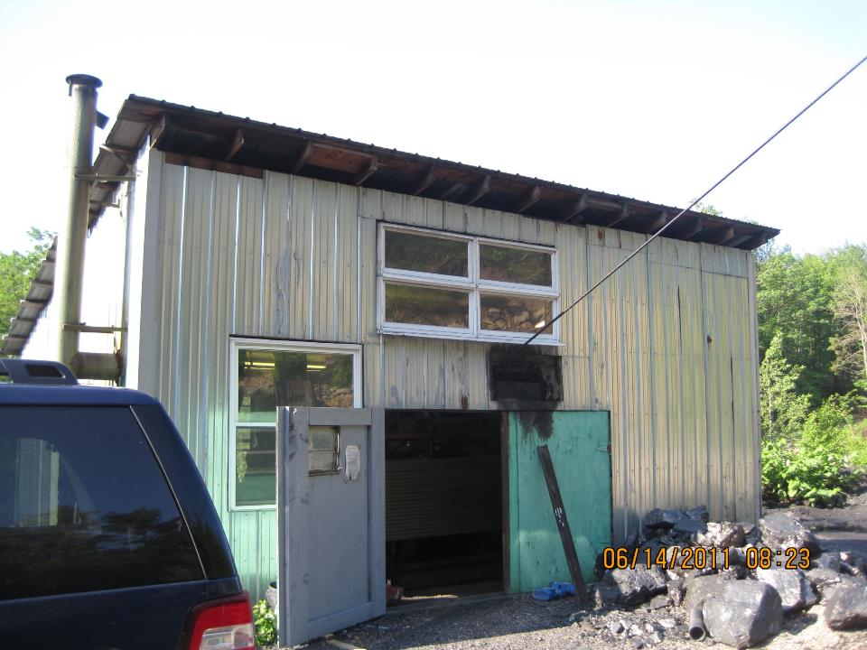

Slide 32
Figure 1. Alfred Brown Coal Company, MSHA ID 36-08893, June 14, 2011, Gunboat Coming Up
June 14, 2011
Approximate Distance (feet)
0
18
48
77
107
137
167
197
226
256
286
316
4
Test Start from Shaft Collar
1.5
2
Gunboat at Bottom
Section Marked
for Cut-off
1.3
0
-2
Gunboat at
1.1
-4
Top of Shaft
-6
0.9
-8
Standardization
Localized Loss
-10
Rod = 3.2% LMA
~6.5% LMA
0.7
LMA (%)
-12
LF
-14
Maximum Loss
~ 11.5% LMA
0.5
-16
Internal
-18
Broken
Corrosion and
Wires
Probable Broken Wires
0.3
-20
-22
0.1
-24
-26
-0.1
-28
-30
-0.3

Slide 33
June 10, 2012

Slide 34
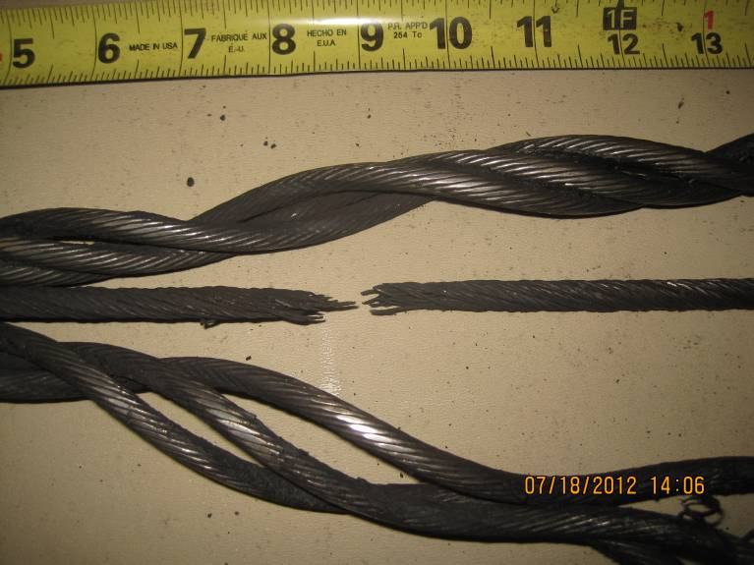

Slide 35

QUESTIONS?
Michael P. Snyder
Mining Engineer, P.E.
Snyder.Michael@dol.gov

