Slide 1
An Analysis of the Adequacy of the Ashley Formula for Barrier Pillar Design in Underground Coal Mines
Presented by:
Phillip C. Mullins, PE
Senior Manager of Permitting & Environmental Affairs
Clintwood JOD, LLC
October 29, 2020

Slide 2
Overview
Basic functions of a coal barrier pillar.
Barrier pillar design methods.
Comparison of results using the various design methods.
Conclusions as to the validity of the Ashley Formula in relation to SMCRA requirements (the control of impounded underground waters).

Slide 3
Background: What is a Barrier Pillar?
A barrier pillar is a block of solid coal which serves to isolate two adjacent underground mines (or two different areas of the same mine) from each other.
Barrier pillars are commonly used to isolate active mines from adjacent abandoned mines.
Barrier pillars are designed to ensure roof stability in active mining areas and to prevent the migration of water and gases.

Slide 4
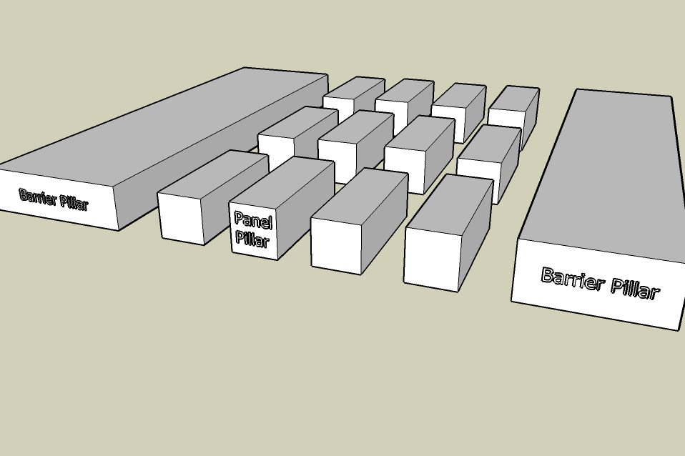
What is a Barrier Pillar?

Slide 5
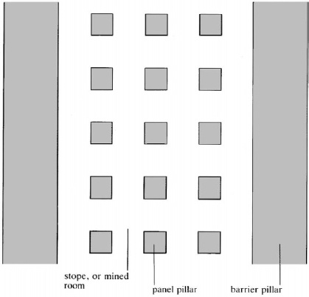
Barrier Pillars / Panel Pillars / Outcrop Barriers
Outcrop
Dip of Coal Seam
Old works or
previously mined panel (with accumulated water)
(Mine A)
Barrier
Pillar
Downslope to Structures
(Mine B)
Outcrop Barrier

Slide 6
Barrier Pillars and SMCRA
SMCRA requires underground coal mines to be designed to prevent the uncontrolled release of water from the underground workings.
In this context, barrier pillars are used to prevent accumulations of water in Mine A from breaking through into Mine B and increasing the head pressure on Mine B’s outcrop barrier.

Slide 7
SMCRA, Barrier Pillars & Outcrop Barriers
SMCRA requires the prevention of uncontrolled releases of water from UG mines
(also known as “blowouts”).
Outcrop
Dip of Coal Seam
Old works or
previously mined panel (with accumulated water)
(Mine A)
Design H = 50’
Potential Blowout
Actual H = 150’
Barrier
Pillar
Downslope to Structures
(Mine B)
H = 100’
Outcrop Barrier (Mine B):
- Original Design H = 50’
- Add. H from Mine A = 100’
- Actual H on Outcrop Barrier = 50’ + 100’ = 150’
- Potential Hazard if Barrier Pillar Between Mines Fails !
Outcrop Barrier:
W = H + 50

Slide 8
Barrier Pillar Design Formulas
Most are empirical formulas which have been around for decades (Dunn, Ashley, Pressure Arch).
NIOSH’s ARMPS program is a more recent approach based on statistical analysis of actual coal mine case studies and has grown in popularity.
The Ashley formula is commonly used by industry mining engineers to design barrier pillars (used for the past 100 years).
Q: How do these formulas compare and how does the Ashley Formula measure up?

Slide 9
The Dunn Rule
One of the earliest empirical formulas.
Developed in England in the late 1800’s.
W = [(D-180) / 20)] + 15
Units are in feet
W = Width of barrier pillar and D = depth of overburden

Slide 10
The Ashley Formula
Another empirical formula with great historical significance (early 1900’s).
Developed by a seven-member panel commissioned by the state of PA. The commission was headed by George Ashley (the State Geologist of PA).
Their work resulted in the most well known and most used barrier pillar formula in use today.
W = 20 + 4T + 0.1D
Units are in feet
W = Width of barrier pillar, D = depth of overburden (or head, whichever is greater) and T = extracted seam thickness

Slide 11
The Pressure Arch Formula
Most conservative design approach.
Primarily applicable to overburden depths of 650 feet or more.
W = 2.625 [(D / 20) + 20]
Units are in feet
W = Width of barrier pillar and D = depth of overburden

Slide 12
Comparison of Empirical Formulas
Dunn: W = [(D-180) / 20)] + 15
Ashley: W = 20 + 4T + 0.1D
Pressure Arch: W = 2.625 [(D / 20) + 20]
Q: What do you notice about the inputs when you compare these three formulas?
The Ashley formula considers both overburden depth (D) and seam thickness (T) in computing an appropriate barrier width. The others consider only D.
Q: Why is this significant?

Slide 13
The ARMPS Program
Developed by NIOSH, based on statistical analyses of pillar performance in actual coal mines in the United States.
Utilizes the Mark-Bieniawski equation with a conservative assumed coal strength of 900 psi.
Similar to the Ashley formula, the ARMPS method considers both overburden depth and extracted seam thickness.

Slide 14
Comparison of Results
Used an Excel spreadsheet to develop graphs of all four design methods.
Assumed an extracted seam height (T) of five (5) feet.
Varied depth of overburden (D) from 100 feet to 1200 feet.
Plotted results on one chart for comparison.

Slide 15
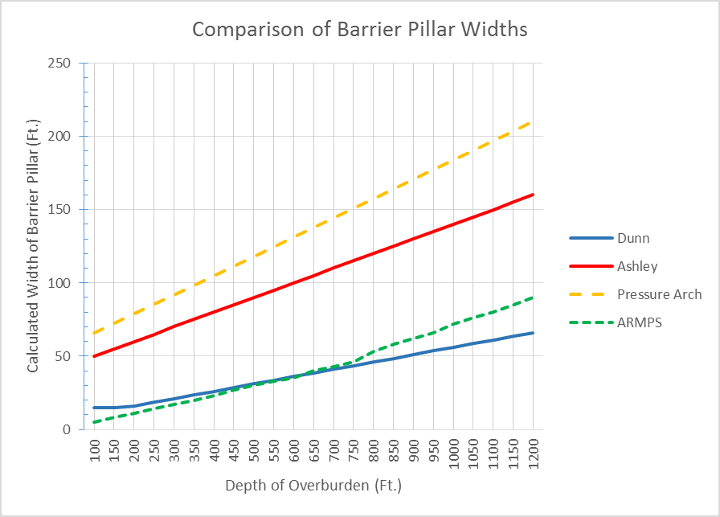
Comparison of Results

Slide 16
Should There be a Minimum Barrier Width?
Studies by Leavitt (1993) and Luo (2001) indicate the permeability of a coal barrier pillar increases as pillar width decreases.
Luo found that piping of the barrier pillar could occur at seepage velocities exceeding 4.7 feet per day. This velocity may occur when barrier pillars are less than 37 feet in width.
Therefore, we recommend a minimum barrier pillar width of forty (40) feet, regardless of the design method used.

Slide 17
Conclusions
The Ashley Formula:
Is the most conservative barrier pillar design method which is applicable to all overburden depths.
Considers all relevant input parameters: overburden depth, head and extracted seam thickness.
Is well known, is simple to use, and has a proven history of successful application.
Therefore, the Ashley formula should be viewed as a fully acceptable method of barrier pillar design.

