Slide 1
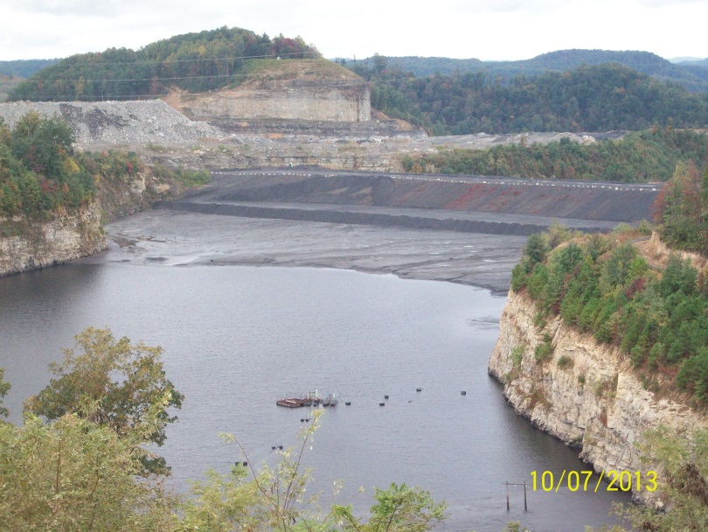
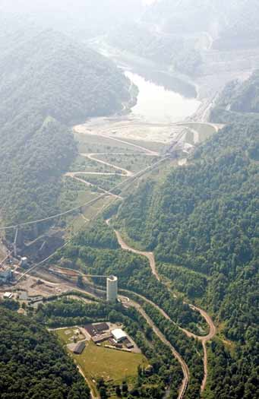
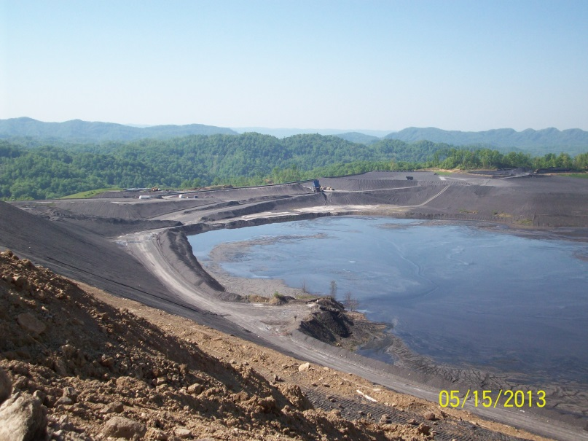

Coal Refuse Materials–Common Mistakes and Misconceptions
BY: Gary Brill, PE

Slide 2
Outline of Presentation
Coarse Refuse Placement, Compaction and Testing
Fine Refuse Placement and Testing

Slide 3
A Little Perspective . . .
Coarse Refuse for Slurry Impoundment embankments is placed in maximum 12 inch thick lifts at a narrow range of moisture content to 95%
These Strict requirements are intended to take the guess work out of bulk fill construction
Should provide a simple and reliable system for the coal operator

Slide 4
Besides . . .
Coarse Refuse properties are well documented and understood
Coarse Refuse makes an excellent embankment construction material
Out of plant moistures are typically close to optimum placement moisture
Coarse Refuse can be successfully placed year round
Until about 1992 Coarse Refuse was placed in 24 inch thick lifts and 90% compaction

Slide 5
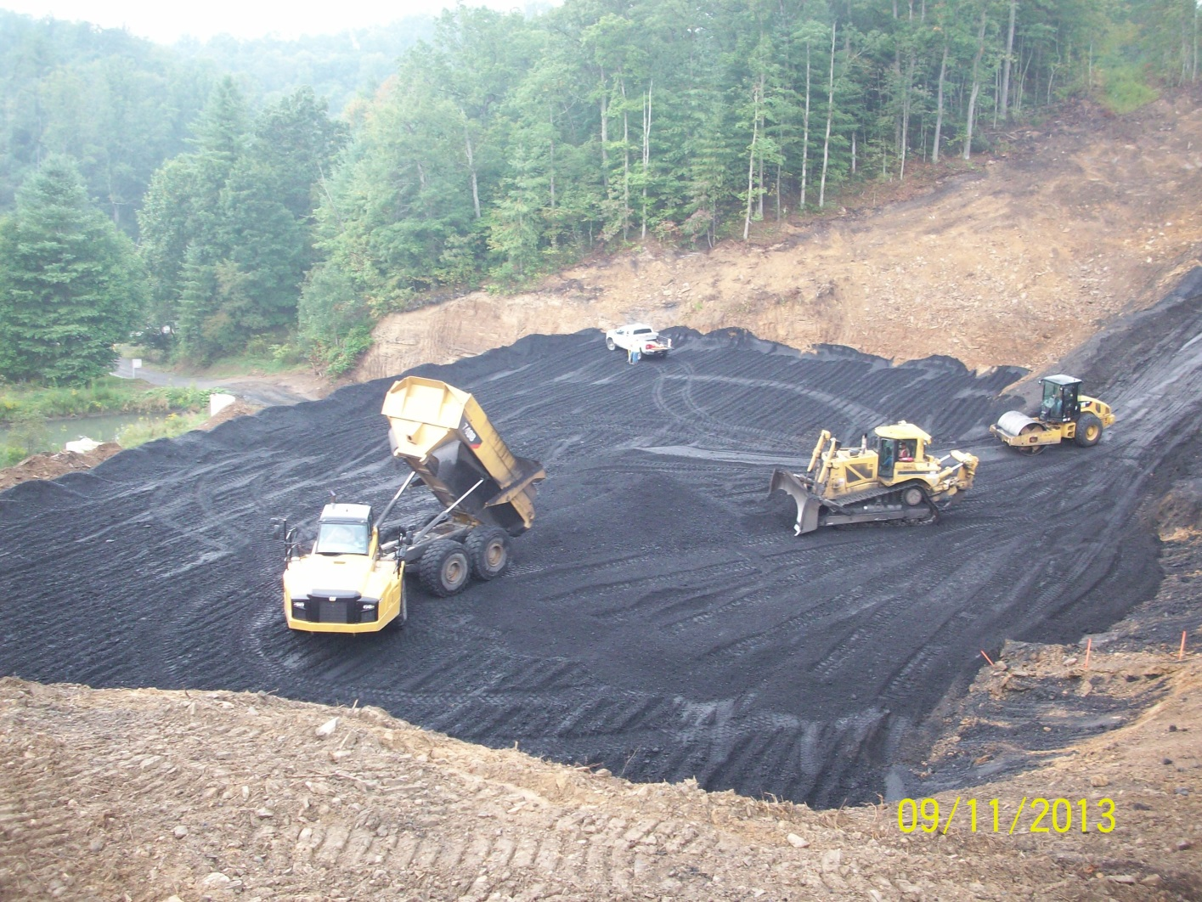

Slide 6
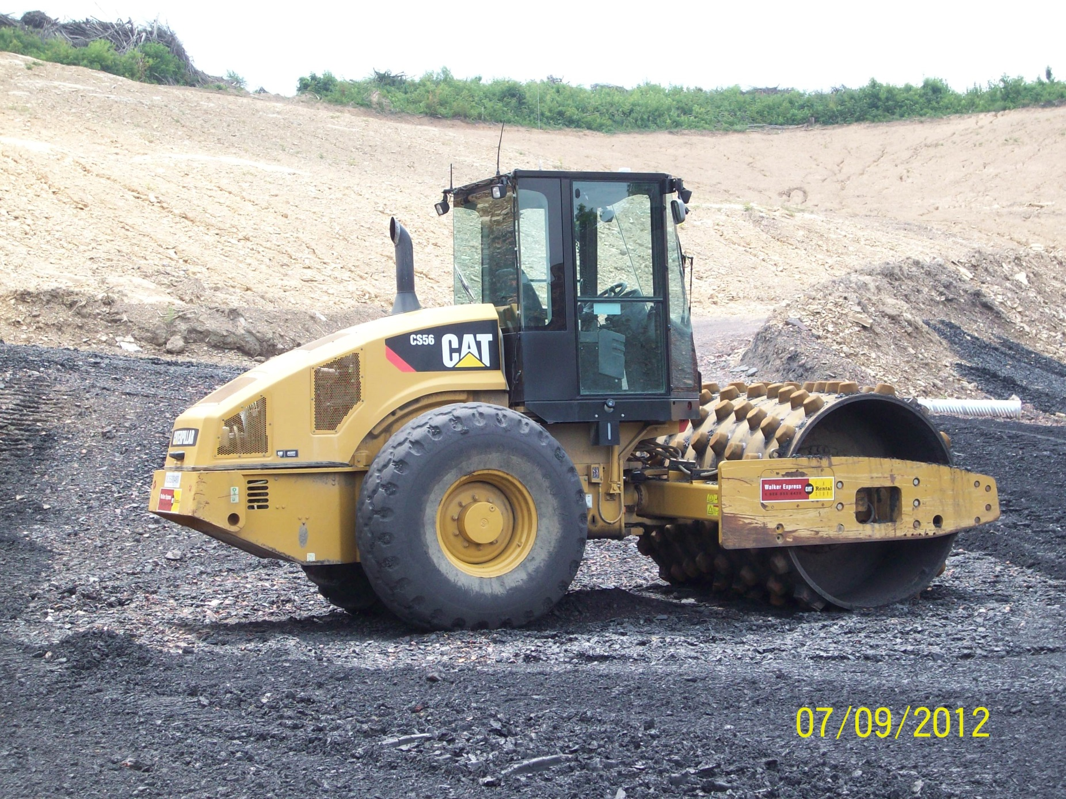

Slide 7
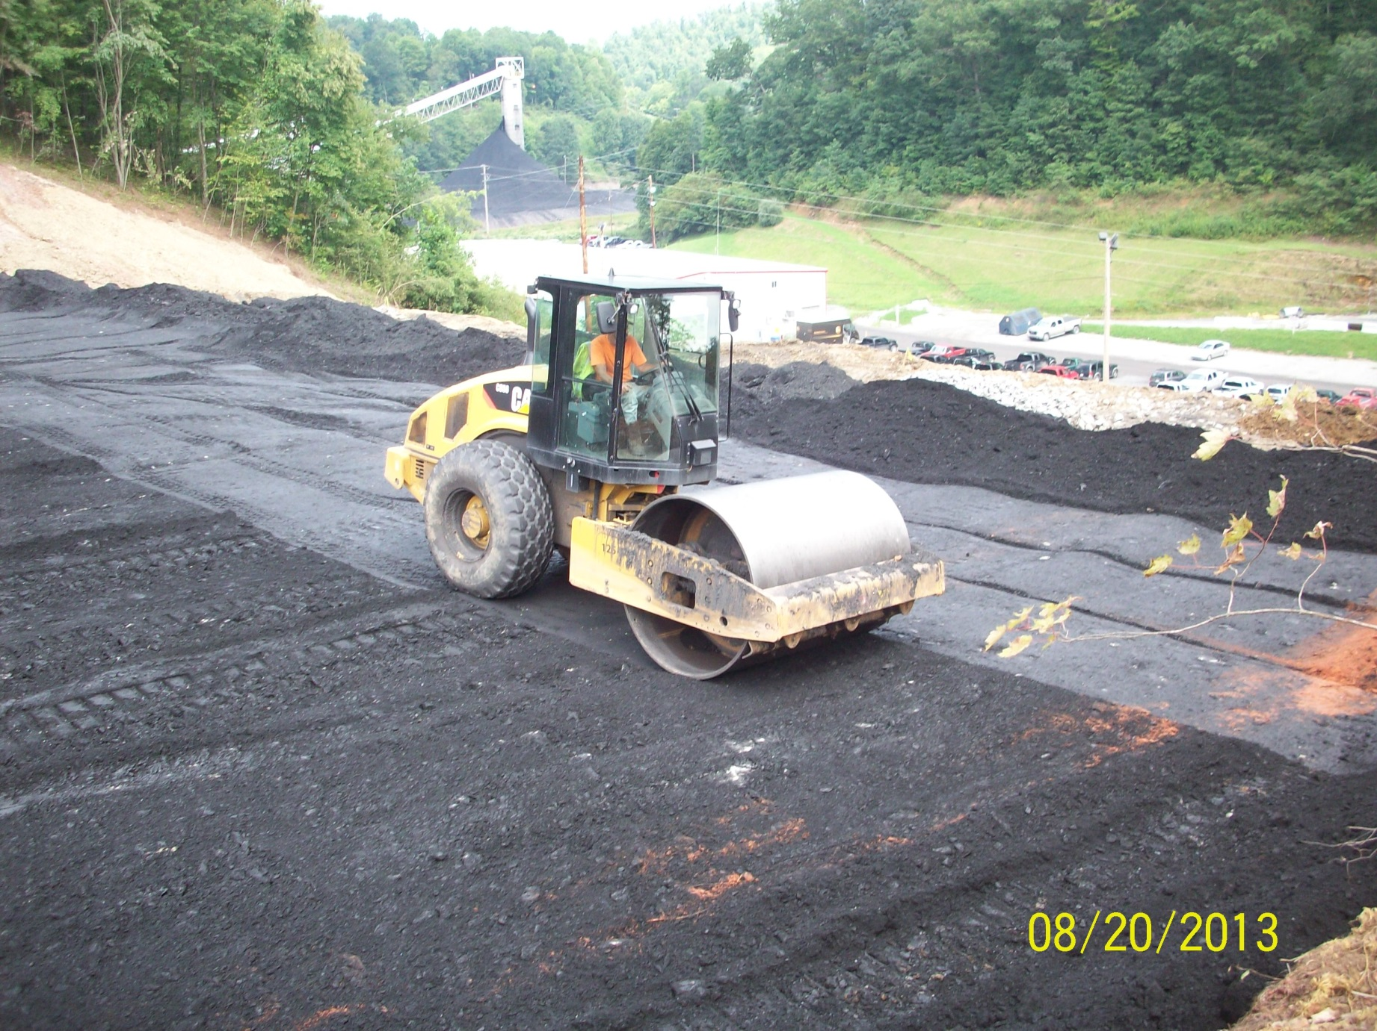

Slide 8
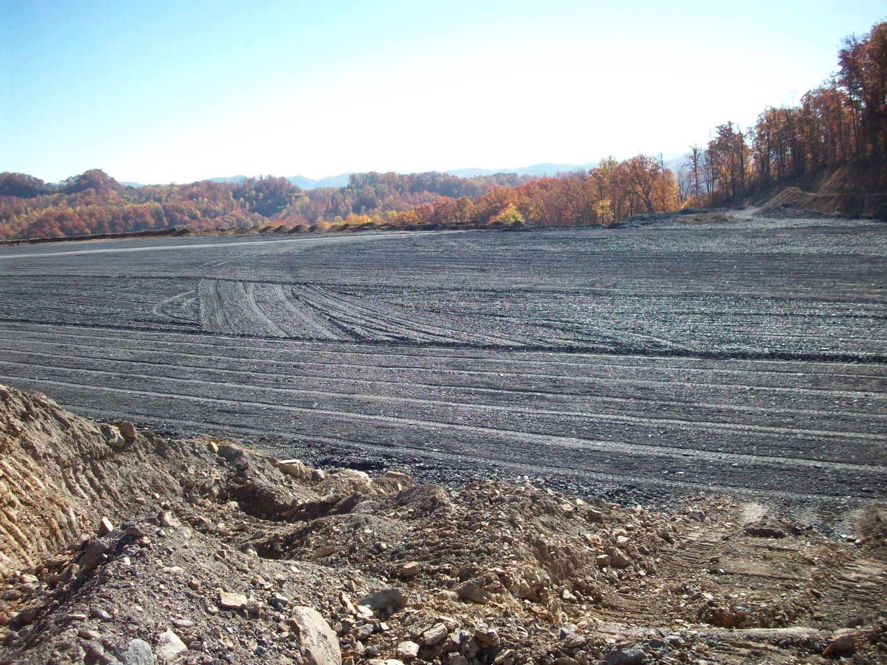

Slide 9
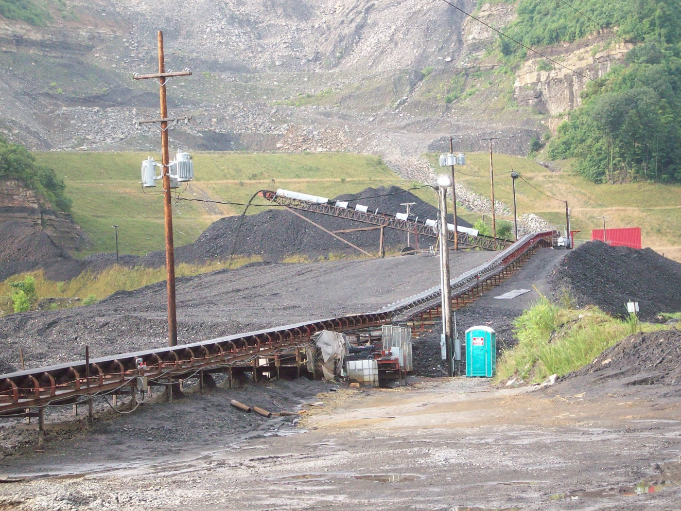

Slide 10
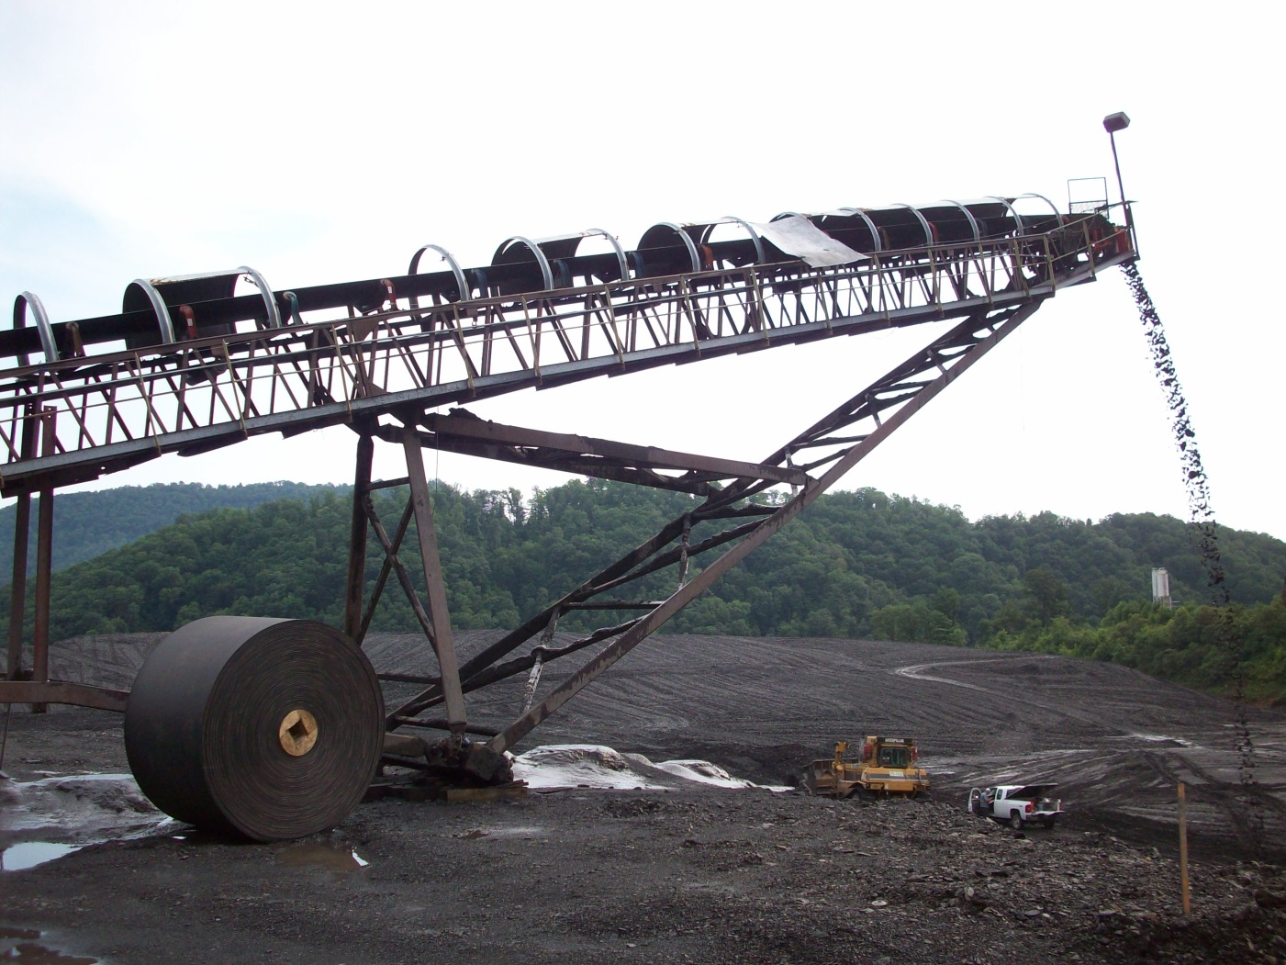

Slide 11
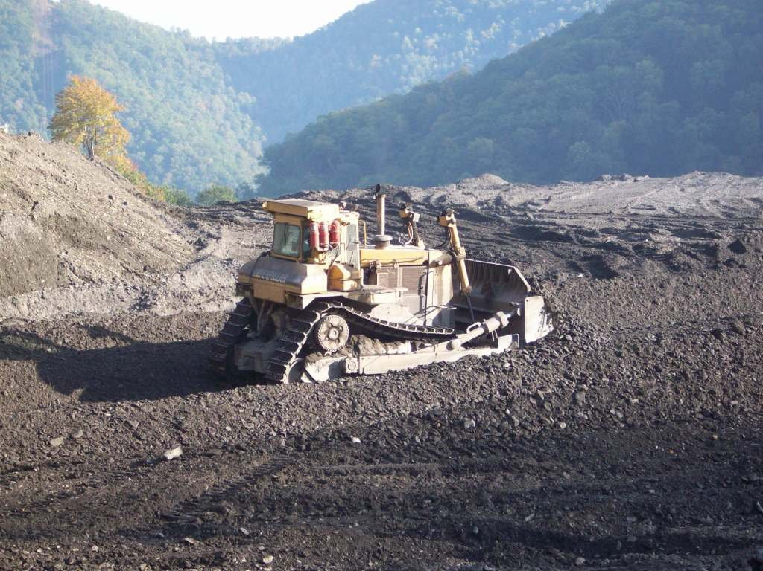

Slide 12
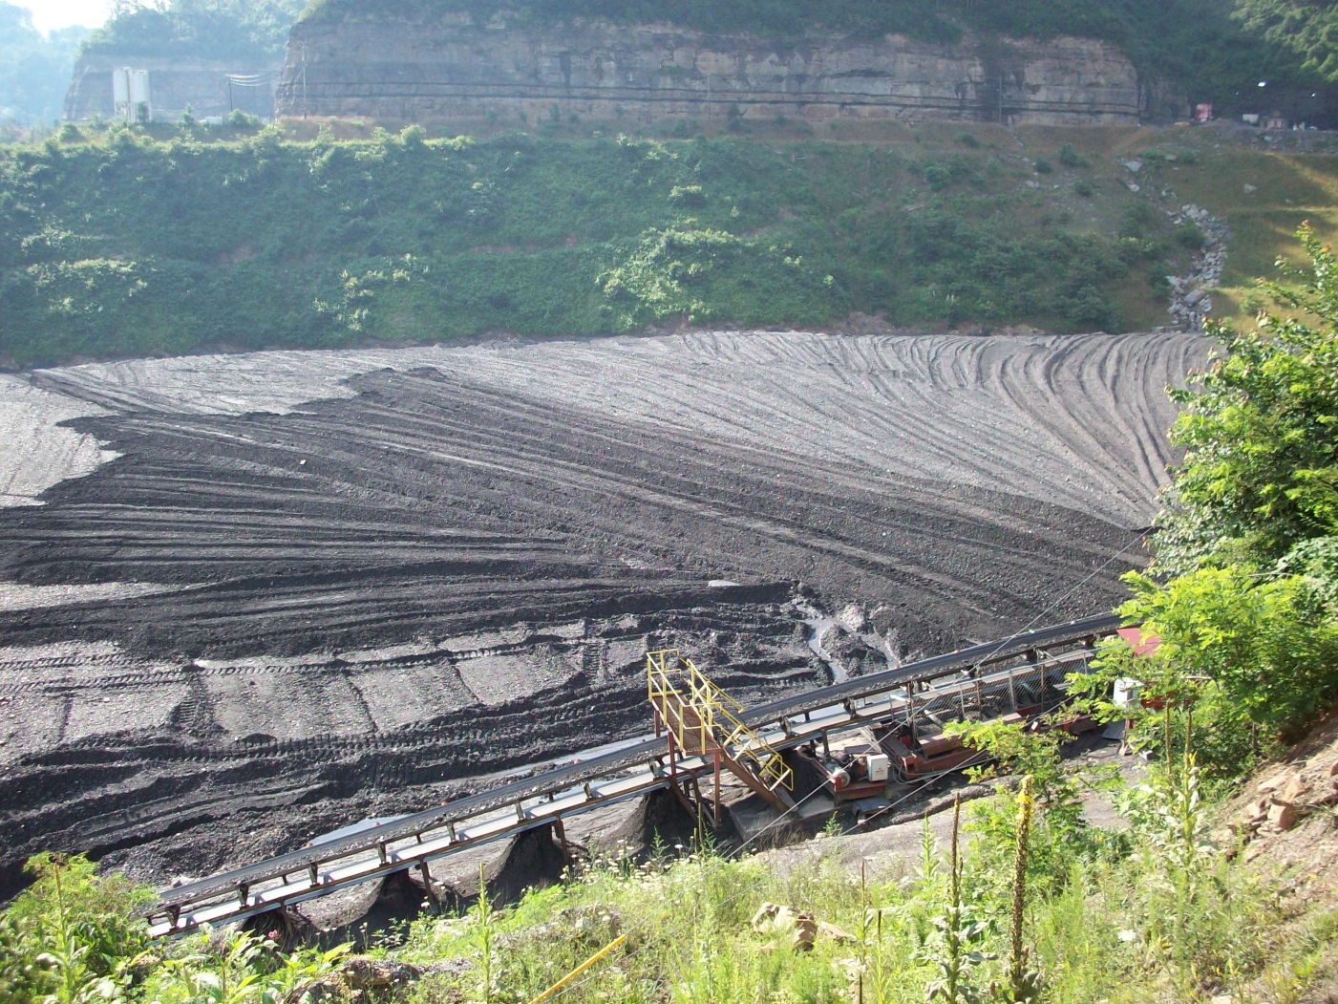

Slide 13
Misconceptions
Over-compaction results in a higher friction angle
Over-compaction results in a better material permeability
Over-compaction makes the dam safer

Slide 14
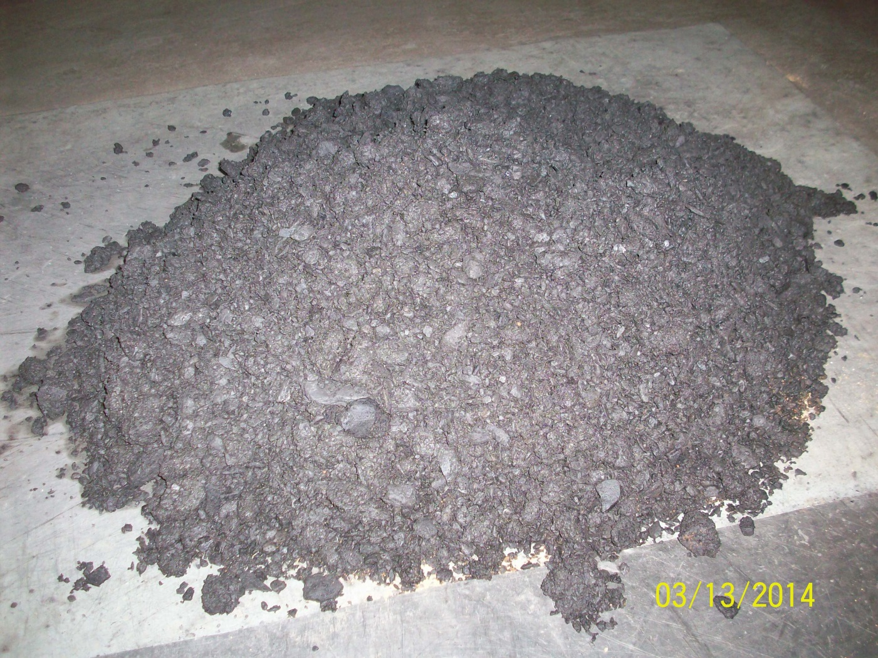
95% of What? Let’s Go to the Lab

Slide 15
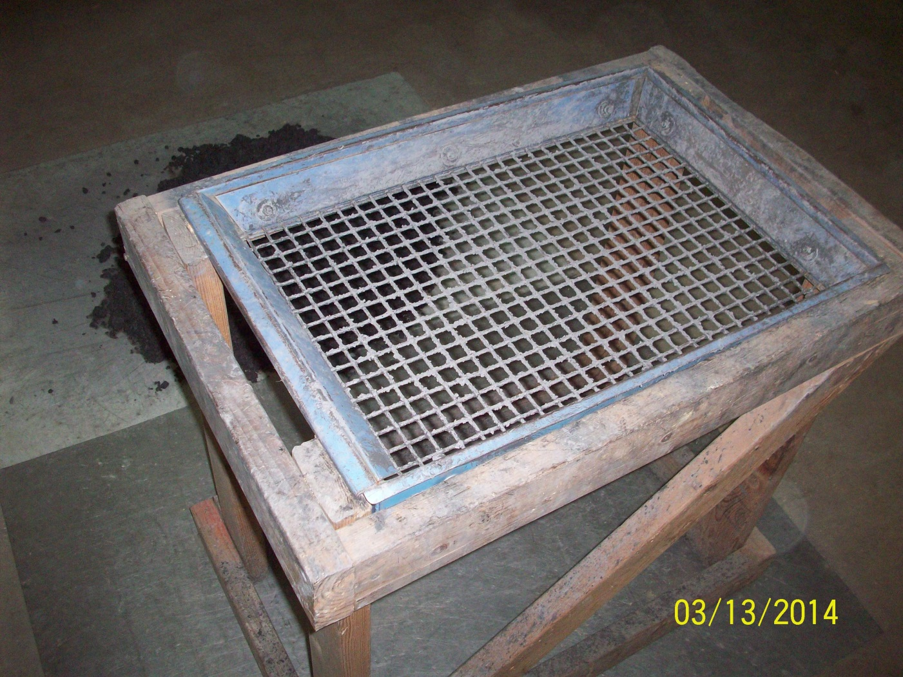

Slide 16
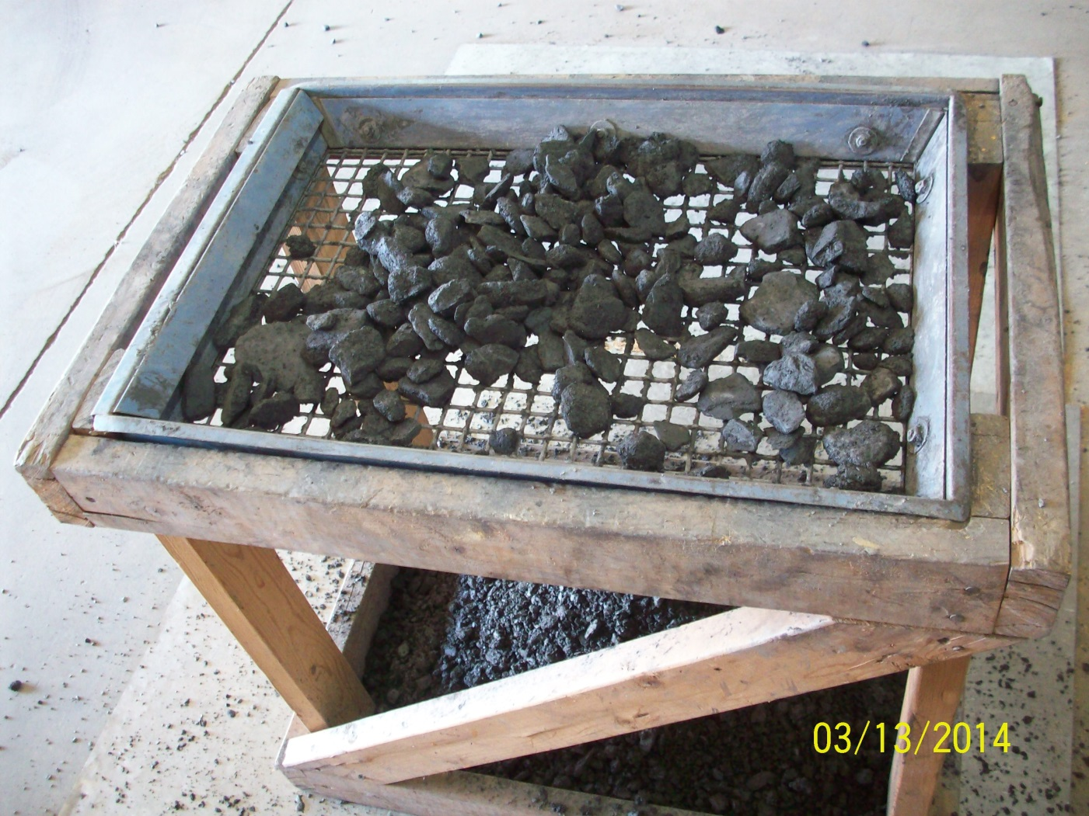

Slide 17
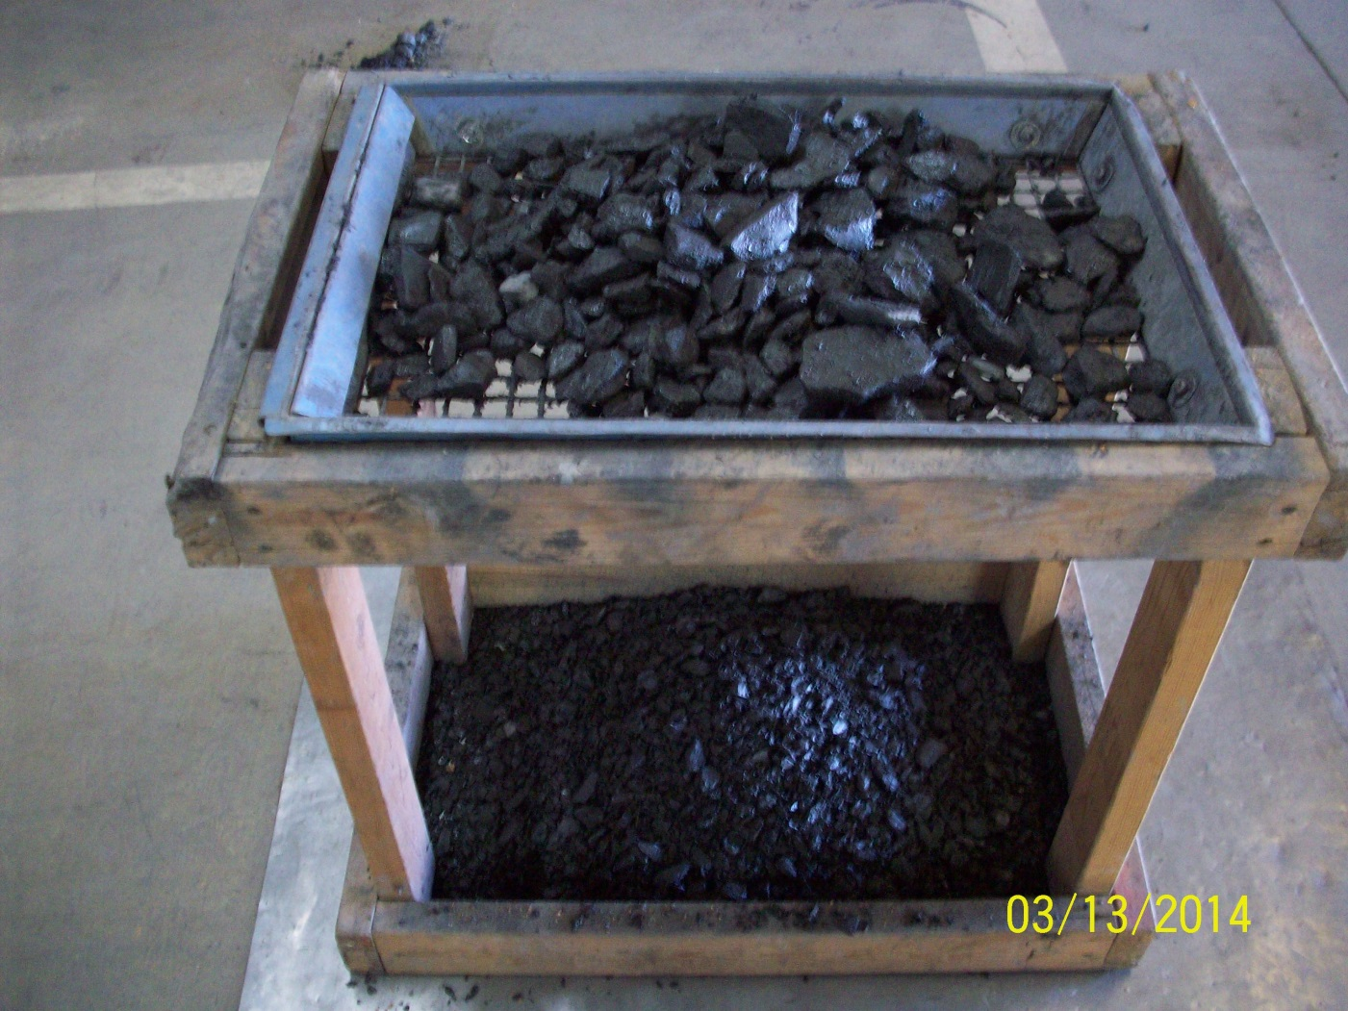

Slide 18
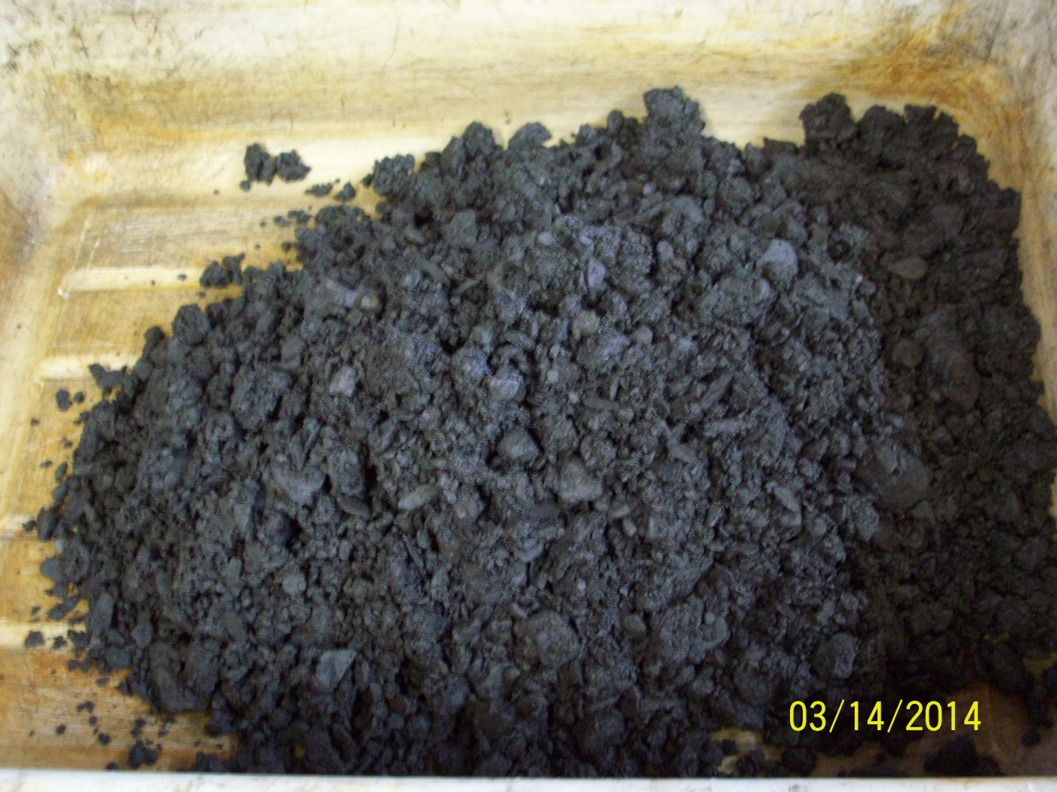

Slide 19
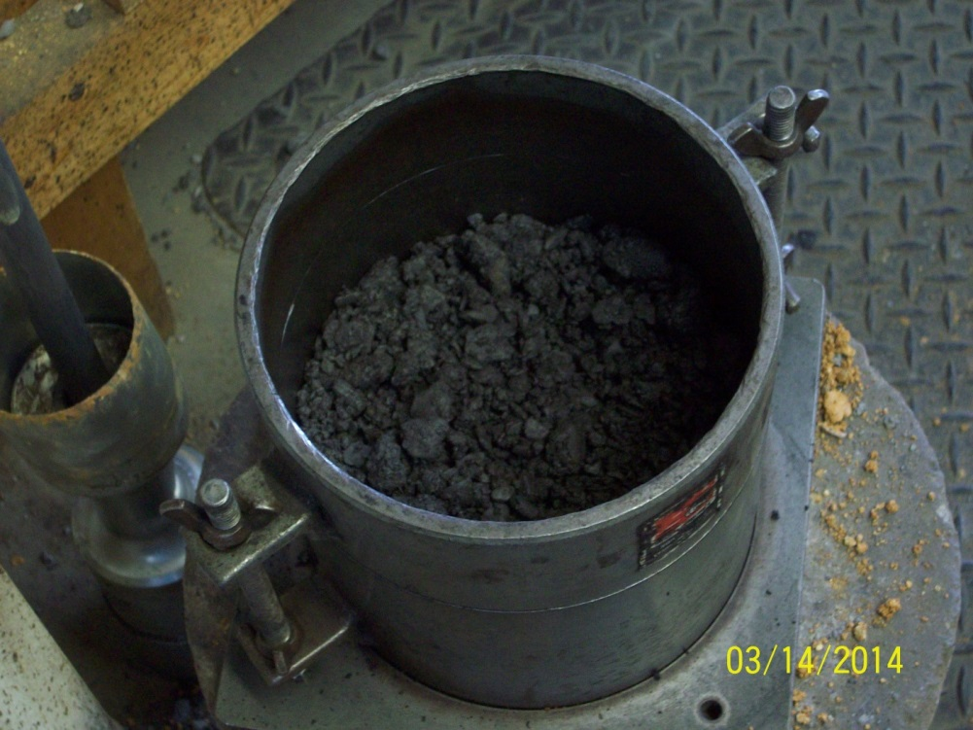
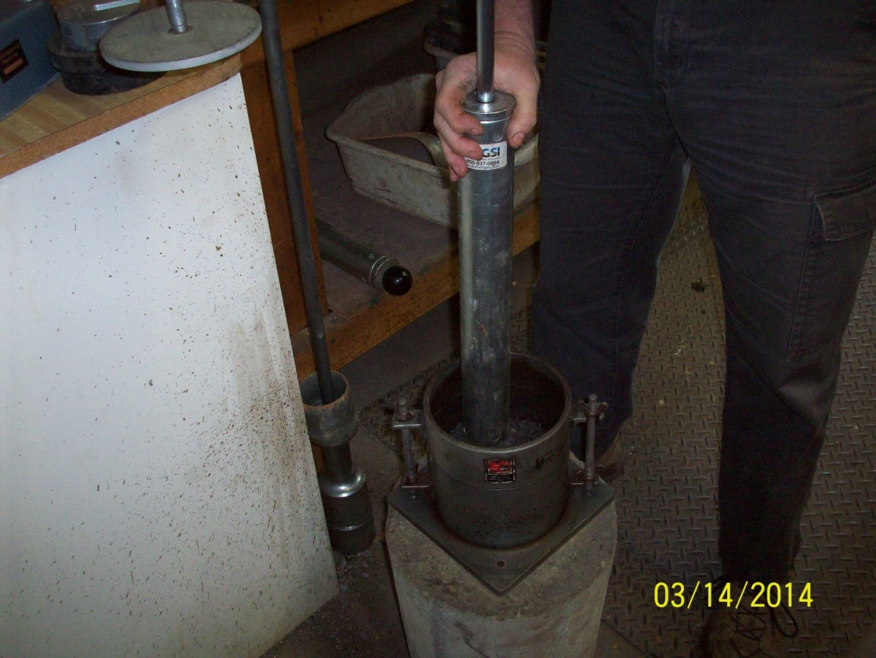
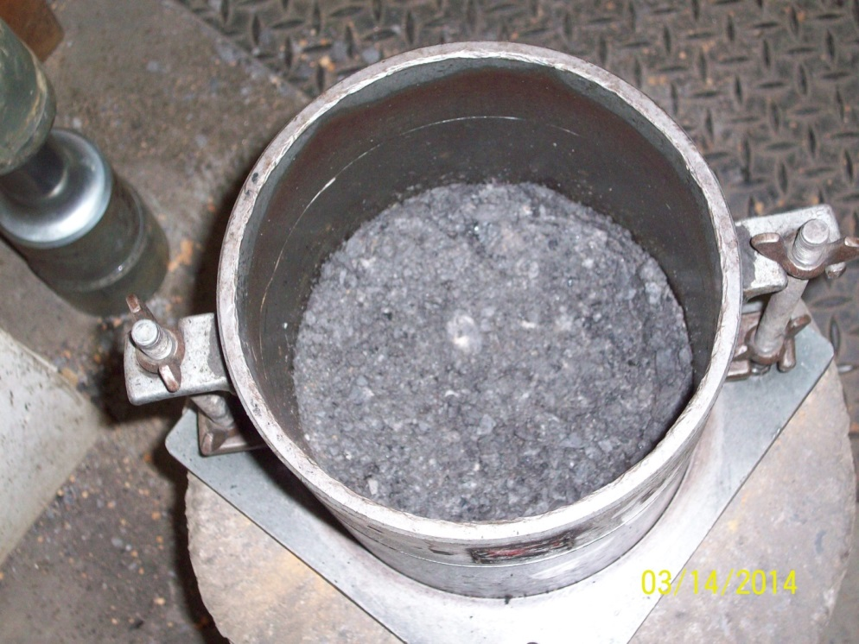

Slide 20
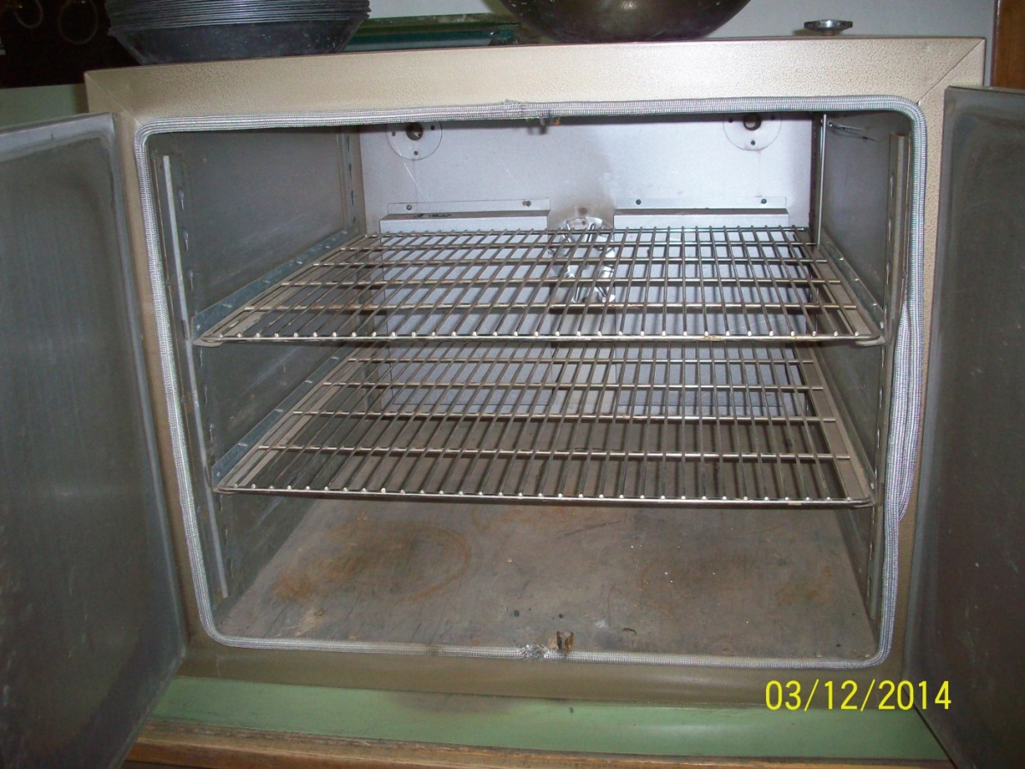
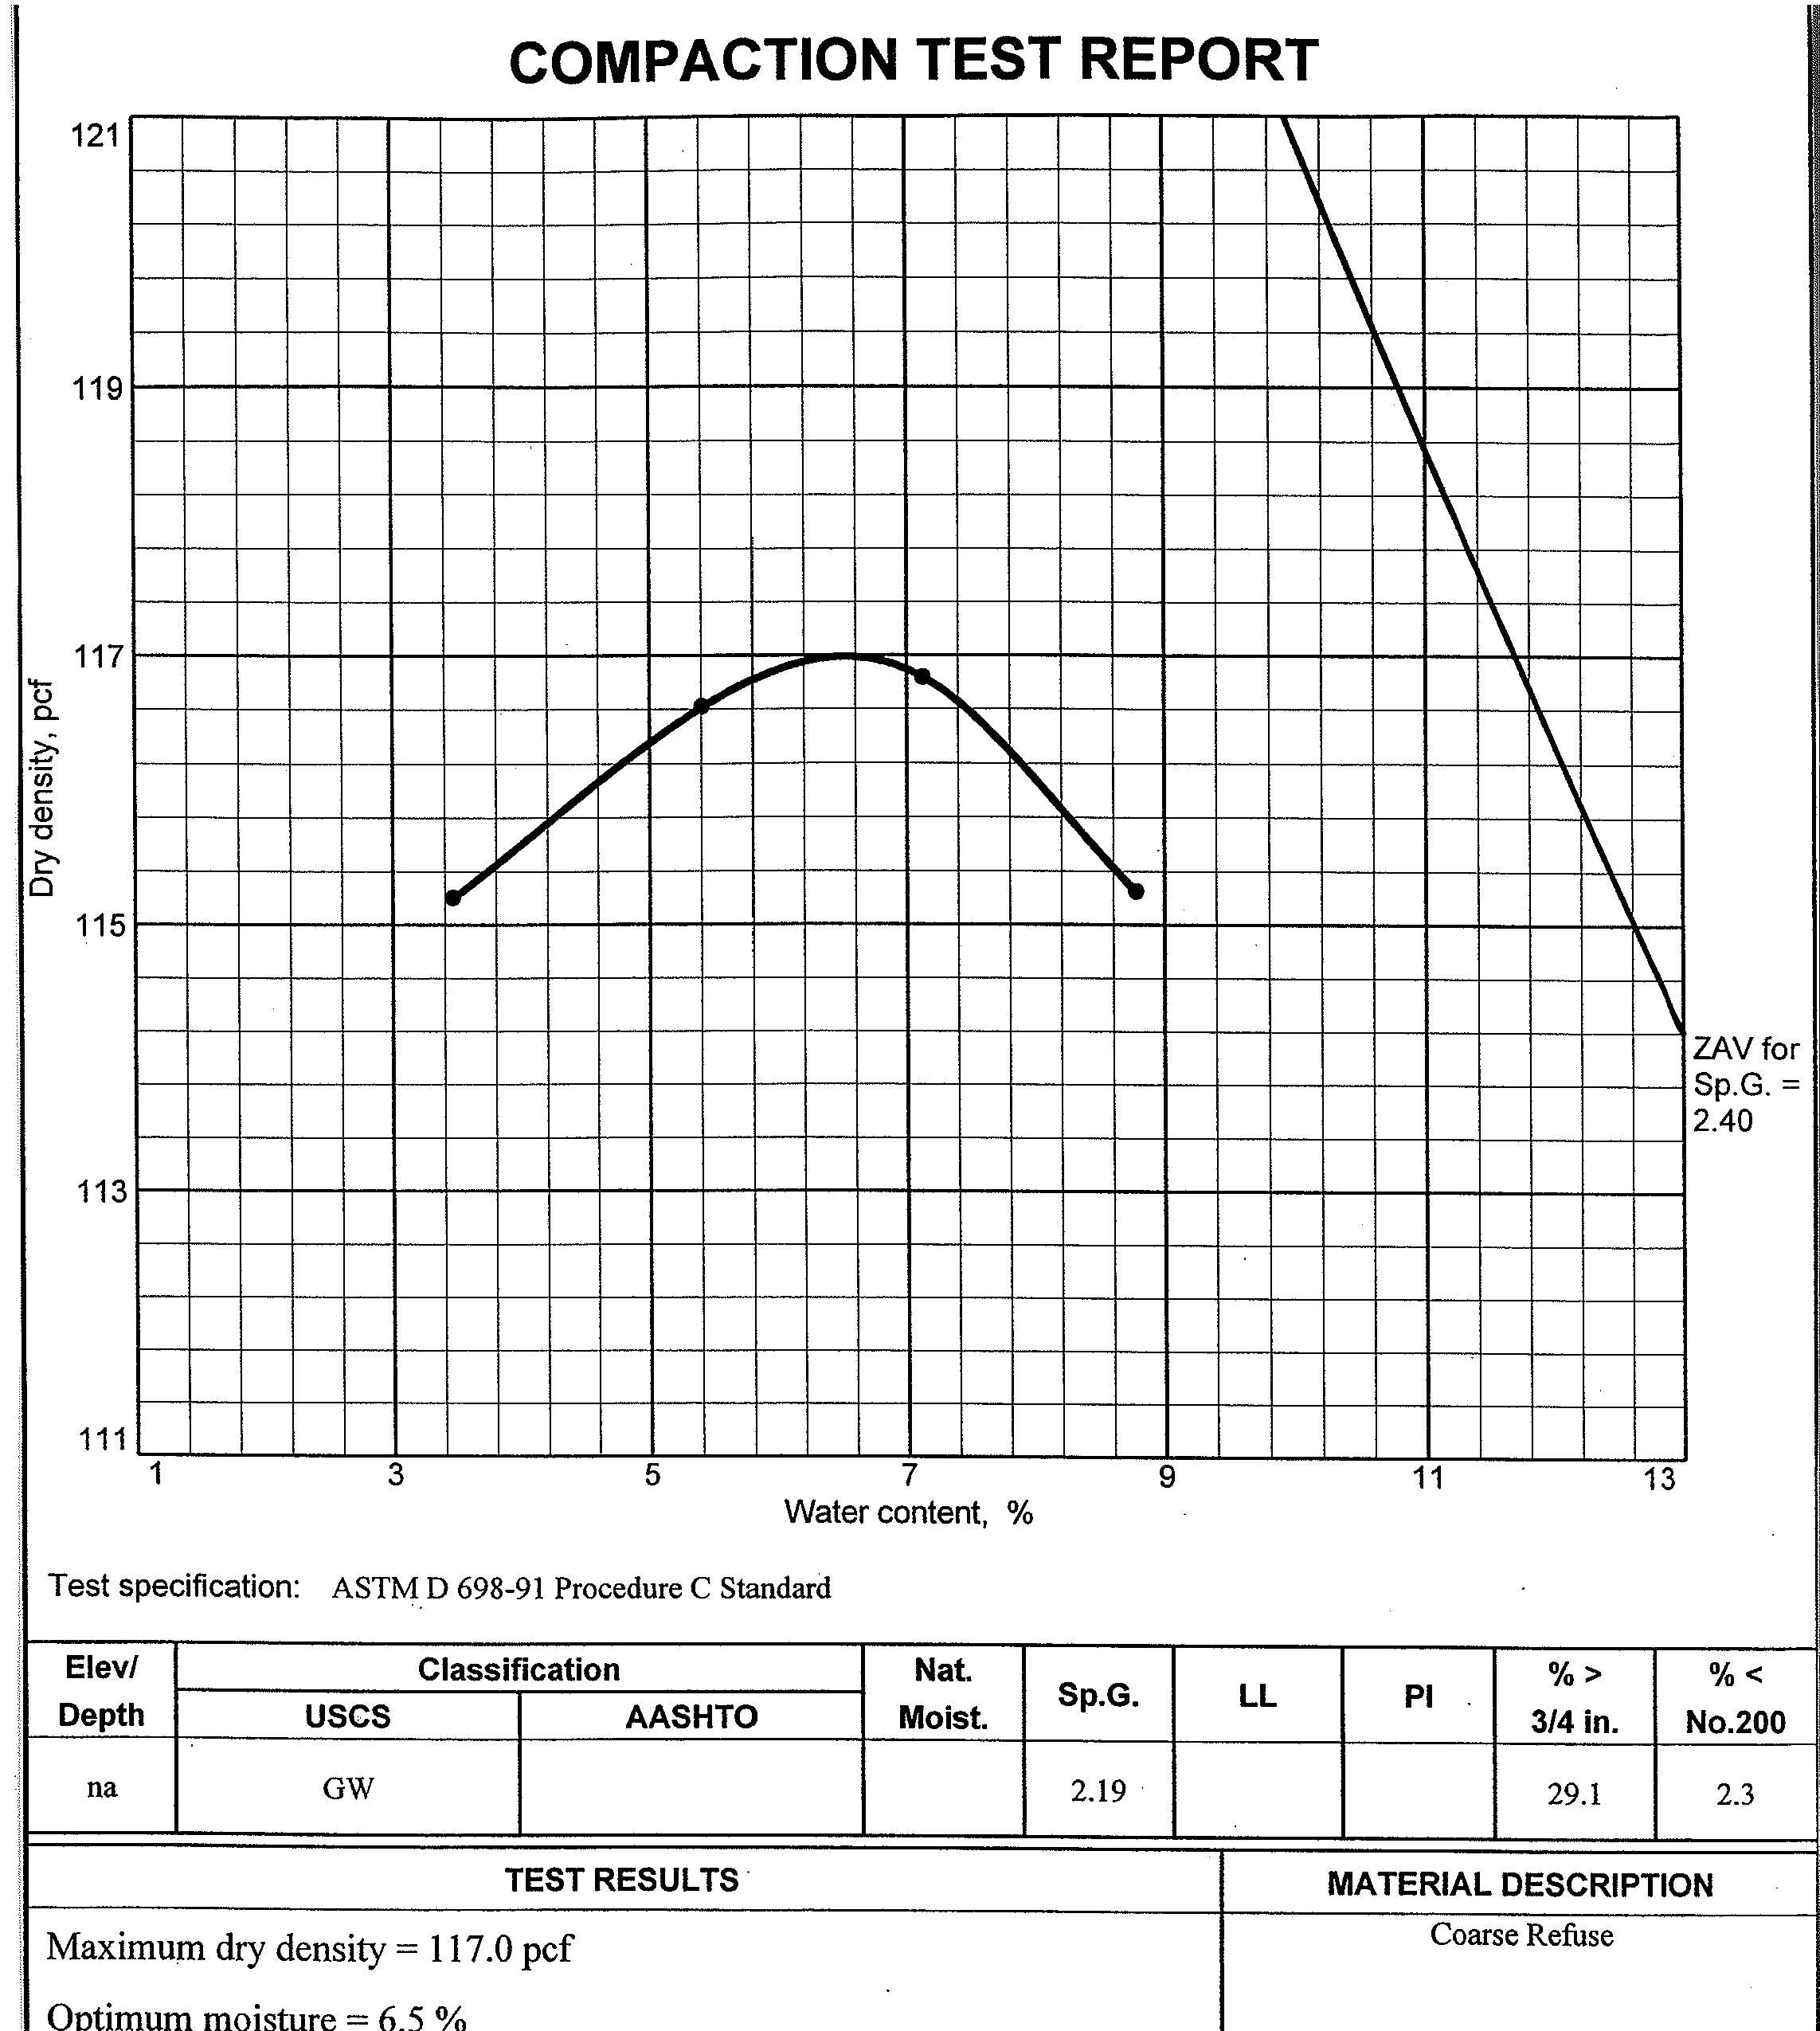

Slide 21
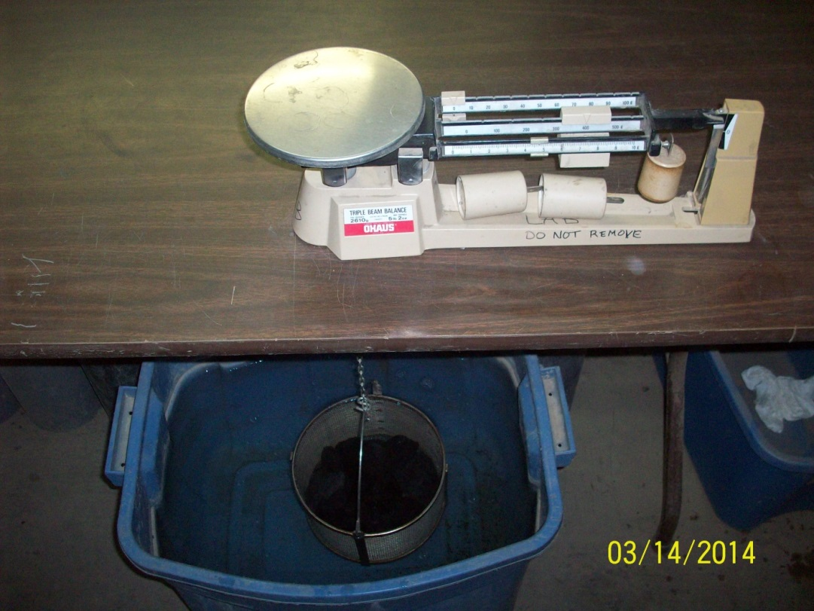
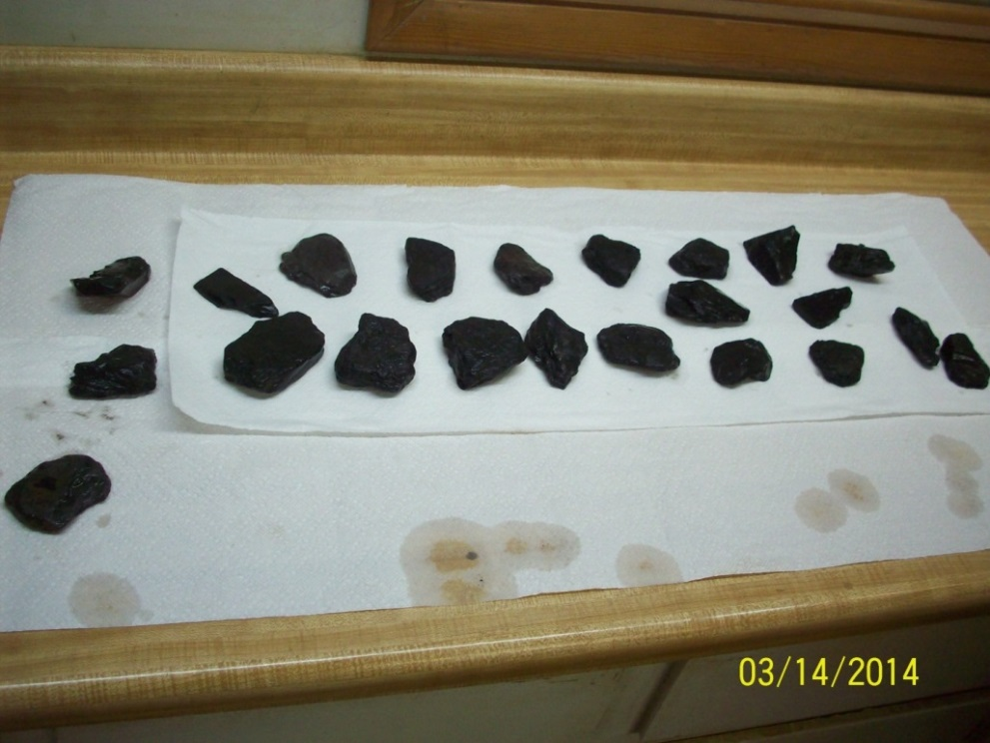
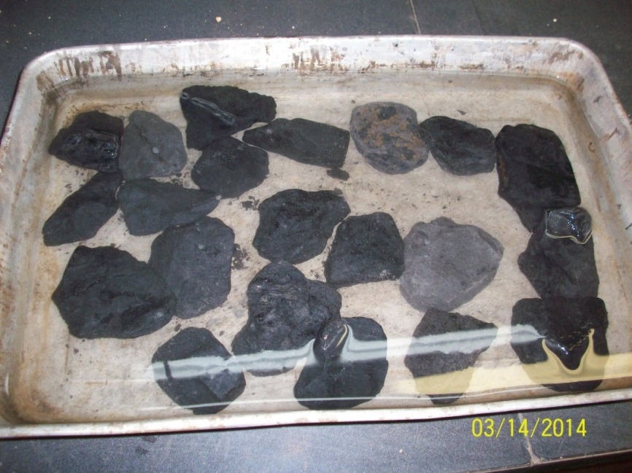
ASTM D4718 Correction for Oversize Particles
May not be applicable to soil-rock mixtures which degrade under field compaction
Application above 30% may affect the unit weight
Document cannot replace experience and should be used with Professional Judgment

Slide 22
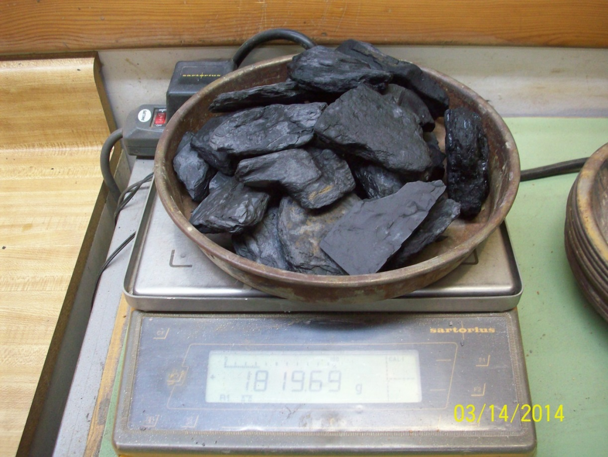
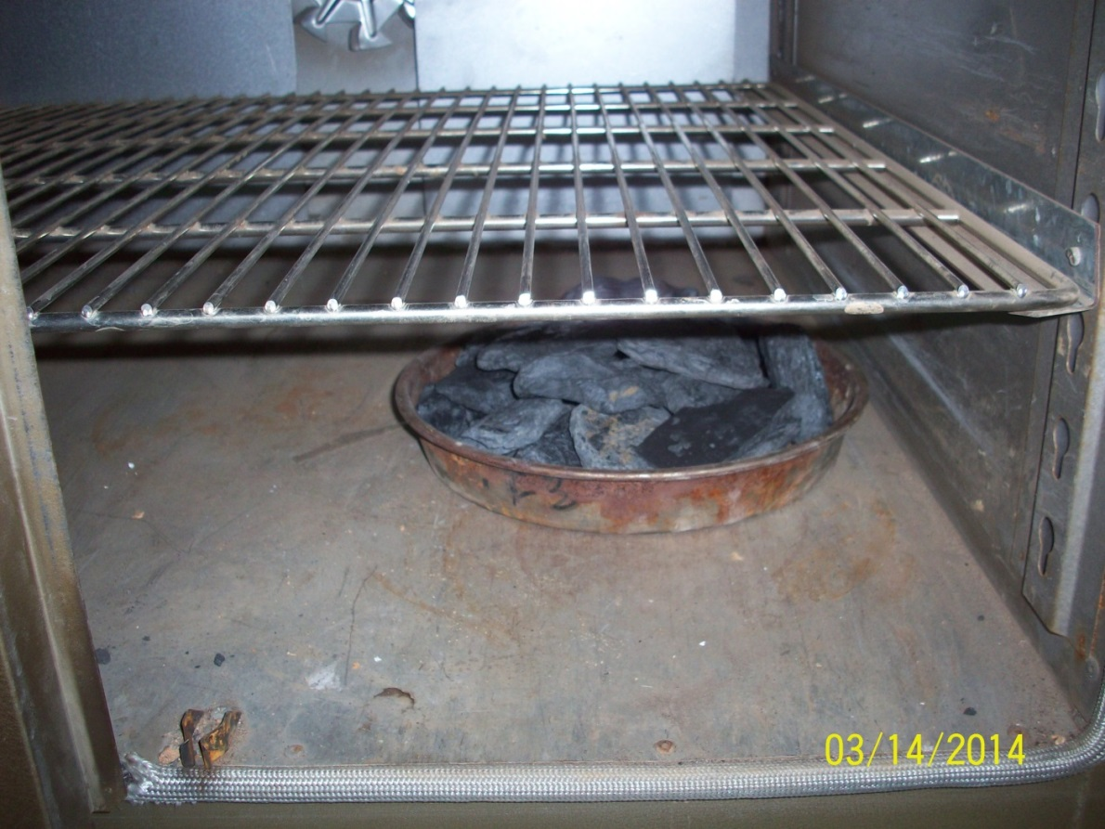

Slide 23
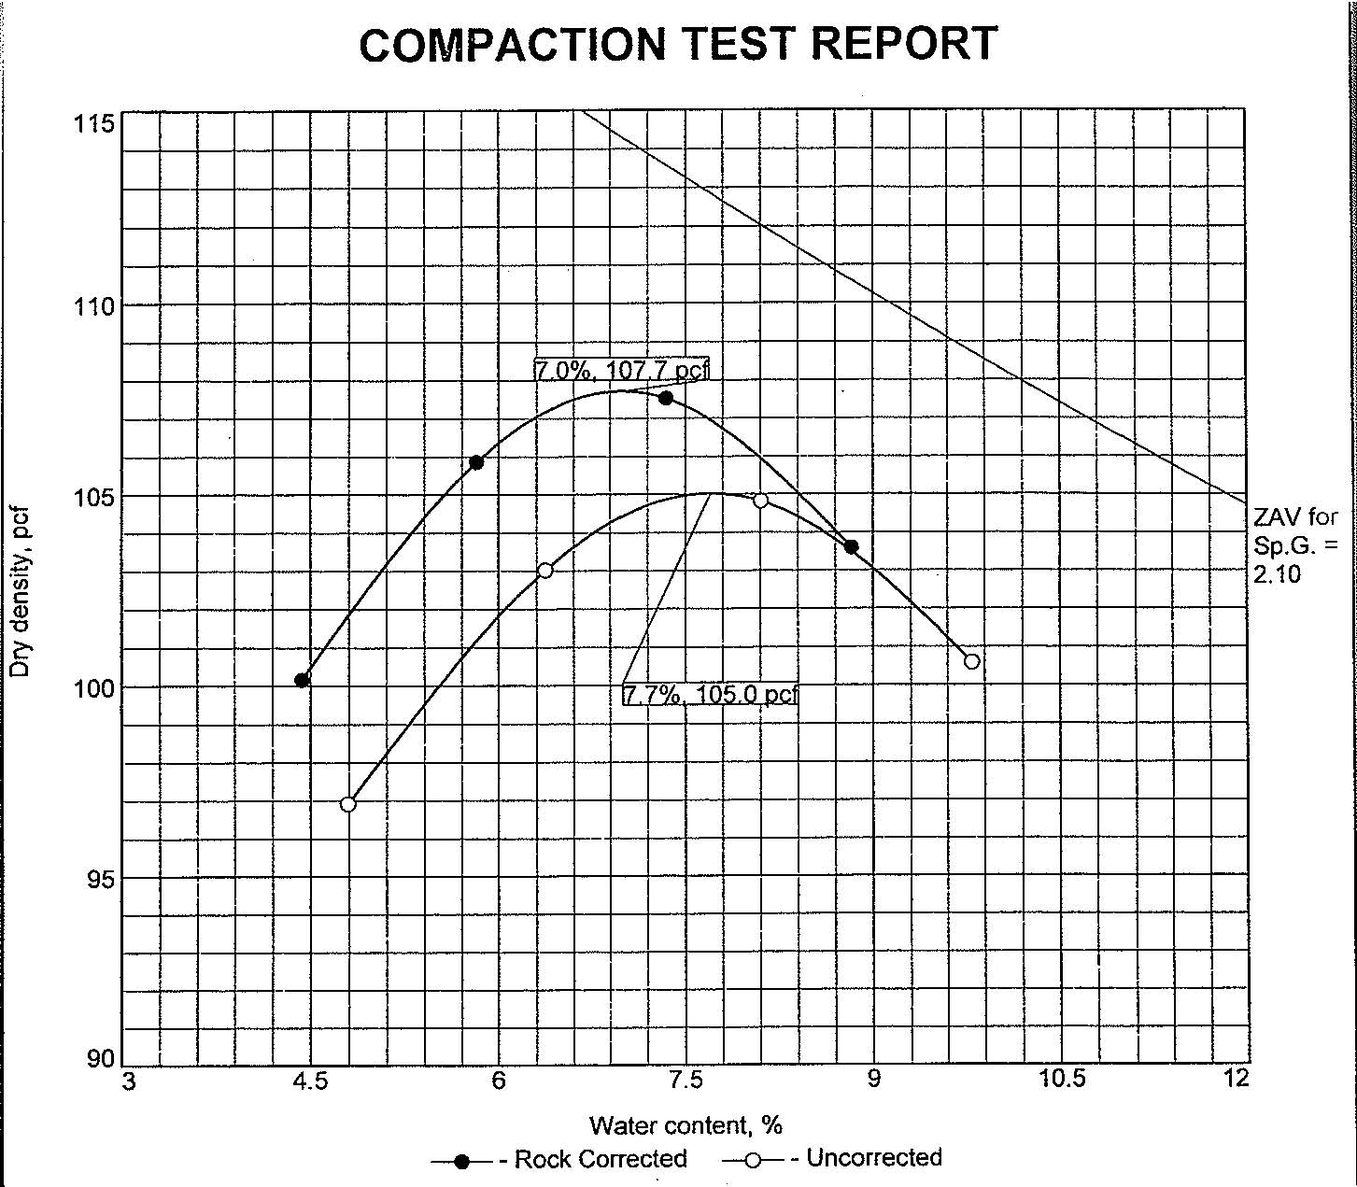
Slurry
Oversize Correction for 12% retained on ¾ inch screen

Slide 24
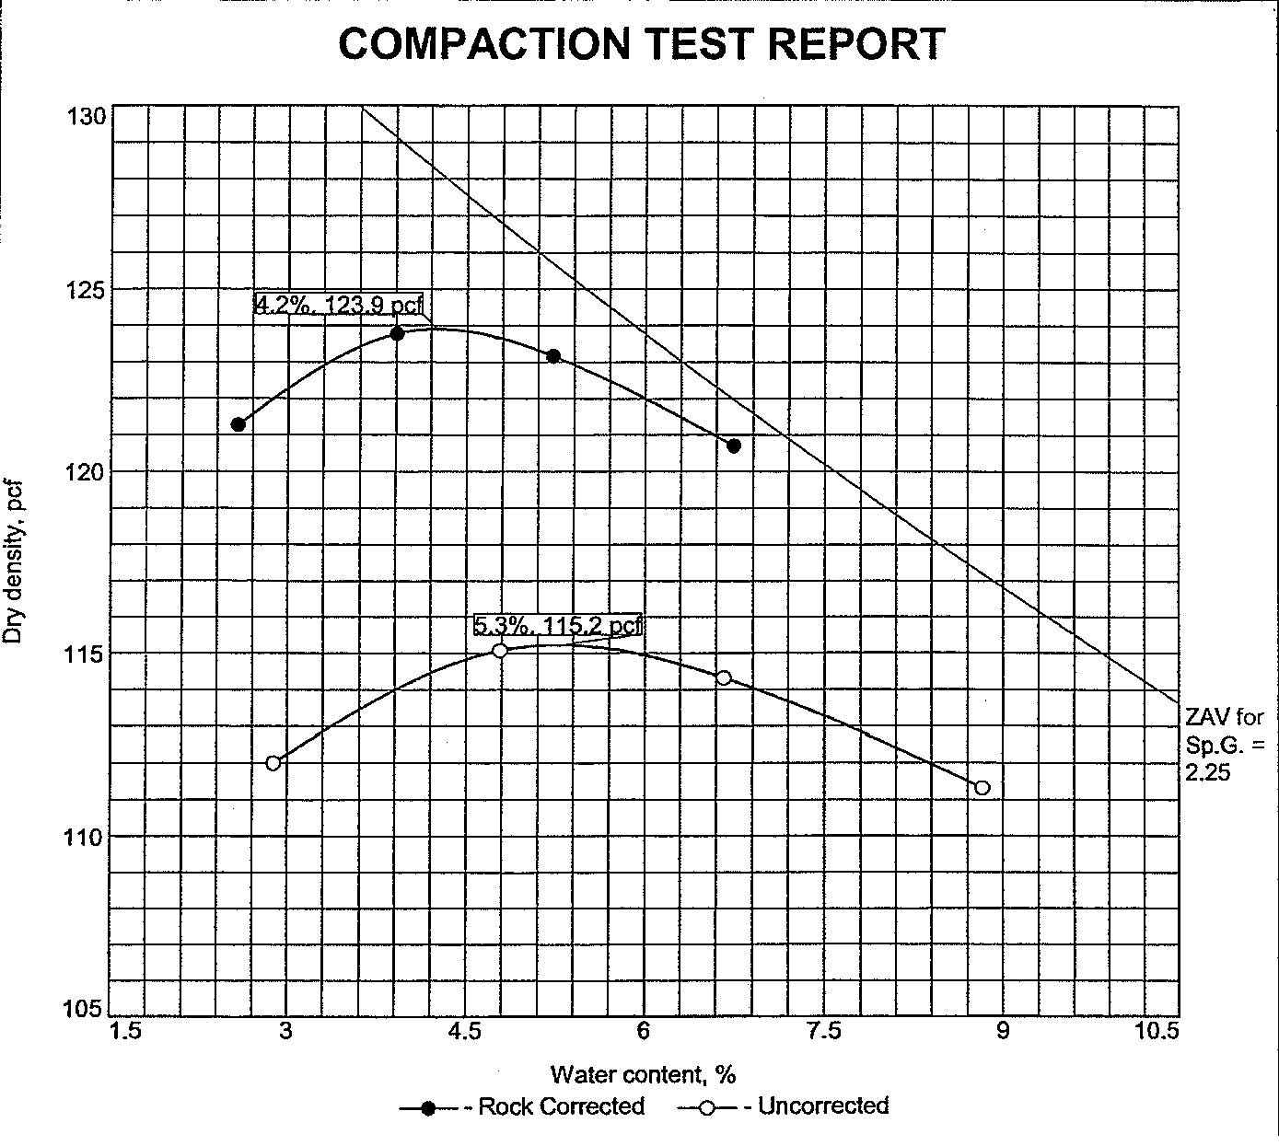
Oversize Correction for 30% retained on ¾ inch screen

Slide 25
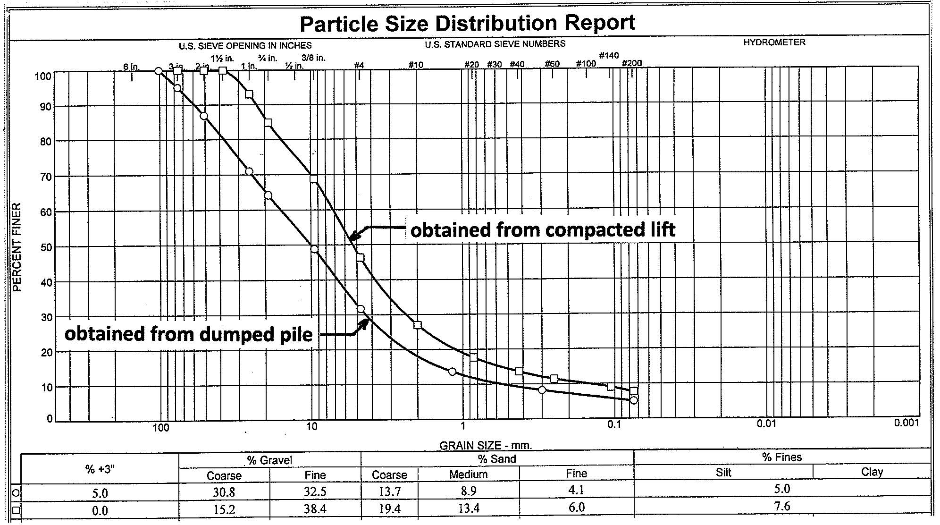
Where do you obtain your proctor sample?

Slide 26
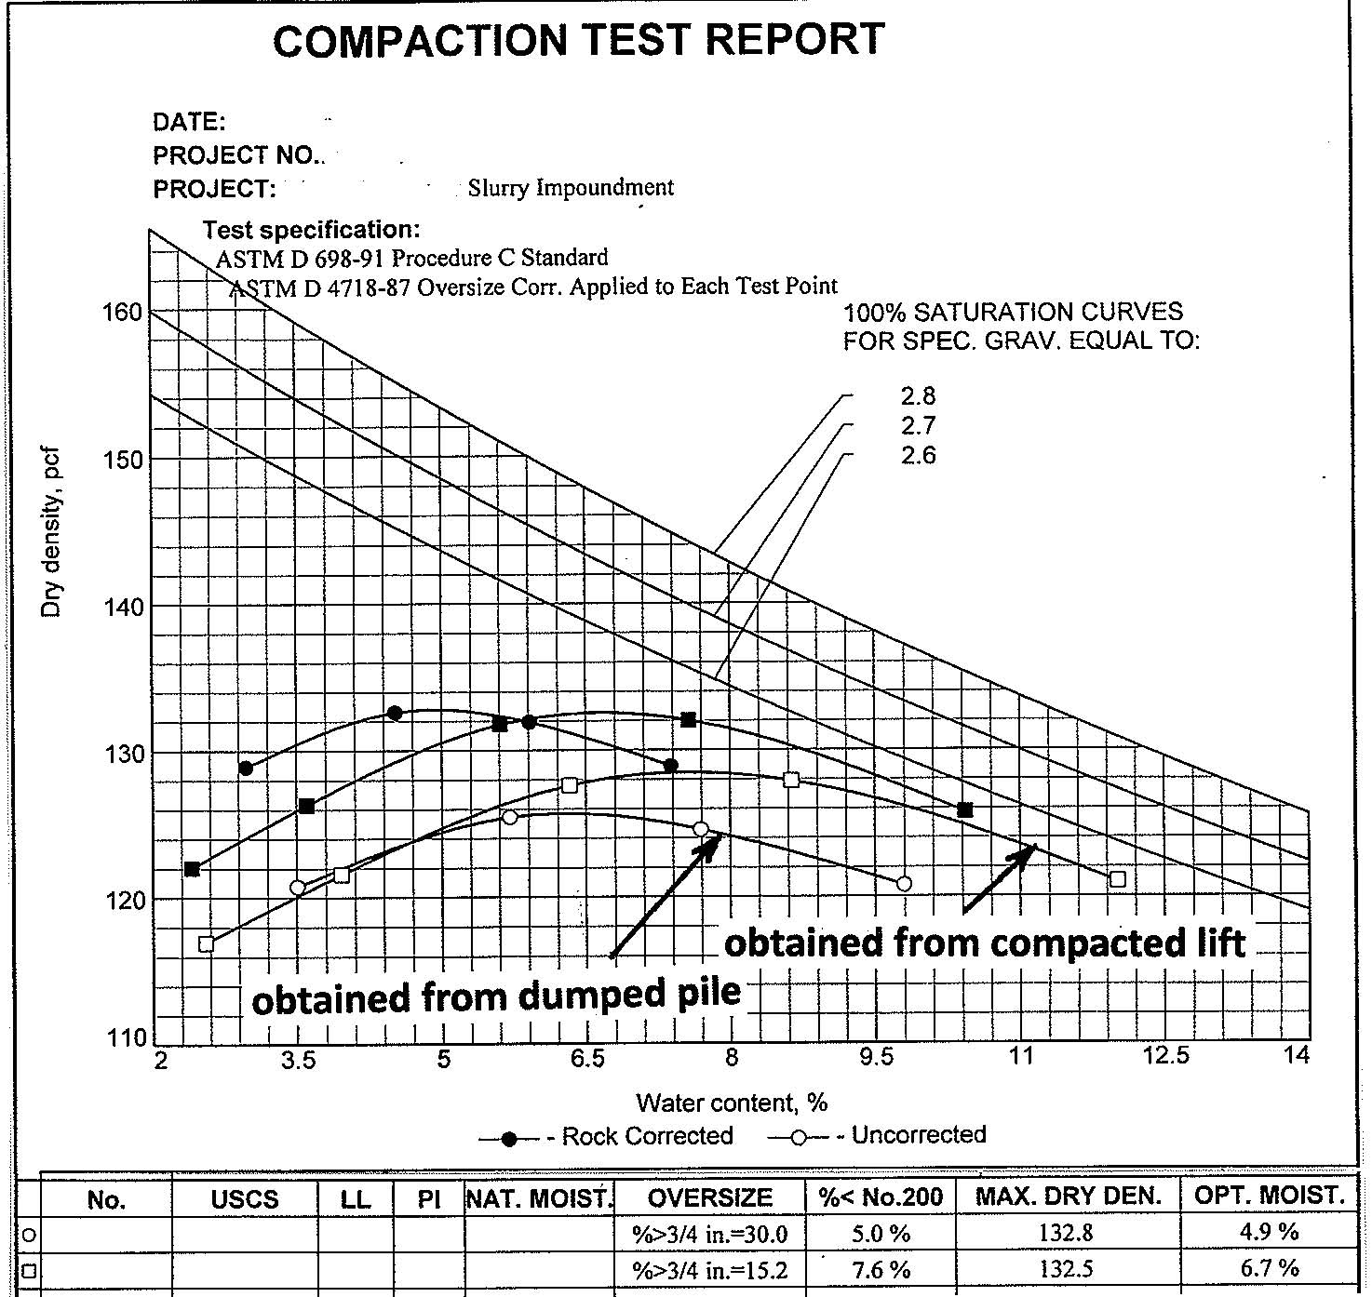
Corrected Max. Dry density = 132.8 pcf, Wcorr = 4.9 %
Corrected Max. Dry density = 132.5 pcf, Wcorr = 6.7 %

Slide 27
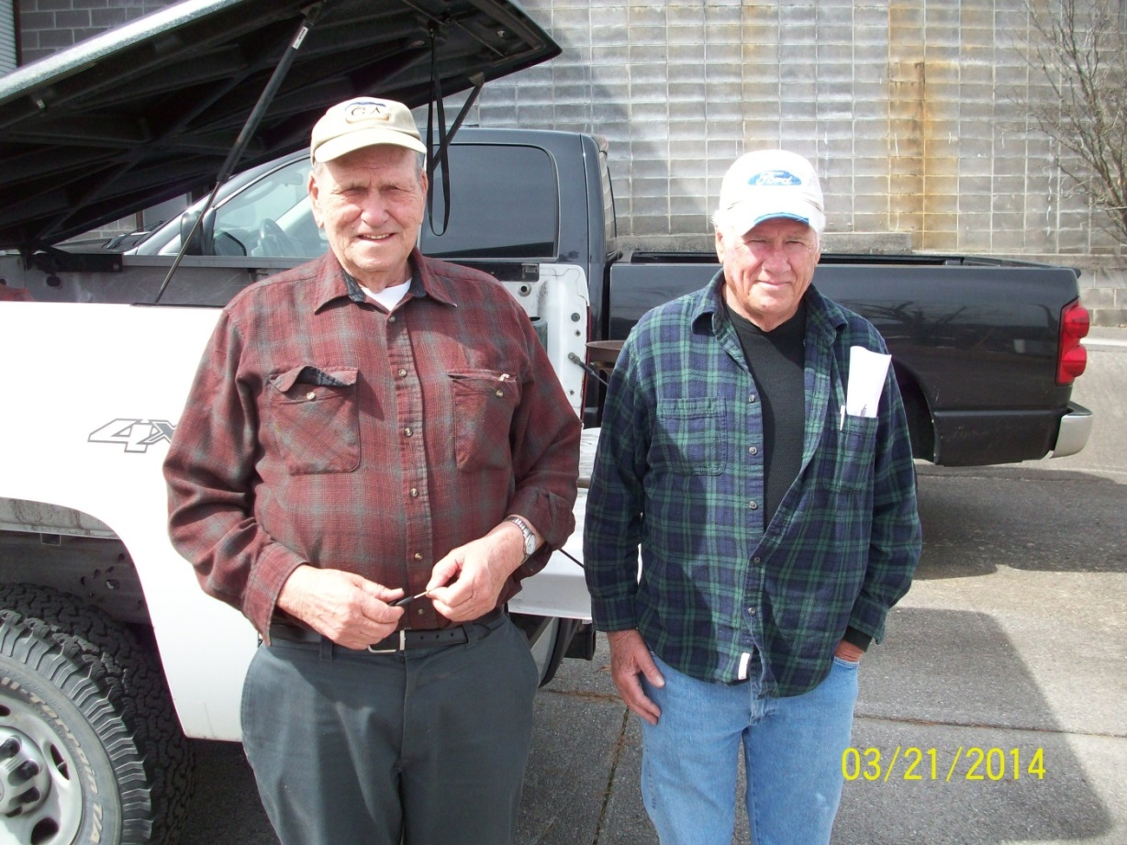
Trained Eye of the Field Guy
Visual Observations from an experienced field technician are as important as confirmation field testing and paperwork

Slide 28
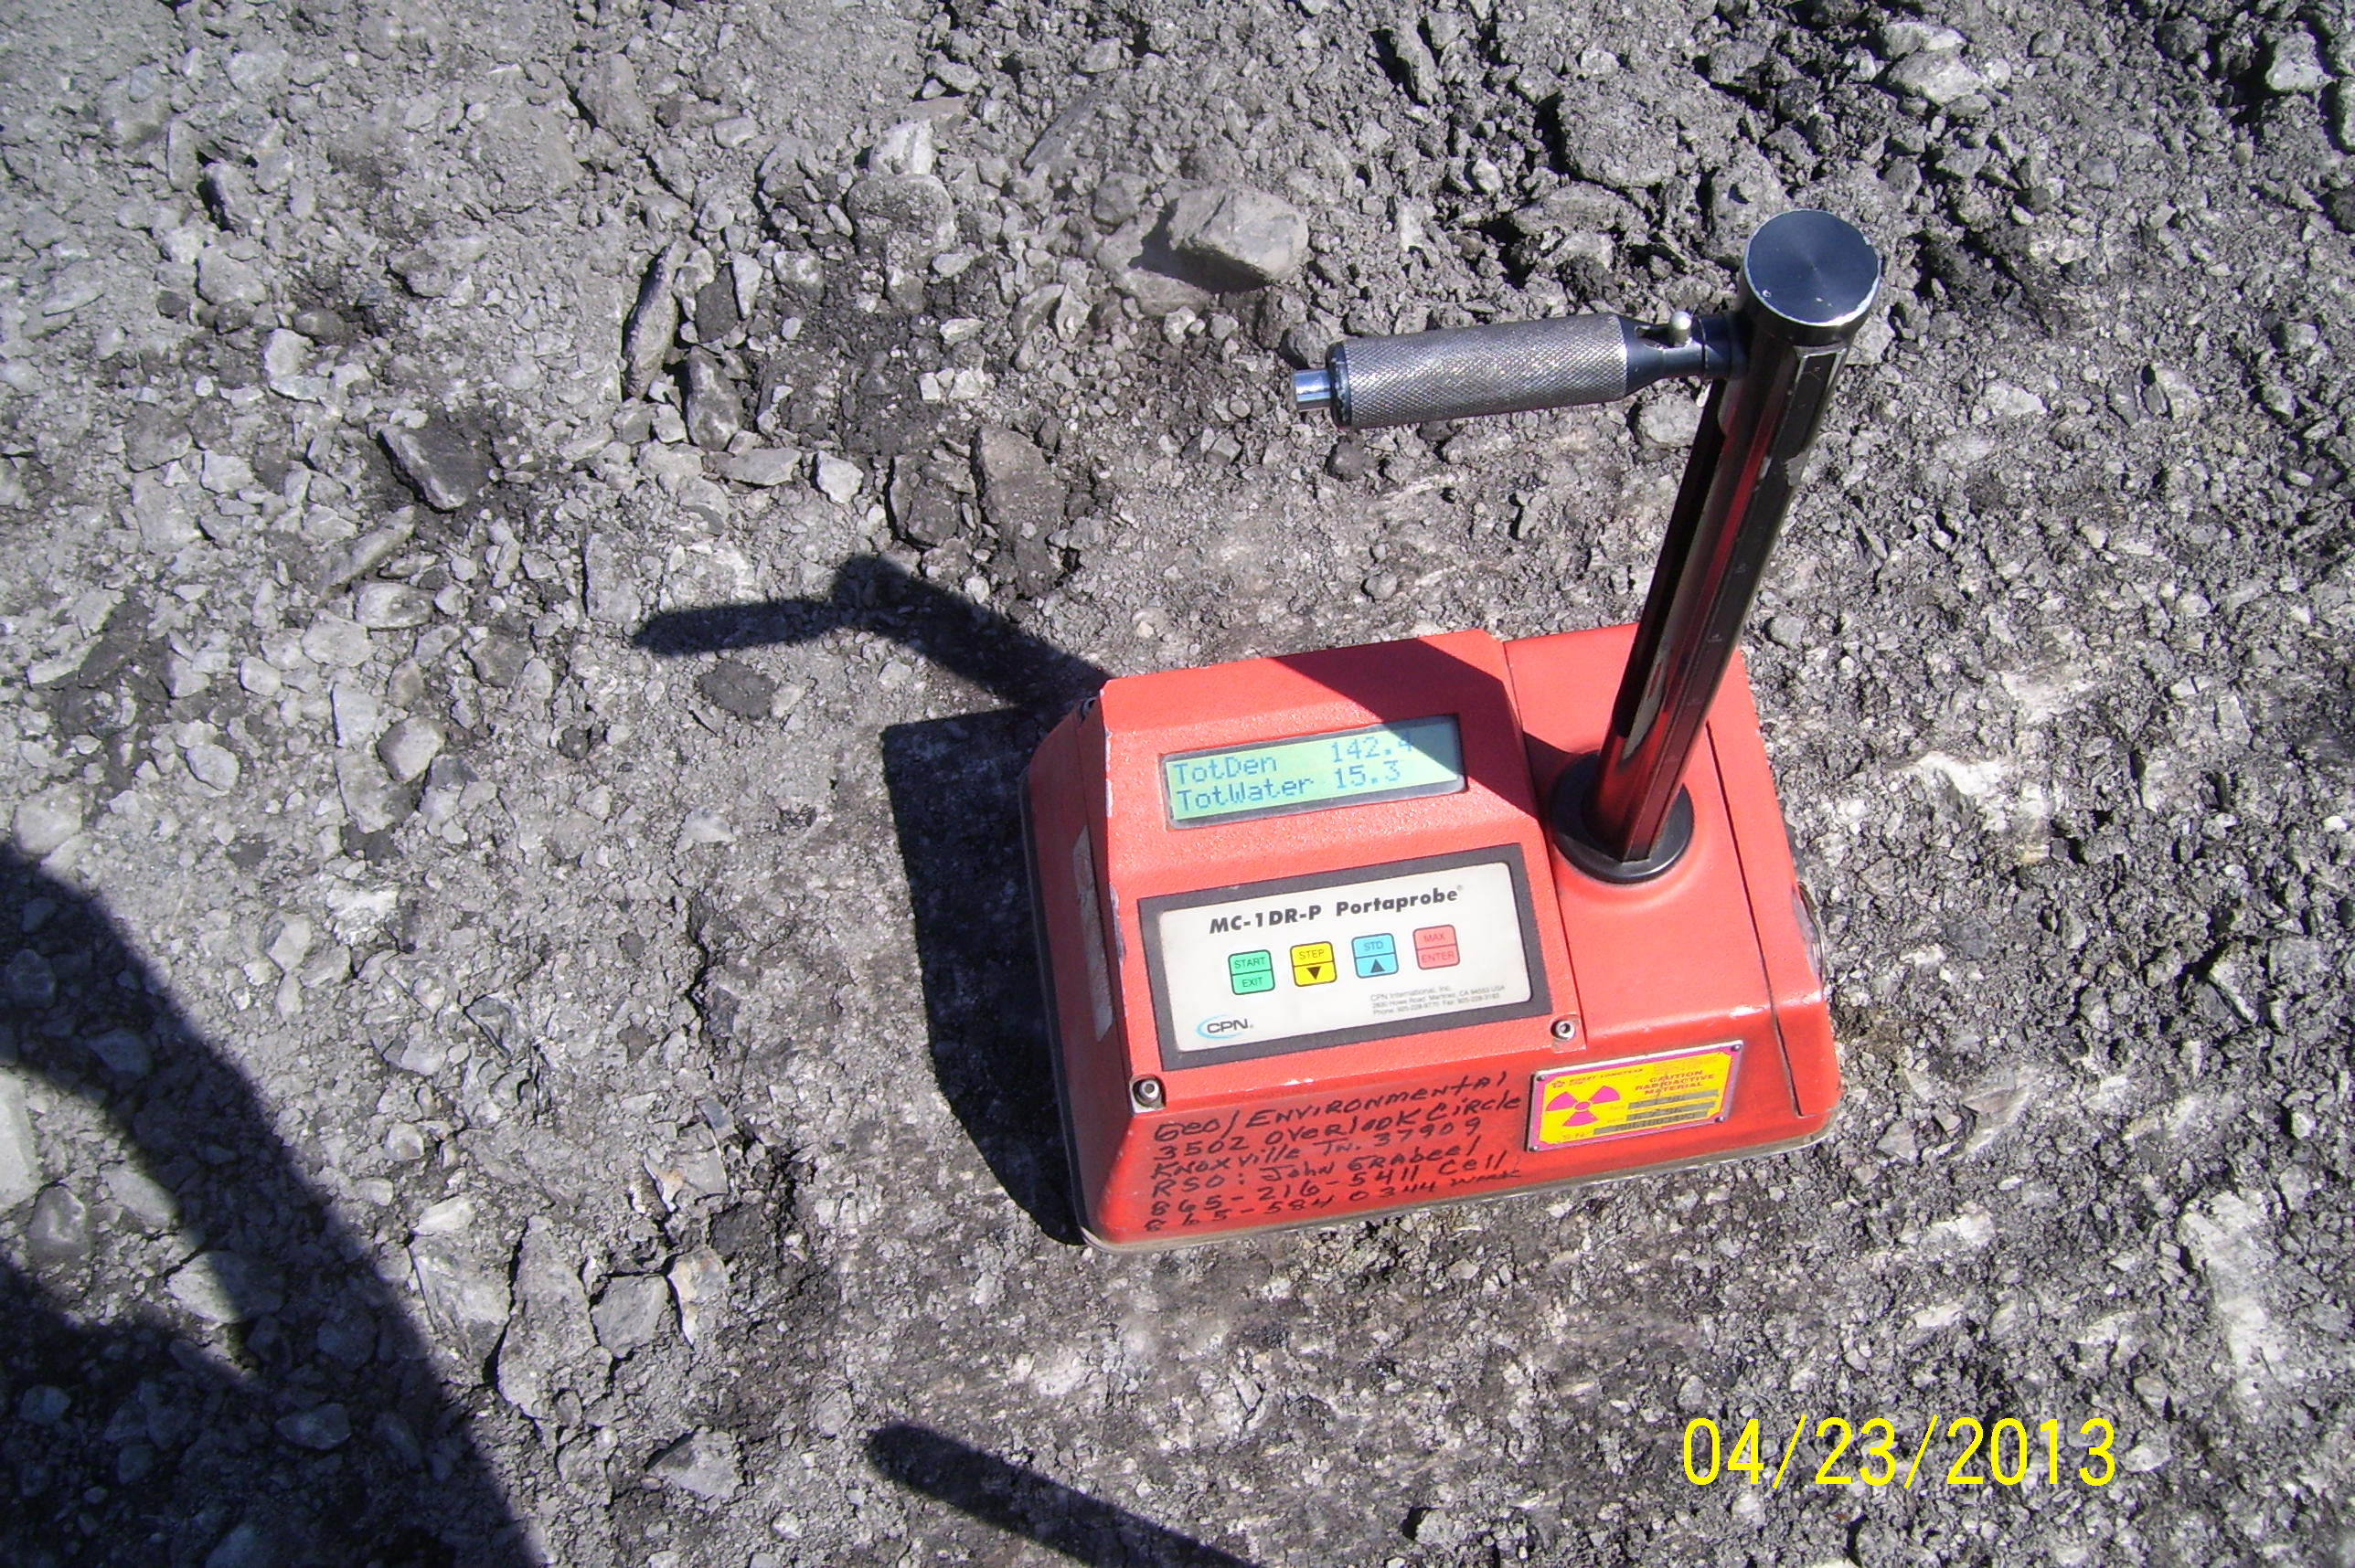

Slide 29
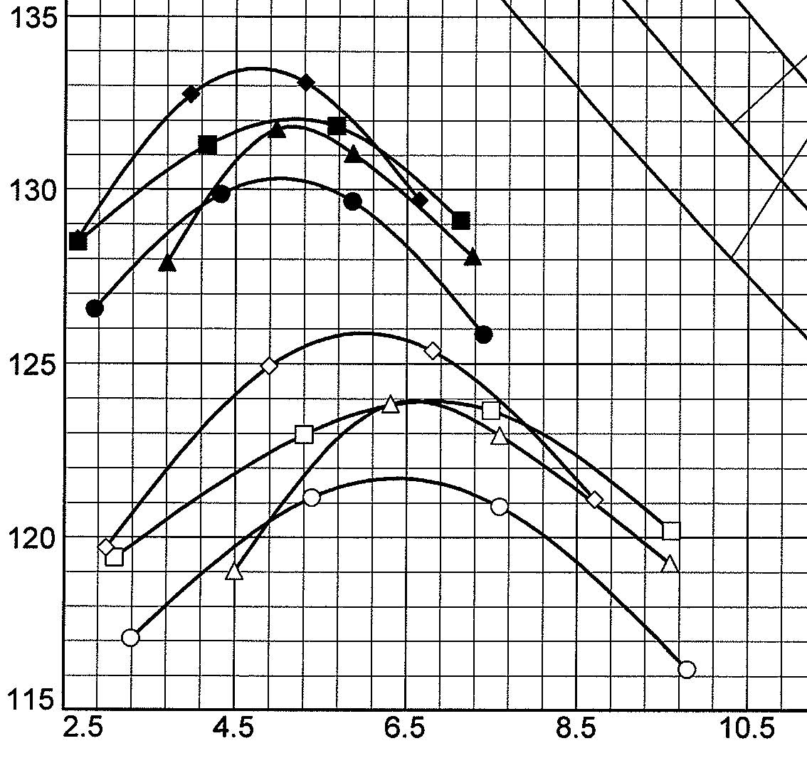
Develop a Family of Curves to Cover Variations in the site specific Coarse Refuse materials
Each time field compaction tests are performed, also perform a one-point proctor test and select the most applicable curve
Continue to perform periodic Proctor Tests

Slide 30
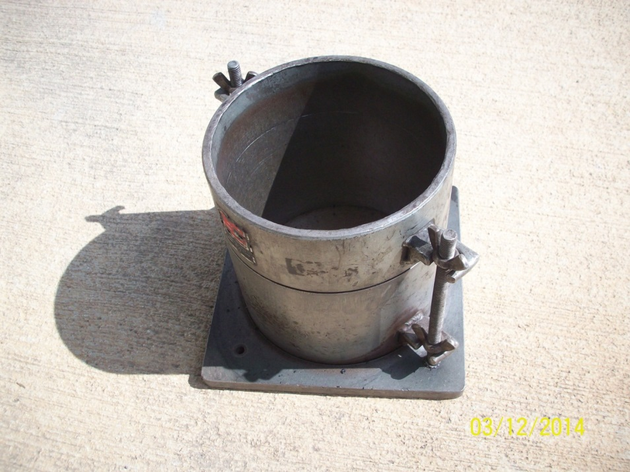
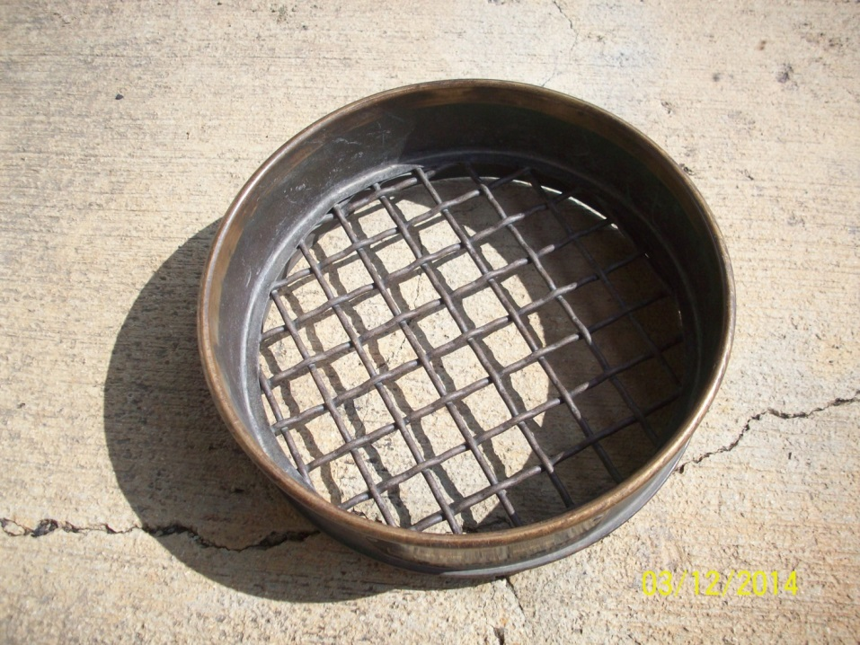
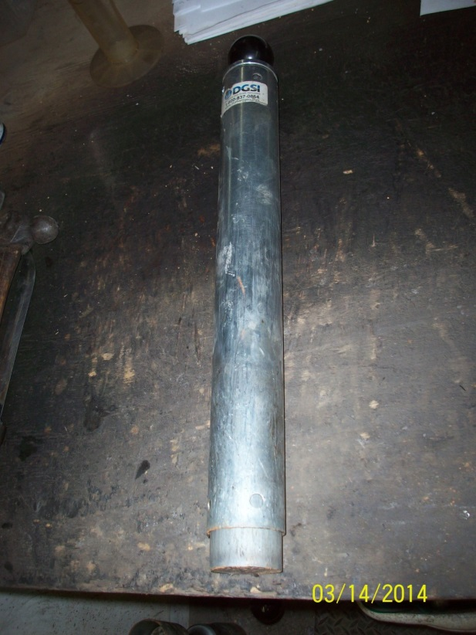
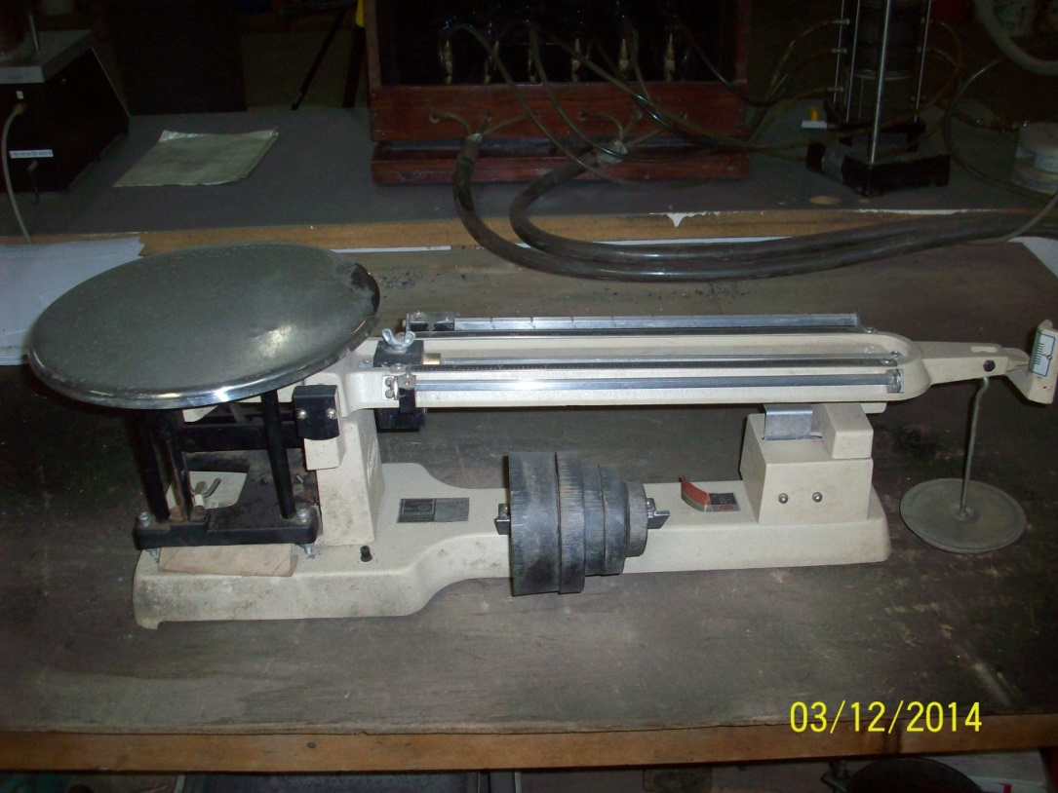

Slide 31
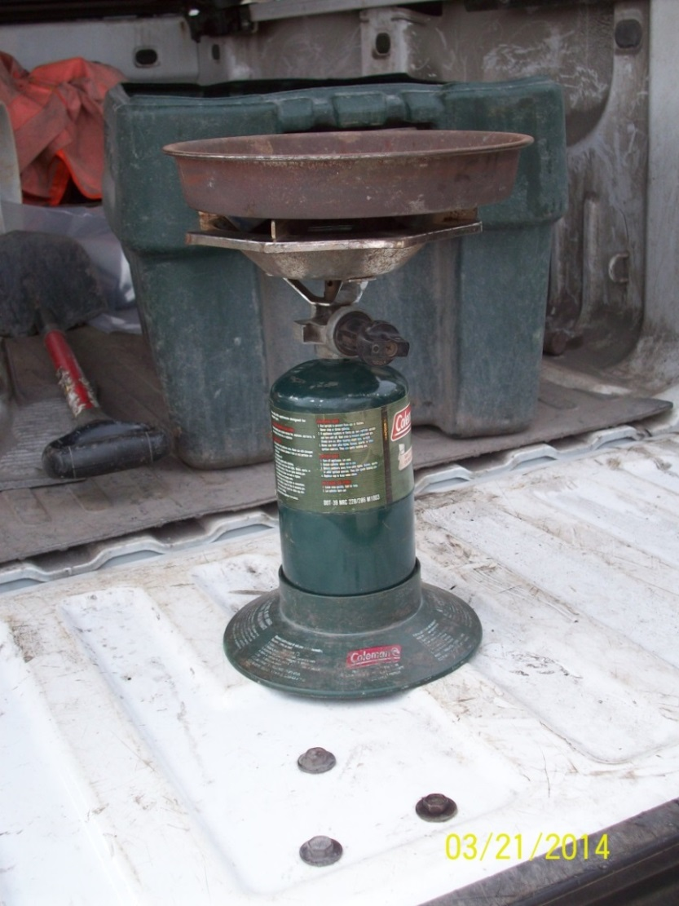
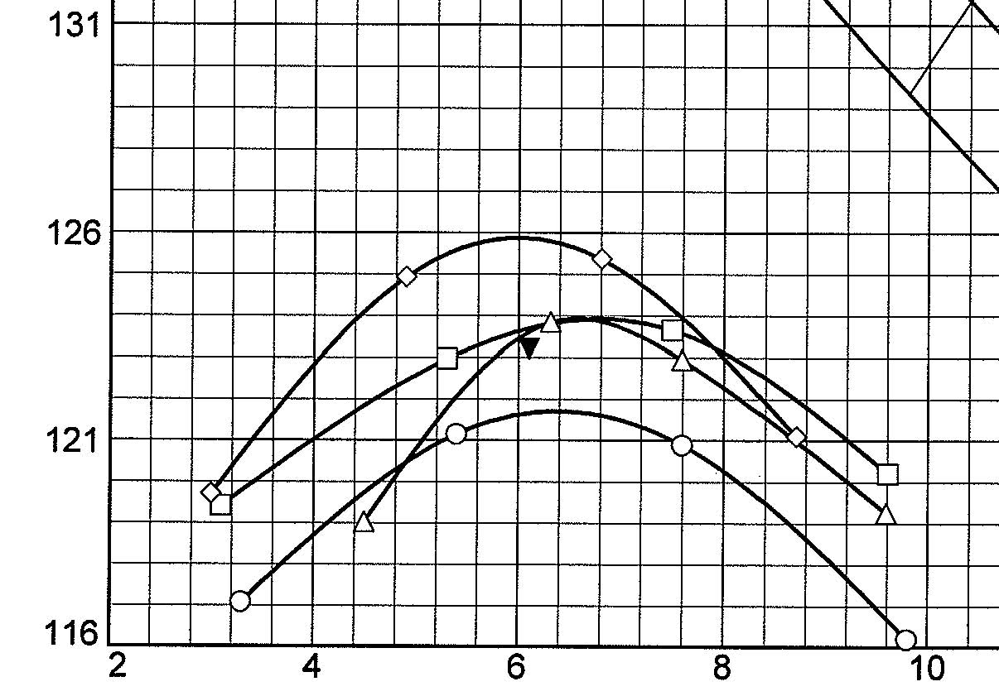
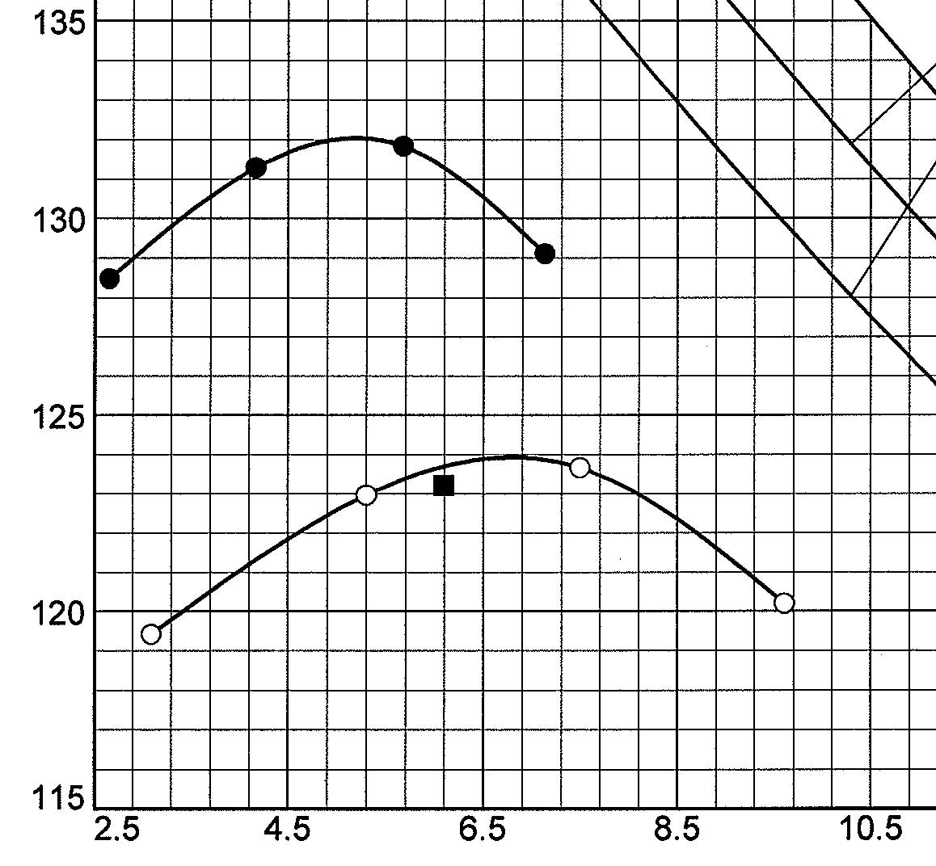
Perform a field moisture content for one-point proctor test and to correlate to nuclear density gauge readings

Slide 32
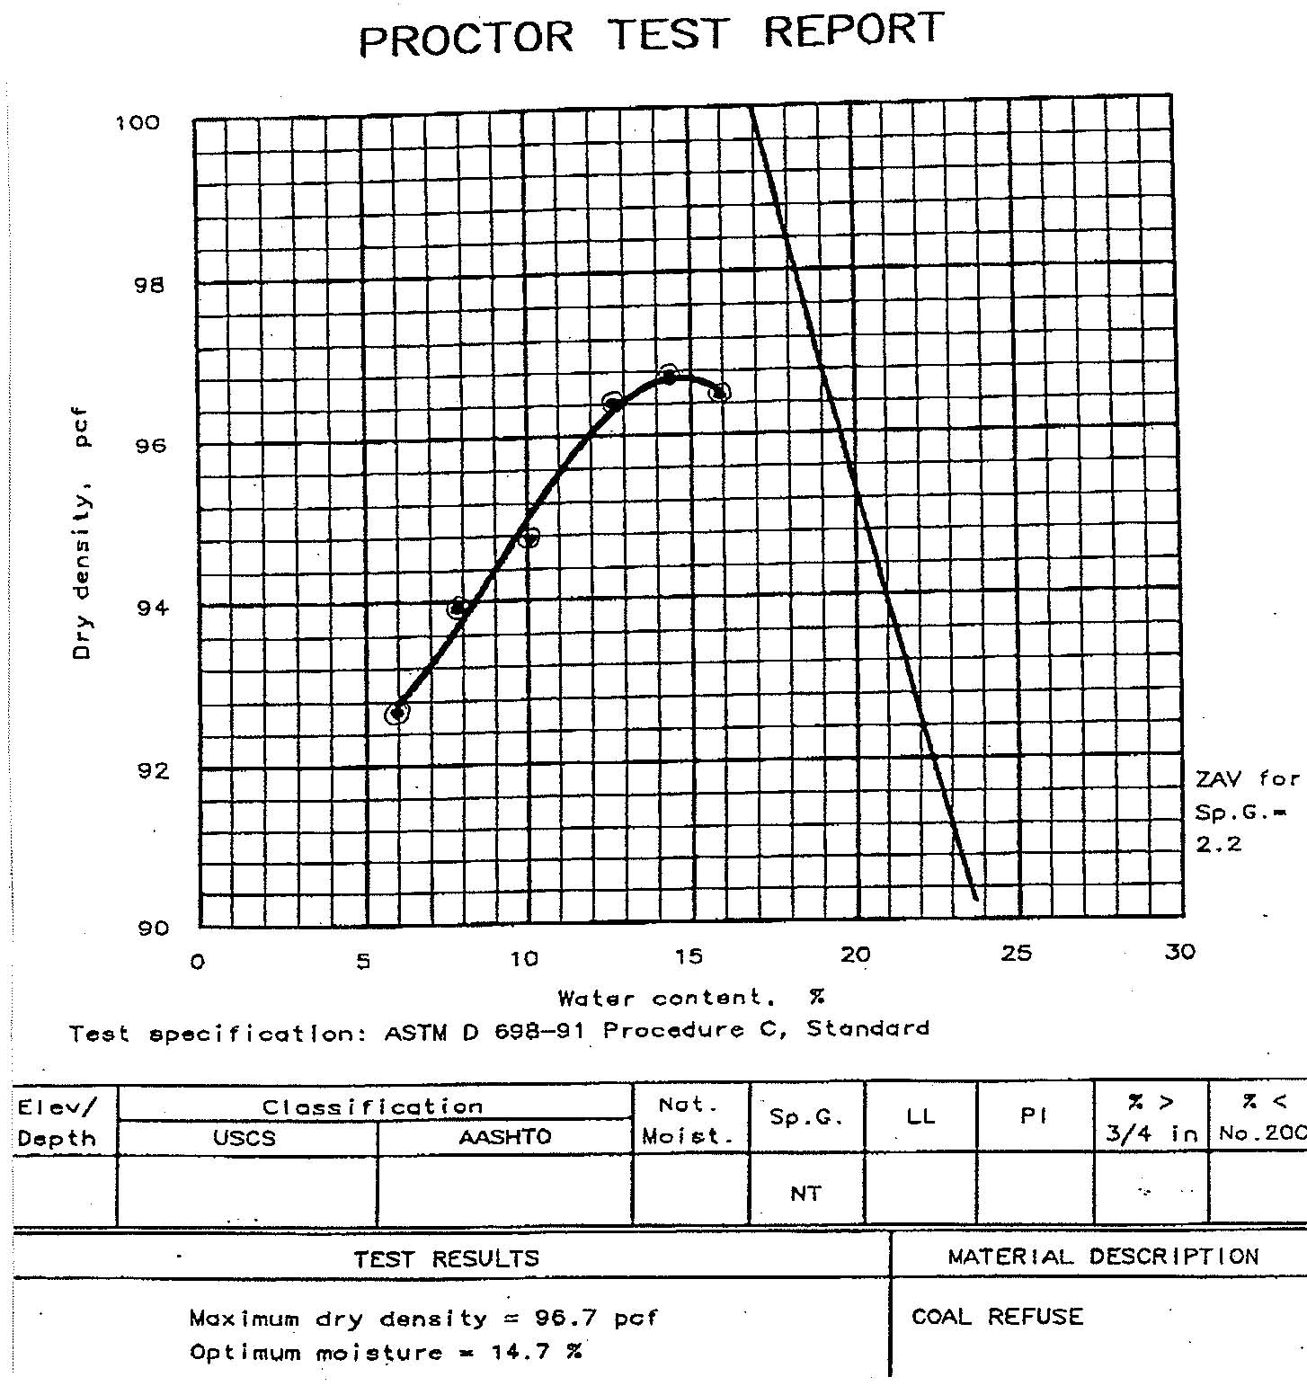
Optimum moisture = 14.7 %, with no distinct curve
Use fresh coarse refuse for each compaction point (i.e., do not reuse refuse)

Slide 33
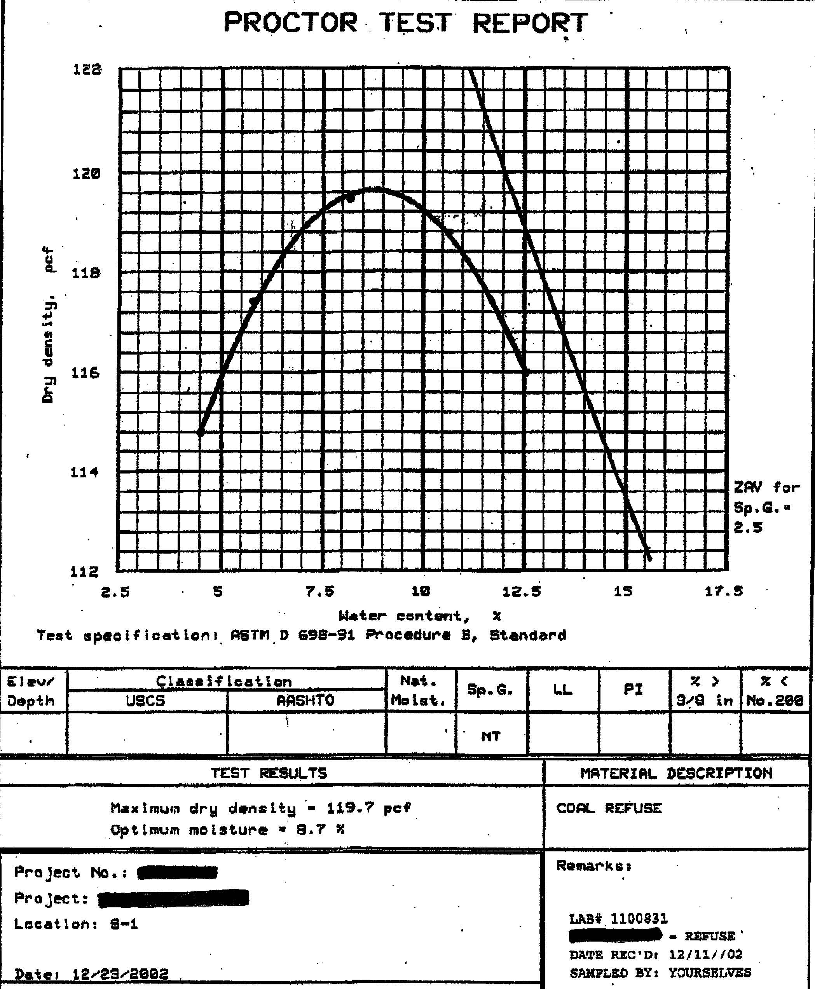
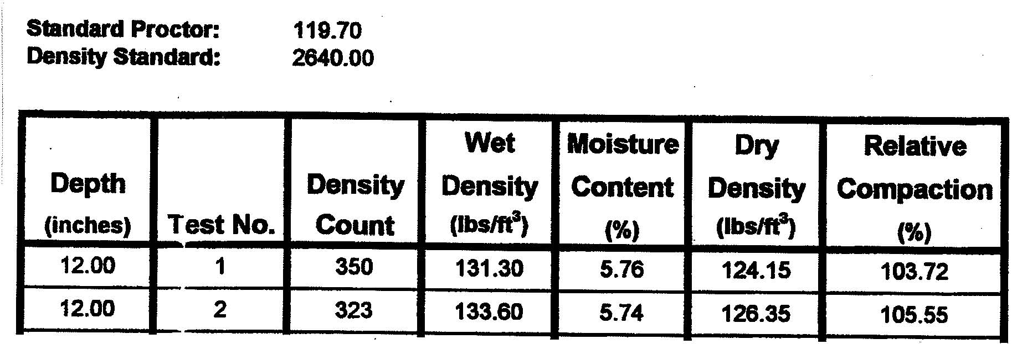
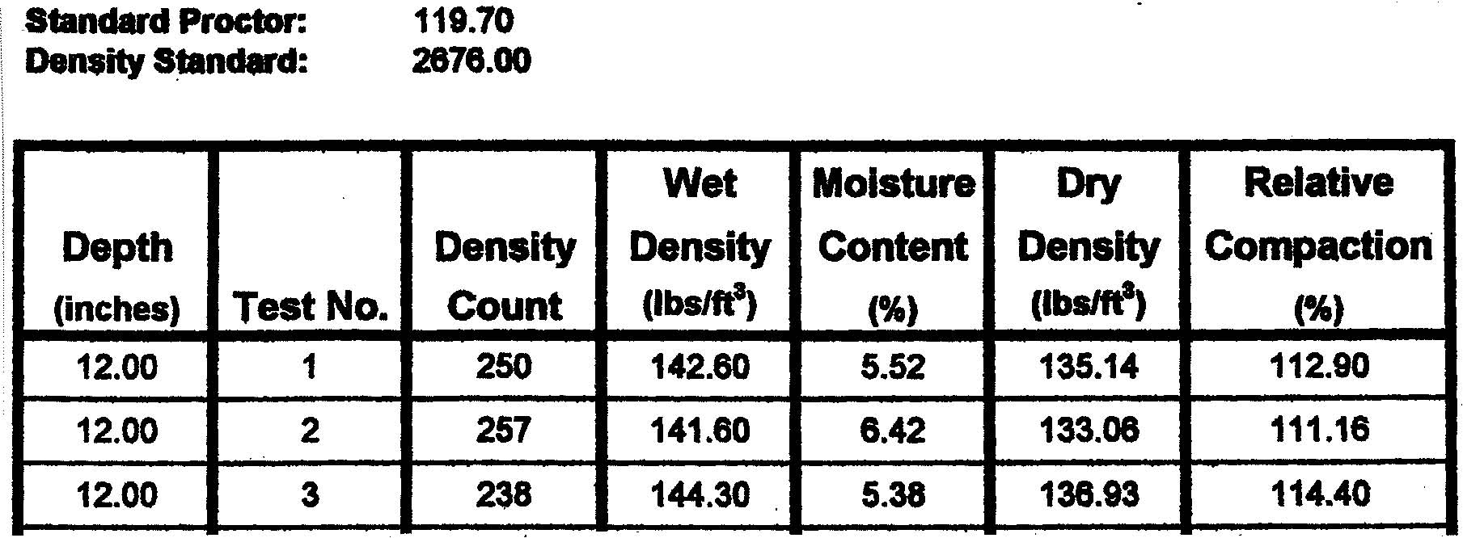
Standard Proctor Max. Dry density = 119.7 pcf, Wopt = 8.7 %
Perform Oversize Correction
Corrected Max. Dry density
= 129.9 pcf, Wcorr = 6.8 %
Results yield about 96% to 97% compaction
Corrected results still yield 104 % compaction
Need New Proctor Test

Slide 34
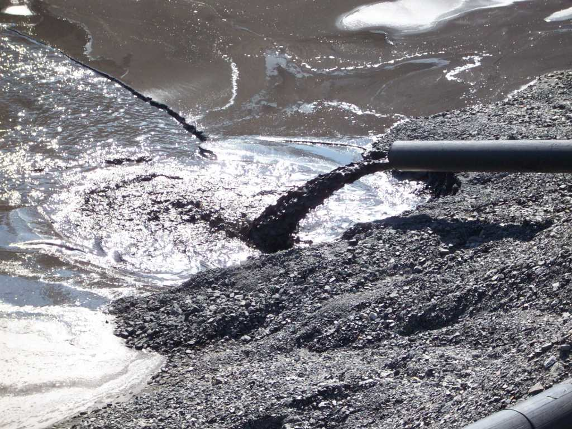

Slide 35
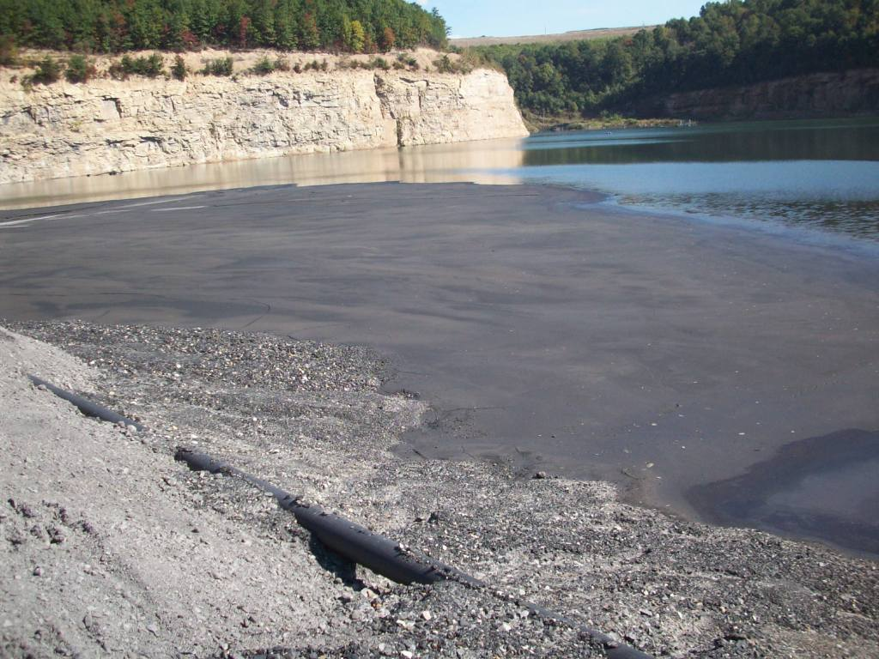

Slide 36
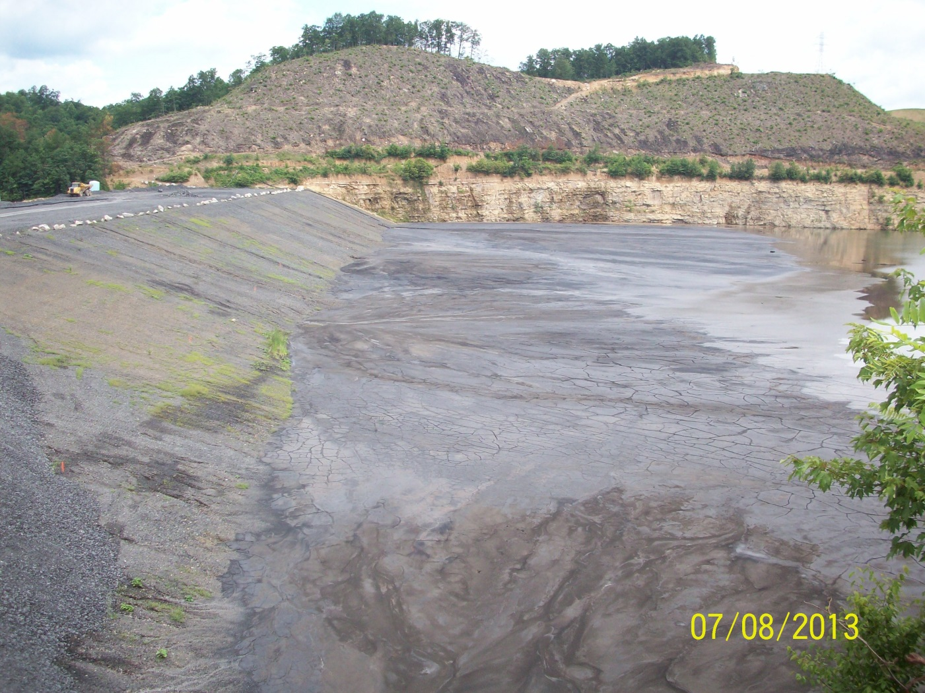
Develop Uniform beach of fine refuse along upstream embankment face
Dewater Pond as much as practical

Slide 37
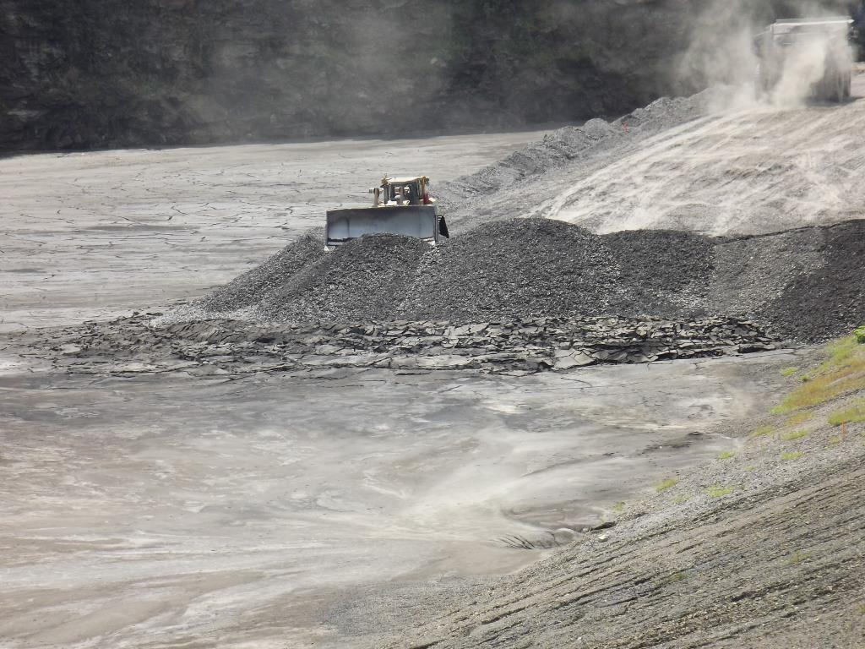
Start Upstream construction at dam abutment hugging upstream slope

Slide 38
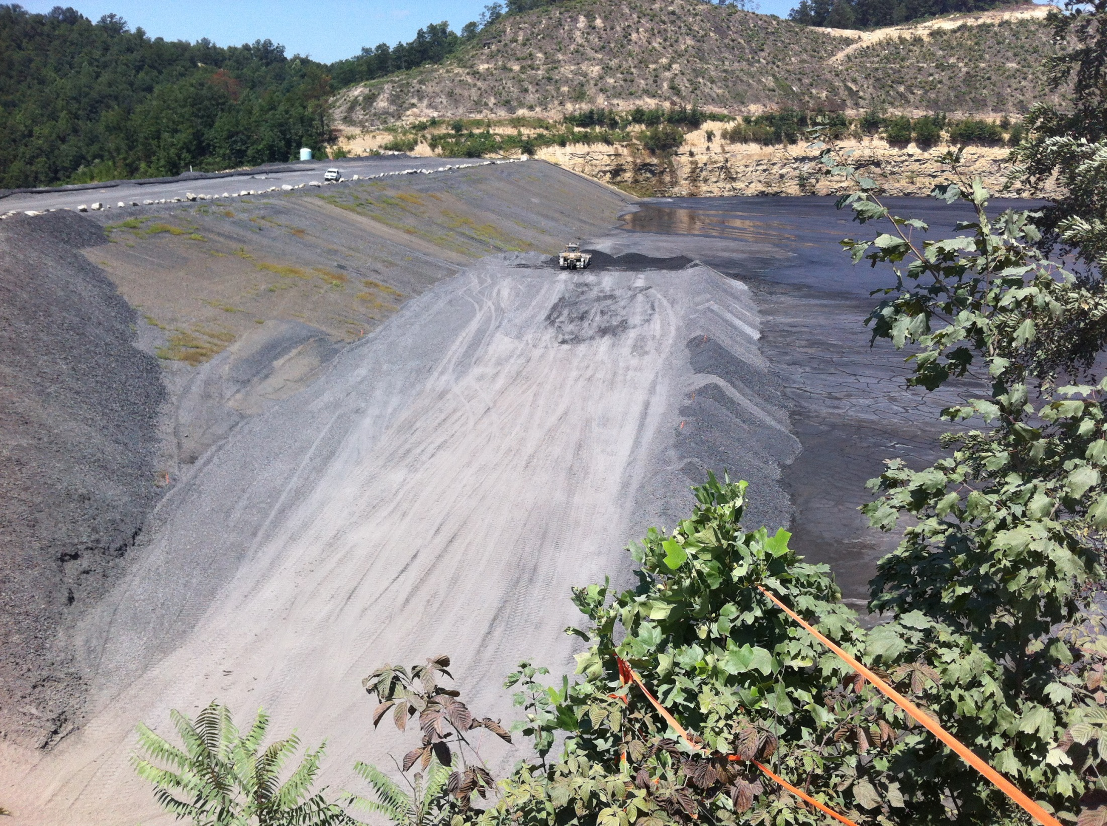
Start Upstream construction as early as possible and don’t get in a rush

Slide 39
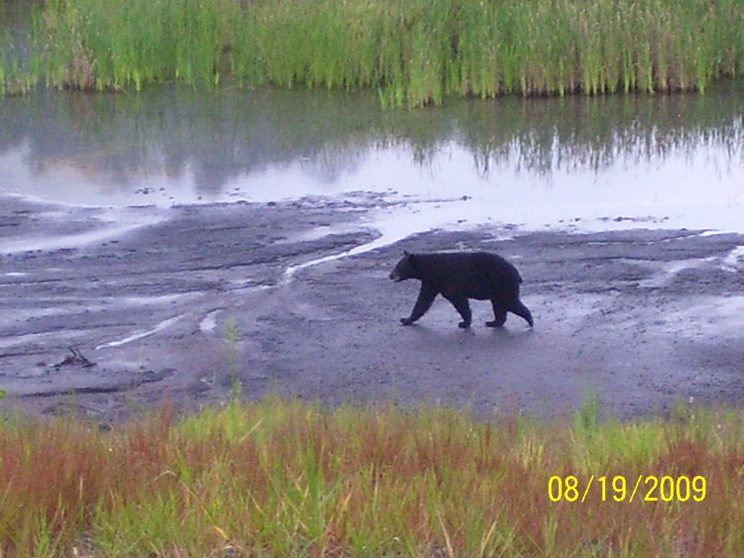
How much load can fine refuse bear?

Slide 40

Clay-like versus Sand-like Fine Refuse for Seismic Strength Allowance – you can assume more for Clay
Plasticity Index PI is greater than or equal to 7
Plasticity Index = Liquid Limit – Plastic Limit
Problem is that Fine Refuse often has a PI of 5 or 6 but exhibits Clay-like behavior

Slide 41


Slide 42

ASTM recommends at least 3 points – we recommend at least 5

Slide 43


Slide 44


Slide 45


Slide 46


Triaxial Strain Behavior – if stress-strain curve shows no distinct drop off, then the material behaves as a Clay

Slide 47


Coefficient of Consolidation If Cv < 3.3 ft²/day then materials behaves as a Clay

Slide 48


Unconfined Compression Testing – Indication of Clay-like behavior?

Slide 49
Summary
Use one-point proctors in the field for Coarse Refuse placement
Use engineering judgment when applying the oversize correction and assessing compaction of Coarse Refuse materials
Develop a uniform beach of Fine Refuse for seepage control and upstream construction
Most Fine Refuse is Clay-like and should be modelled accordingly

