Slide 1
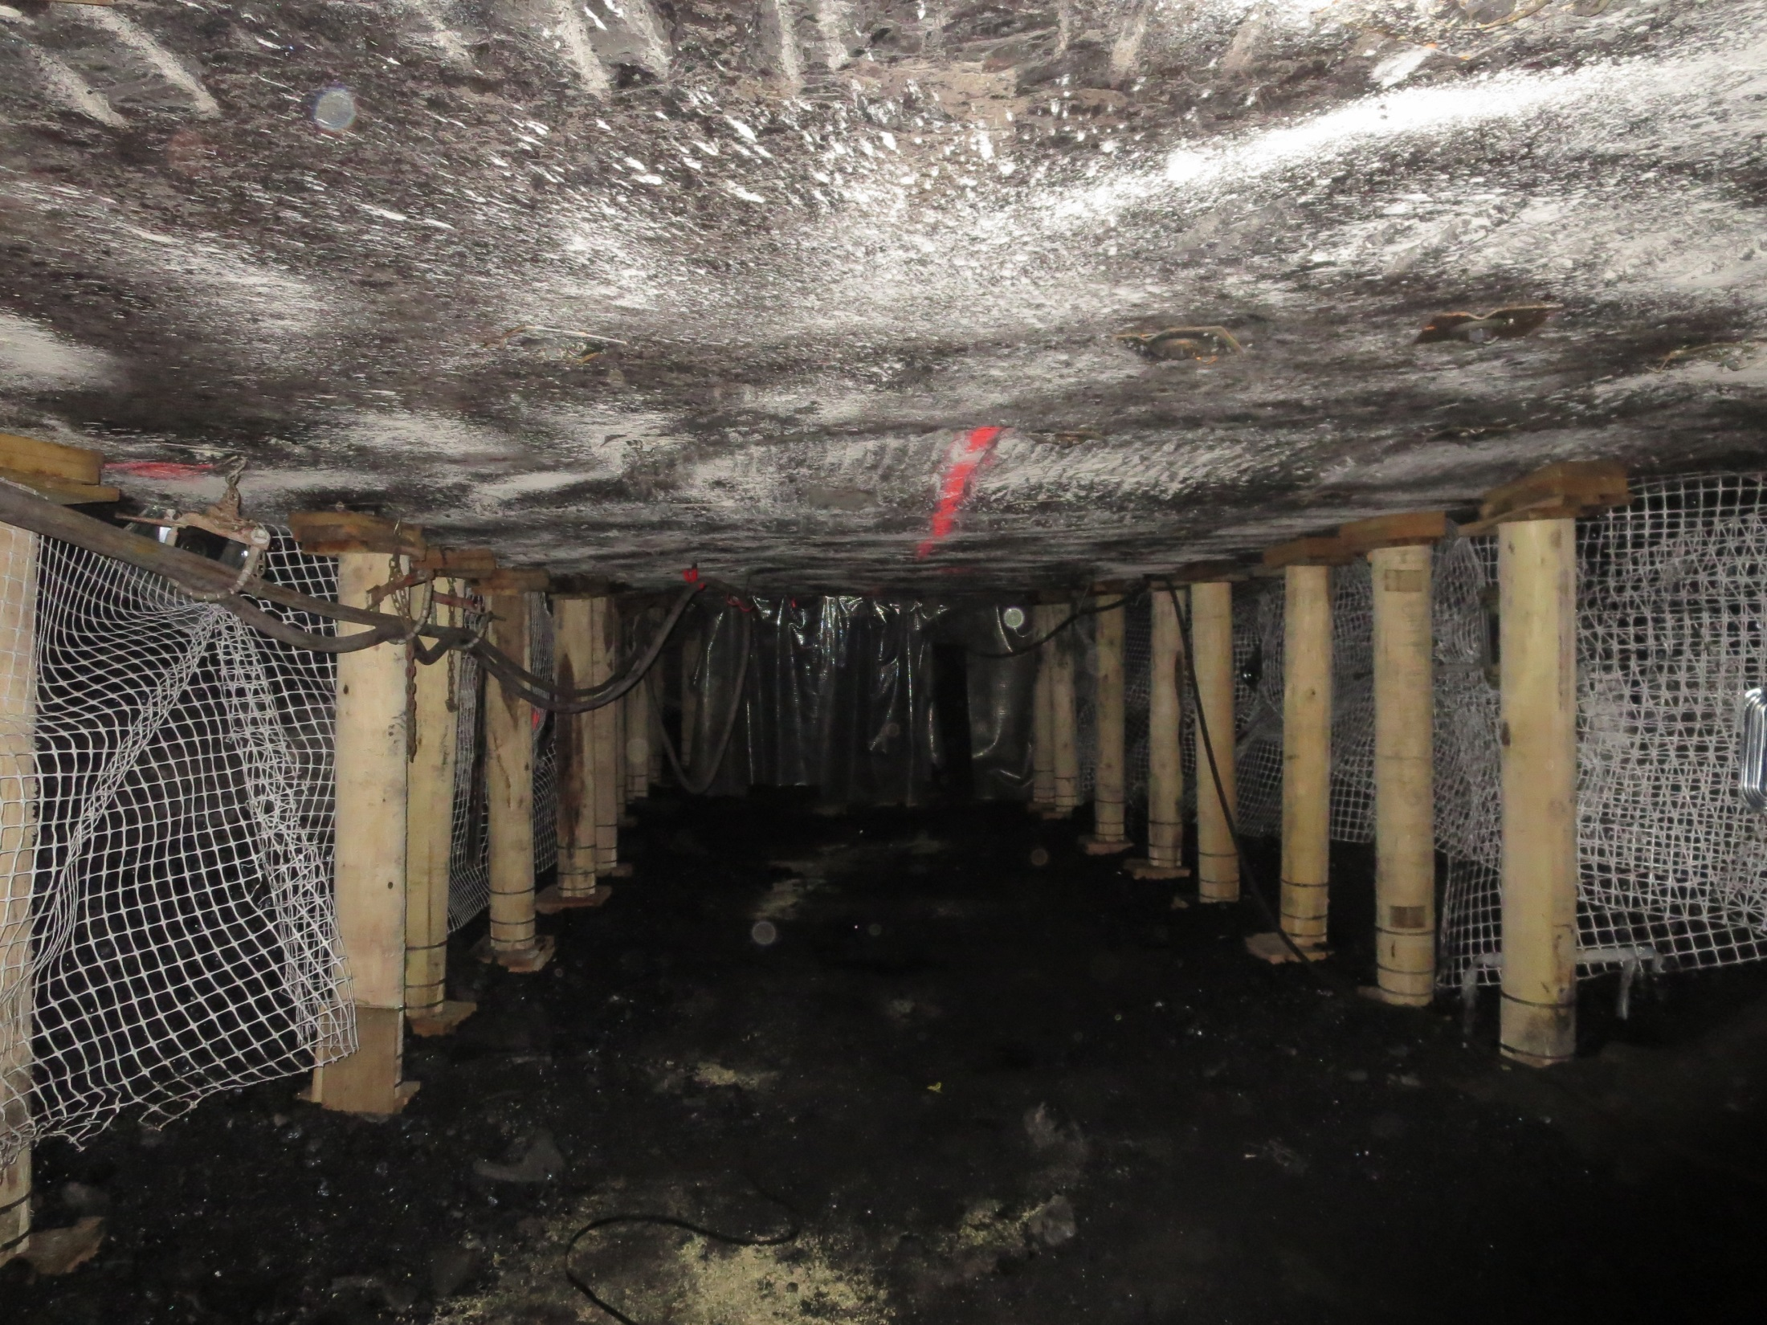
Underground Support System Limitations
Ryan C. Stephan, P.E.
Mechanical Engineer
MSHA- Technical Support
Roof Control Division
412-386-6314

Slide 2
Outline
Load Expectations
Standing Support Characteristics
Wood Crib Best Practices
Pumpable Crib Best Practices
New Standing Support Product
Roof Beam Deflection Demonstration

Slide 3








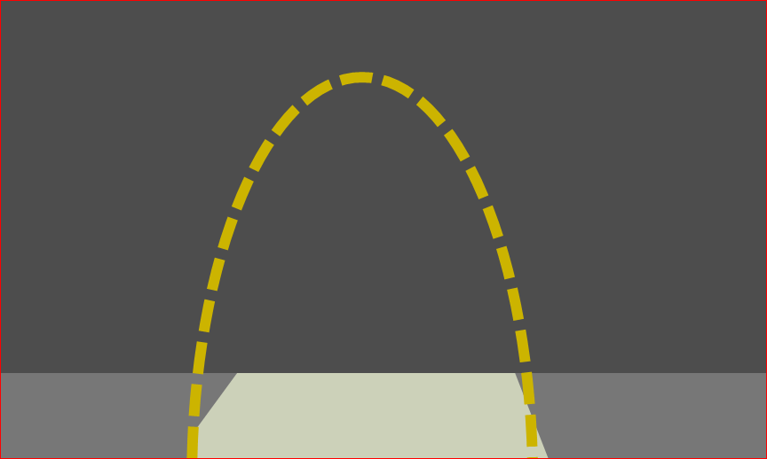
Standing Support Load Requirements
Pillar Loads
Roof Load
Notes:
Can’t stop global convergence
Want to control local roof load

Slide 4
Standing Support
Mains
Longwall Tailgate
Bleeders
Belt Drive
Notes:
Discuss how much movement may be expected in each area
More abutment loading = more convergence = deteriorating roof conditions
Different support types
Different expected convergence/ abutment load

Slide 5
Outline
Load Expectations
Standing Support Characteristics
Wood Crib Best Practices
Pumpable Crib Best Practices
New Standing Support Product
Roof Beam Deflection Demonstration

Slide 6

Properties of Roof Supports
Yield/peak capacity
Stiffness
Residual characteristics
Convergence Range
The following data was collected by NIOSH through full scale testing

Slide 7
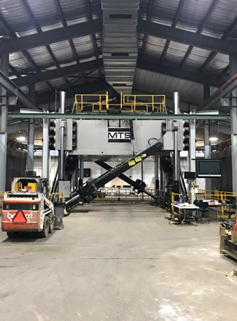
Notes:
3,000,000 pounds vertical
1,600,000 pounds horizontal
8,800 tests since 1981

Slide 8
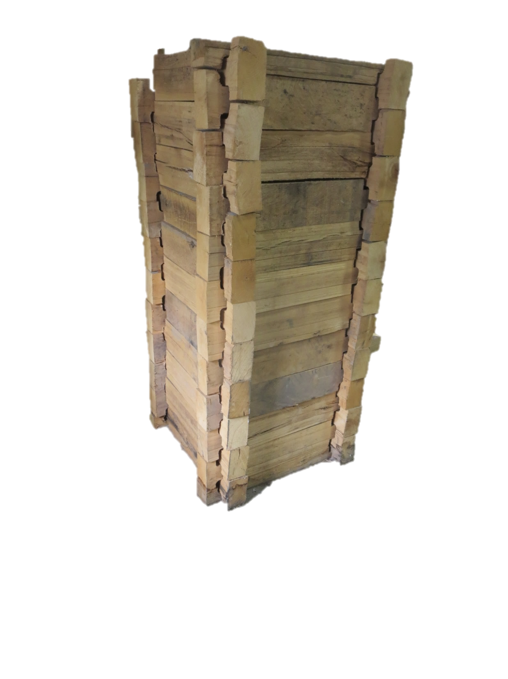
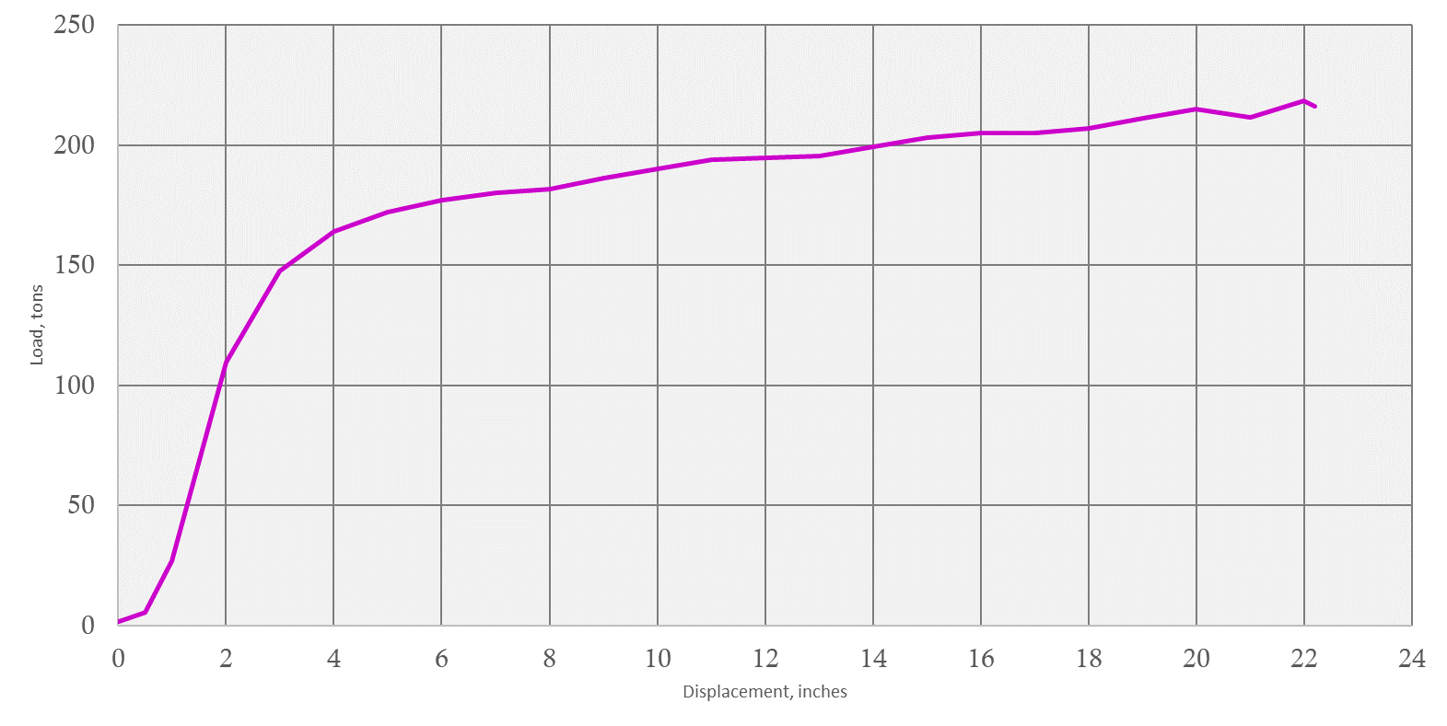
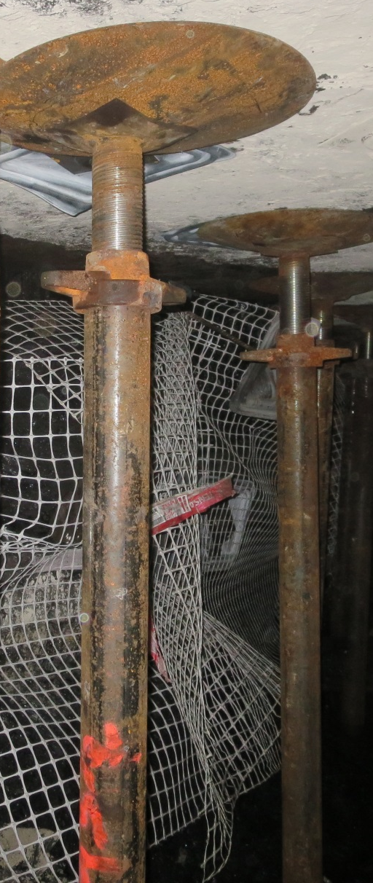
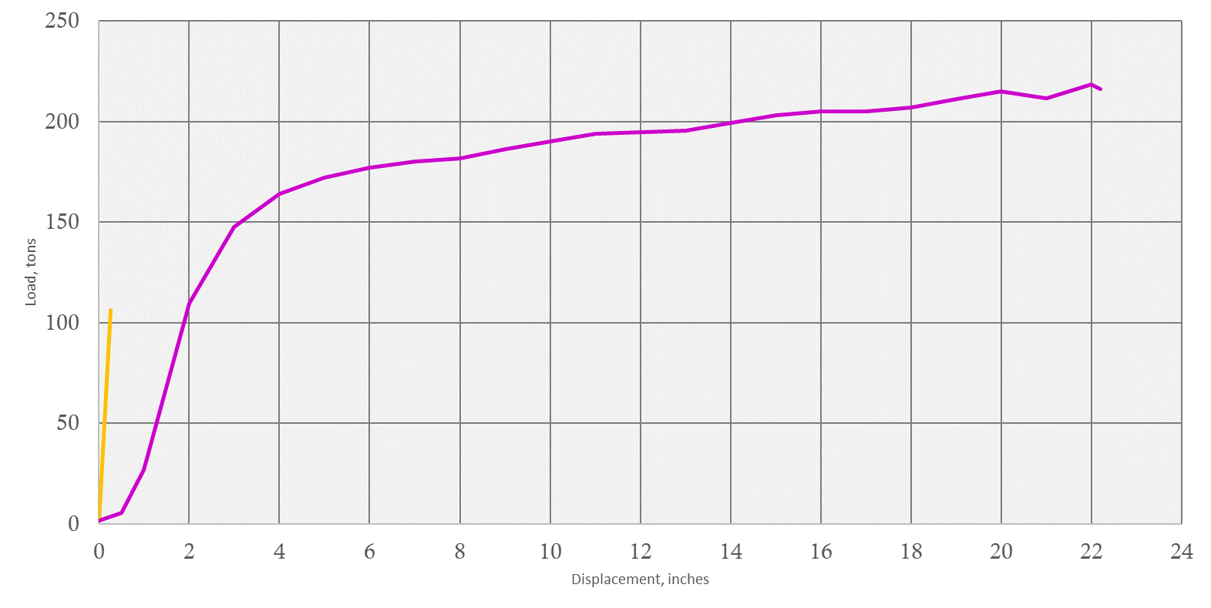
Load vs. Displacement
36-inch Link-N-Lock
Support Load, tons
100-ton Prop
Link-N-Lock
100-ton Prop
Displacement, inches
Notes:
First question is usually “How much load can the support carry” = capacity
Explain chart- load vs displacement…
Depends on- configuration, materials, and height
Peak capacity = Link N Lock = 2X jack
If you don’t want any movement…Jack is better
Load @ 1/4” … Jack= way stronger

Slide 9
Support Stiffness
Standing supports develop their load-carrying capacity only through roof movement
A measure of how quickly a support system develops its load carrying capacity in response to convergence

Slide 10
Capacity vs. Stiffness
Capacity = How much load can the support carry
vs.
Stiffness = How much load can the support carry
at a specified amount of displacement?

Slide 11
Support Stiffness
Support Type | Initial Stiffness (tons/inch)
4-Point Crib | 23
12’ Cable Bolt | 38
9-Point Crib | 54
8-12” Post | 112
Fiber Crib Column | 221
24” Pumpable Crib | 234
100-ton Prop | 485

Slide 12
Residual Load
The behavior of a support after peak capacity is exceeded
Notes:
Discuss longwall tailgate

Slide 13
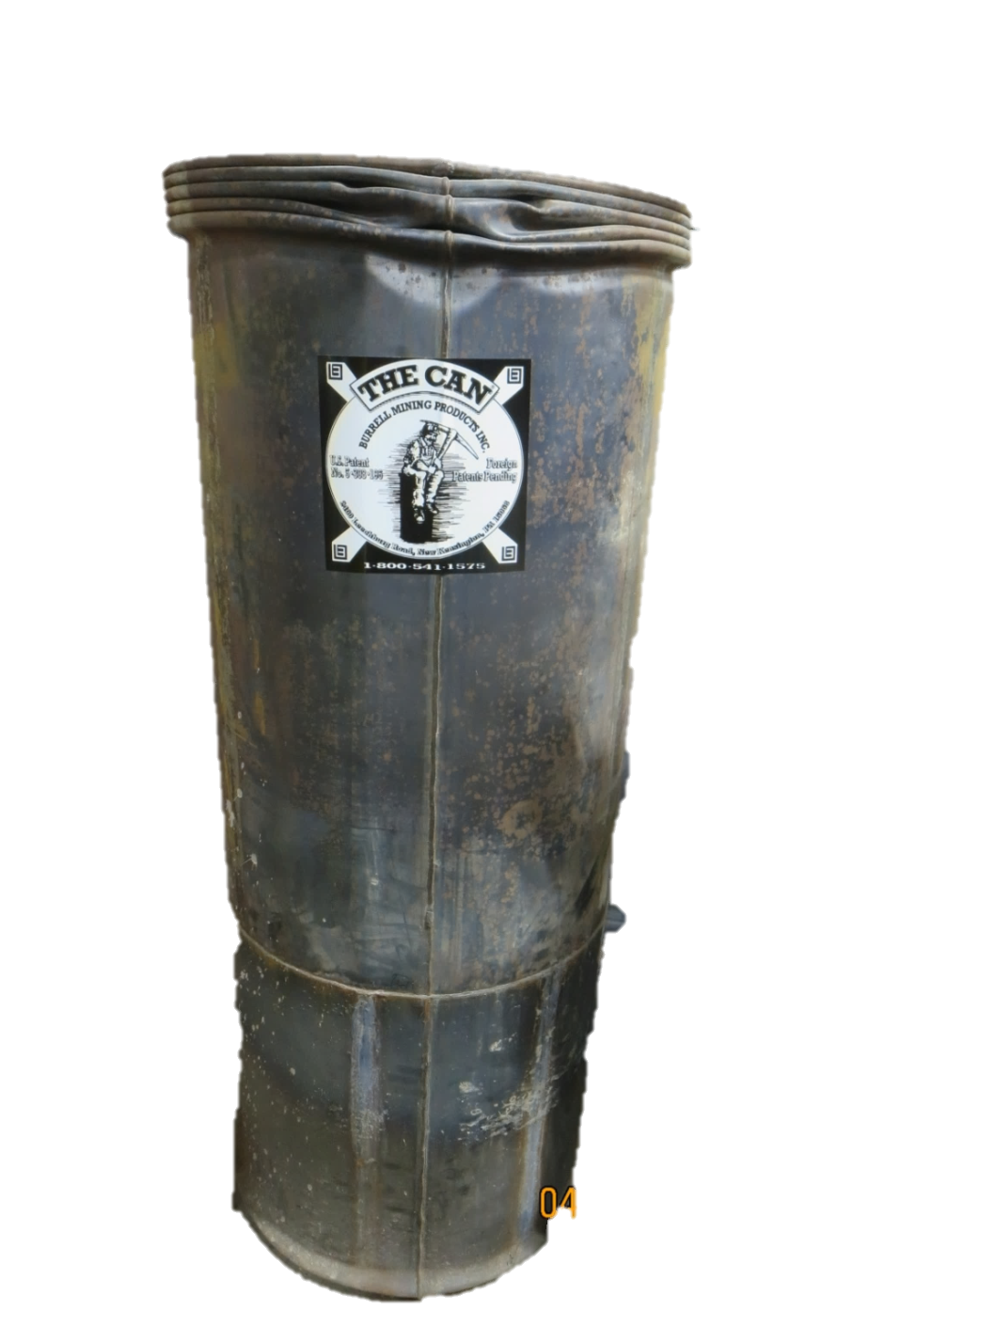
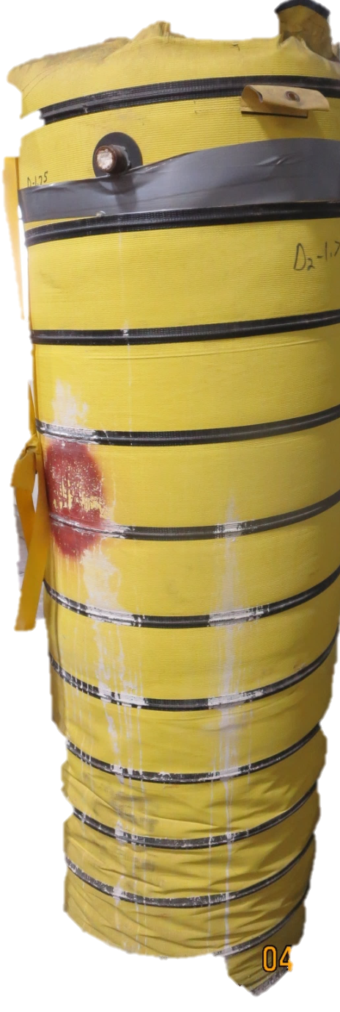
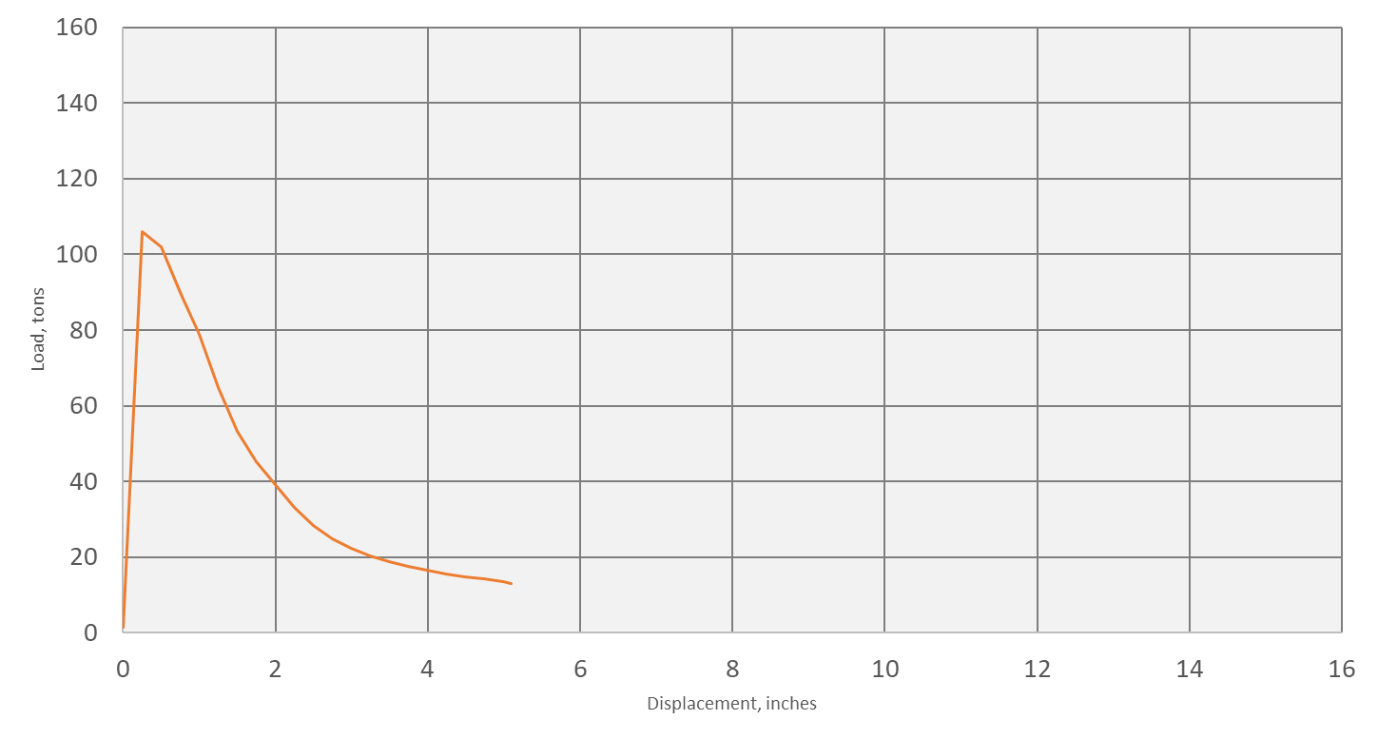
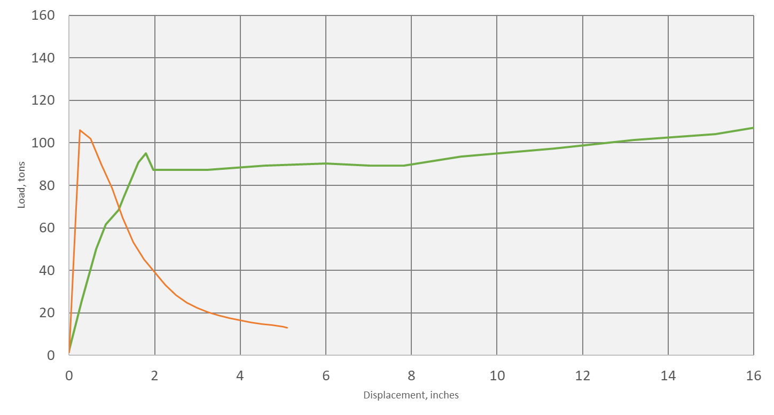
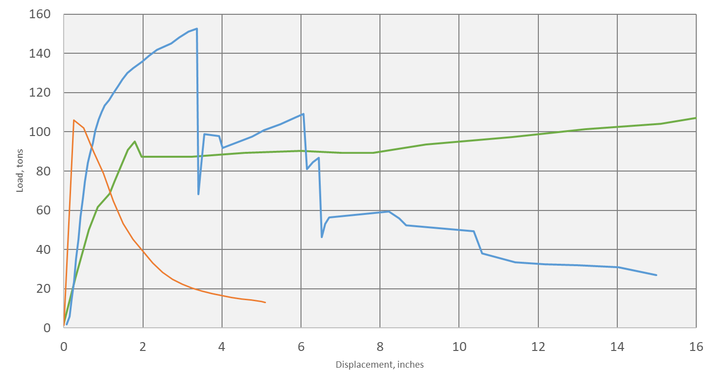
Residual Load
24-inch Pumpable Crib
24-inch CAN
Support Load, tons
100-ton Prop
24-inch Pumpable Crib
24-inch CAN
100-ton Prop
Displacement, inches
Notes:
Residual Load = behavior of a support after peak capacity is exceeded

Slide 14
Convergence Range
The total amount of convergence of the support until the support has declined to 40% of its peak load capacity
Notes:
NIOSH determined 40% as arbitrary cutoff – still can be usefulness after that…

Slide 15
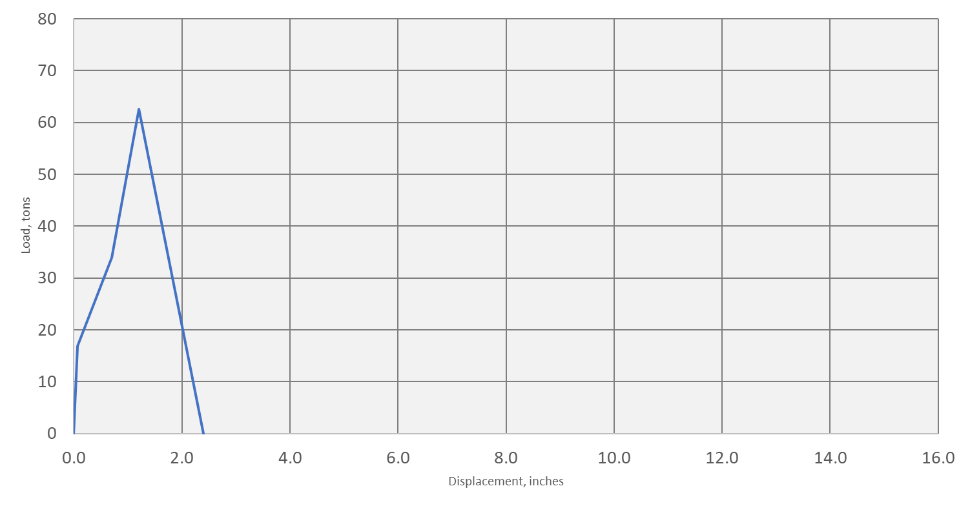
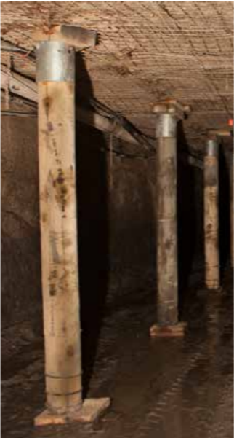
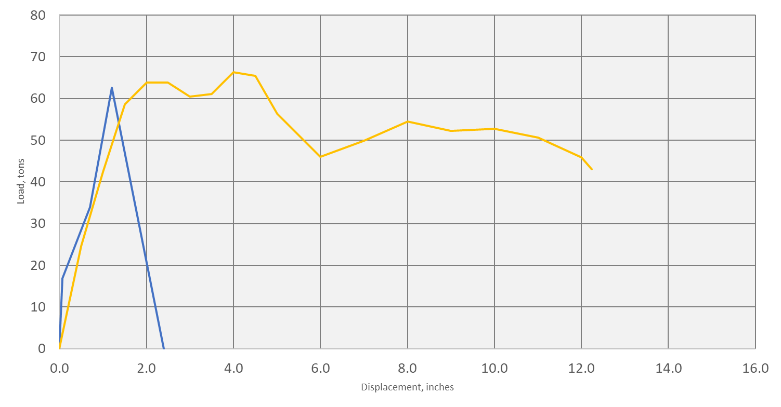
Convergence Range
10-inch Propsetter
Support Load, tons
8-inch Wood Post
Propsetter
Displacement, inches

Slide 16
Convergence Range
Support Type | Convergence Range (inch)
100-ton Prop | 1
Fiber Crib Column | 2
8-12” Post | 3
10” Propsetter | 13
24” Pumpable Crib | 19
9-Point Crib | 20
4-Point Crib | 22

Slide 17
Stiffness vs. Convergence Range
Support Type | Initial Stiffness (tons/inch) | Convergence Range (inch)
100-ton Prop | 485 | 1
Fiber Crib Column | 221 | 2
8-12” Post | 112 | 3
10” Propsetter | 71 | 13
24” Pumpable Crib | 234 | 19
9-Point Crib | 54 | 20
4-Point Crib | 23 | 22

Slide 18
Other Factors
Stability
Material handling requirements
Installation Quality
Timing
Skin Control
Notes:
Material handling – 5,000 workdays lost each year from timber handling…

Slide 19
Outline
Load Expectations
Standing Support Characteristics
Wood Crib Best Practices
Pumpable Crib Best Practices
New Standing Support Product
Roof Beam Deflection Demonstration

Slide 20
Timber Overhang
Overhang timbers by half of the timber width
6”
3”
3”

Slide 21
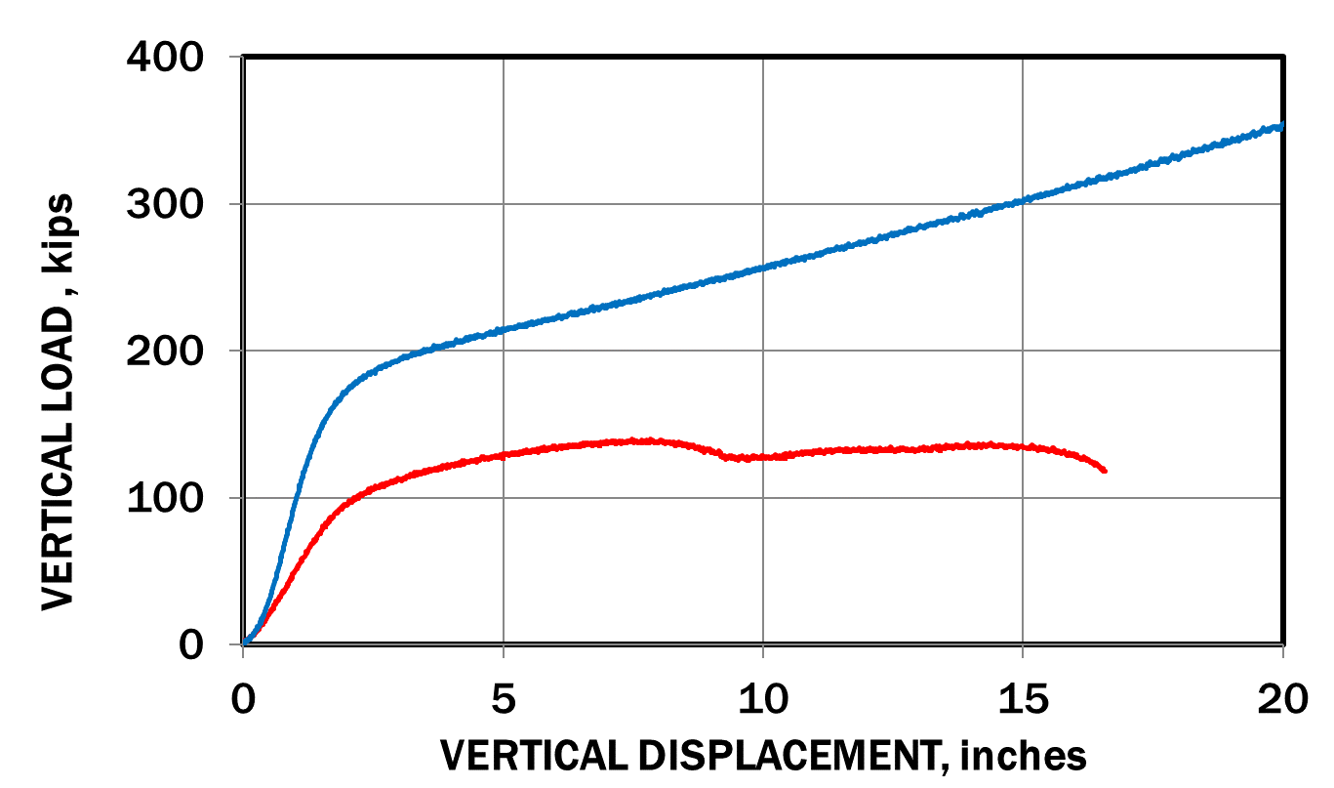
Timber Orientation
7-inch Wide Timber
7-inch Tall Timber
Notes:
Cribs constructed of 5x7” timbers
Capacity, stiffness, residual load, convergence range

Slide 22
Aspect Ratio
Maximum Aspect Ratios (H/W):
  4-Point Wood Crib: 4.3:1
  Concrete Crib: 6.0:1
  CAN: 5.0:1
  Pumpable Crib: 5.0:1
W
H
Notes:
What does this look like for 4-point crib?

Slide 23
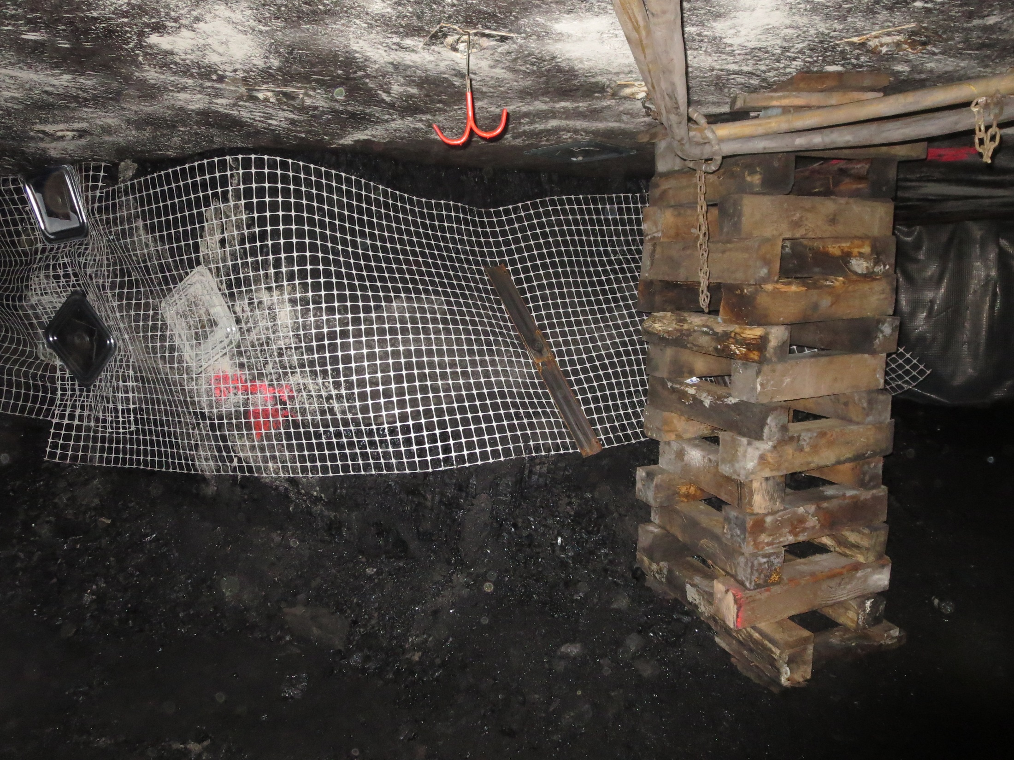
Aspect Ratio ~ 4.3:1
Notes:
~Maximum height
30-inch timbers
6.5-7 feet tall

Slide 24
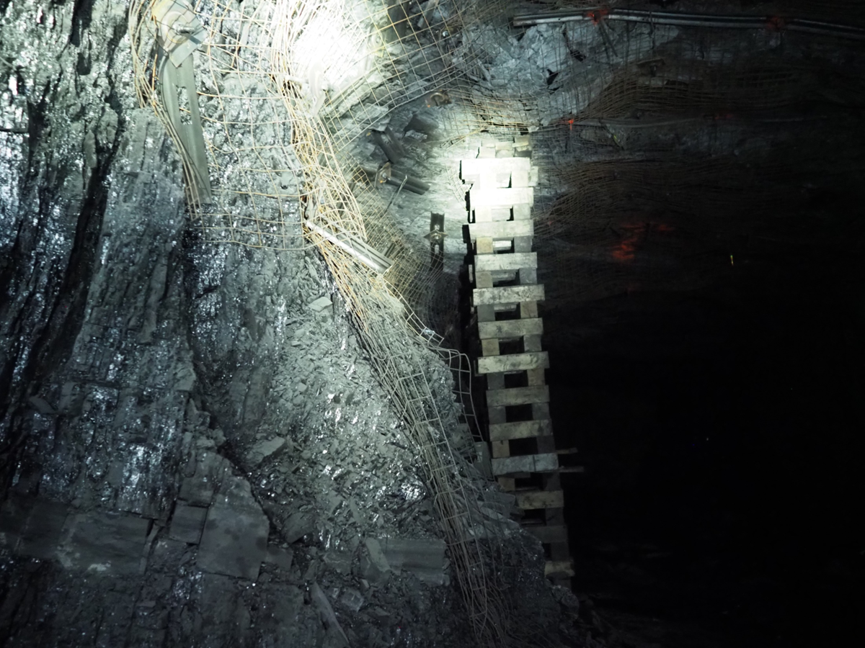
Aspect Ratio ~ 9.3:1
Notes:
Does this seem within aspect ratio?
Also, Minimal overhang

Slide 25
4-Point Crib Height
Maximum Crib Height (6x6 blocks)
Timber Length (inches) | Maximum Crib Height
24 | 4’ 4”
30 | 6’ 6”
36 | 8’ 7”
42 | 10’ 10”
48 | 12’ 11”
Notes:
Good chart to keep on hand

Slide 26
Outline
Load Expectations
Standing Support Characteristics
Wood Crib Best Practices
Pumpable Crib Best Practices
New Standing Support Product
Roof Beam Deflection Demonstration

Slide 27
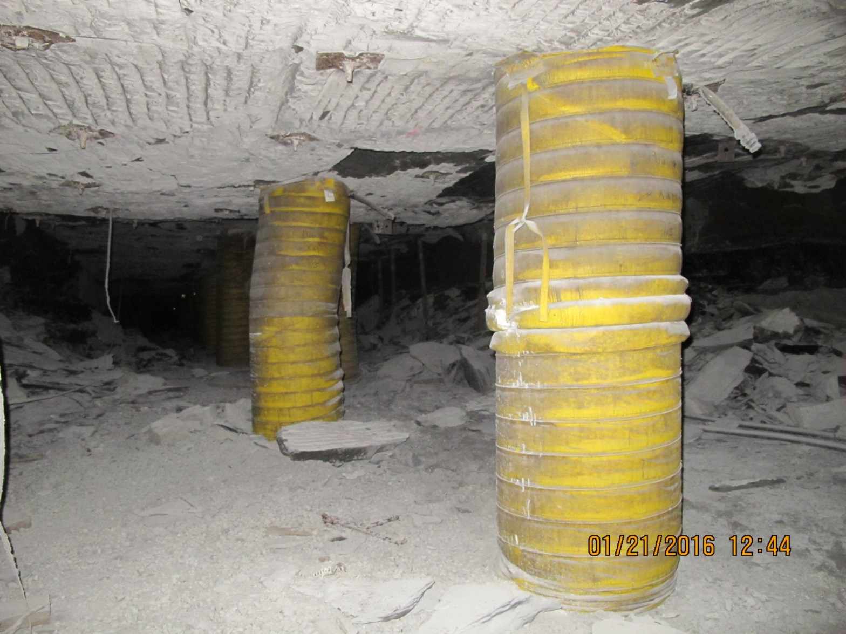
Pumpable Crib Best Practices
Proper Installation:
  Within aspect ratio
  Plumb
  Damage to bag repaired
  Roof contact
  Slightly pre-stressed
Notes:
Cut-able cribs have about half the peak and residual capacity. Same convergence range

Slide 28
Pumpable Crib Best Practices
 | RCD
Max Aspect ratio | 5:1
Max bow/tilt | 25% of Diameter
Wood Base | Until aspect ratio is below 5:1
Capacity | De-rated based on aspect ratio

Slide 29
Installed Off-Plumb
10% of height
25% of diameter
Notes:
5:1 aspect ratio

Slide 30
Pumpable Crib Best Practices
 | RCD
Max Aspect ratio | 5:1
Max bow/tilt | 25% of Diameter
Wood Base | Until aspect ratio is below 5:1
Capacity | De-rated based on aspect ratio

Slide 31
Outline
Load Expectations
Standing Support Characteristics
Wood Crib Best Practices
Pumpable Crib Best Practices
New Standing Support Product
Roof Beam Deflection Demonstration

Slide 32
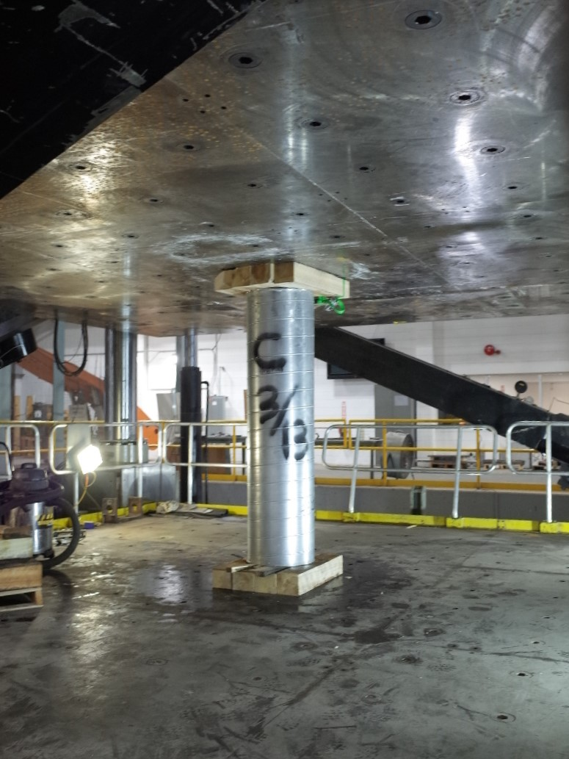
Gorilla Support
Manufactured by MICON
Diameters ranging from 8 to 20 inches
7.2:1 Maximum Aspect Ratio
Corrugated tube filled with bamboo and polyurethane
Lightweight and requires minimal labor to install

Slide 33
Gorilla Support
Manufactured by MICON
Diameters ranging from 8 to 20 inches
7.2:1 Maximum Aspect Ratio
Corrugated tube filled with bamboo and polyurethane
Lightweight and requires minimal labor to install

Slide 34
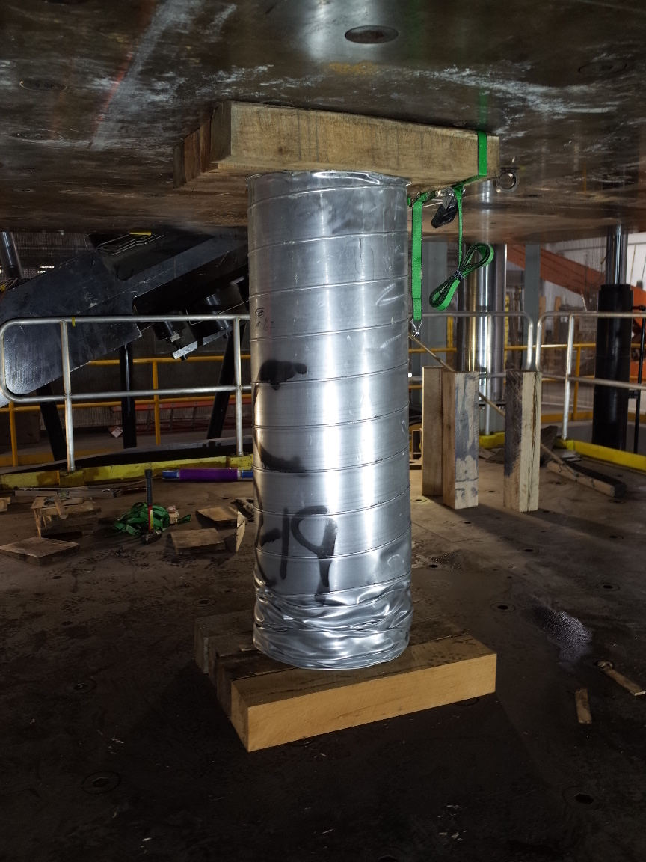
Gorilla Support
Gorilla Support

Slide 35
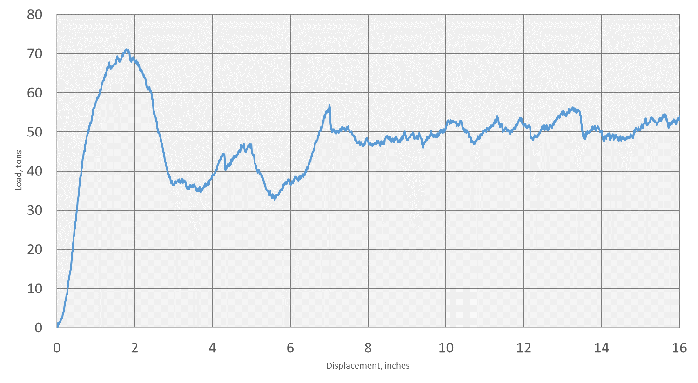
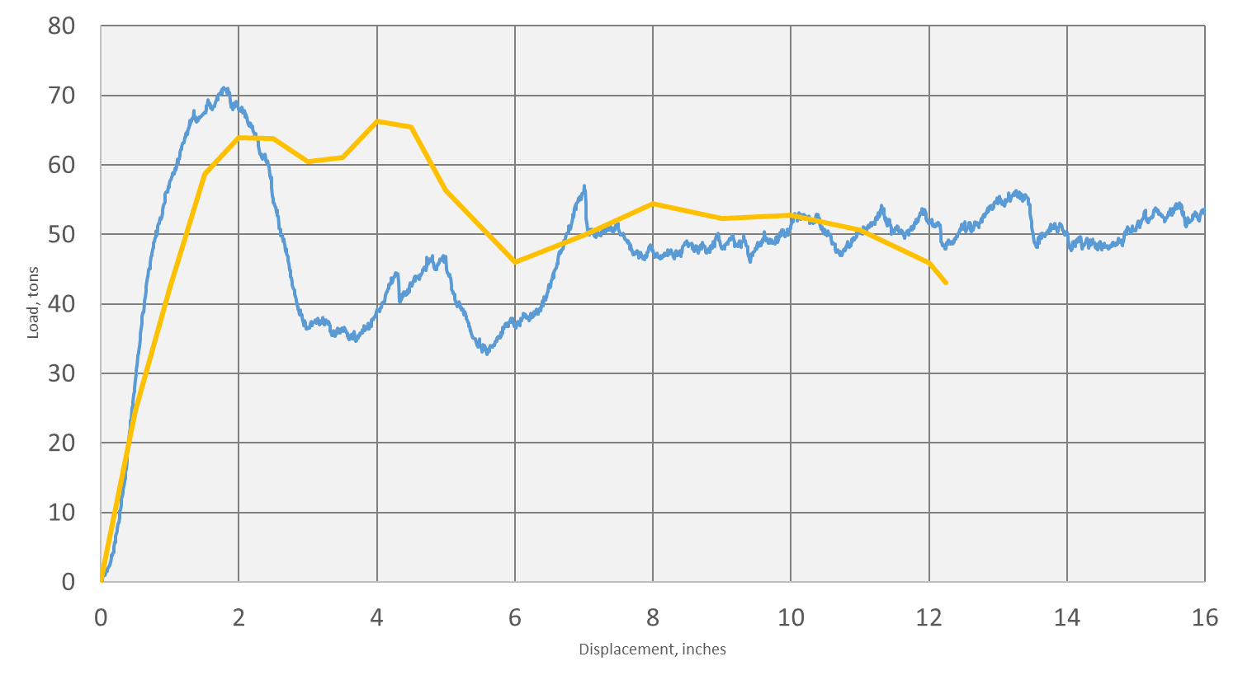
Gorilla Support
10-inch Propsetter
Support Load, tons
12-inch Gorilla Support
Gorilla Support
Deflection (inches)
Notes:
You may ask…”Is that any good?”
It depends on what you compare to

Slide 36
Outline
Load Expectations
Standing Support Characteristics
Wood Crib Best Practices
Pumpable Crib Best Practices
New Standing Support Product
Roof Beam Deflection Demonstration

Slide 37

Roof Beam Deflection Example

Slide 38
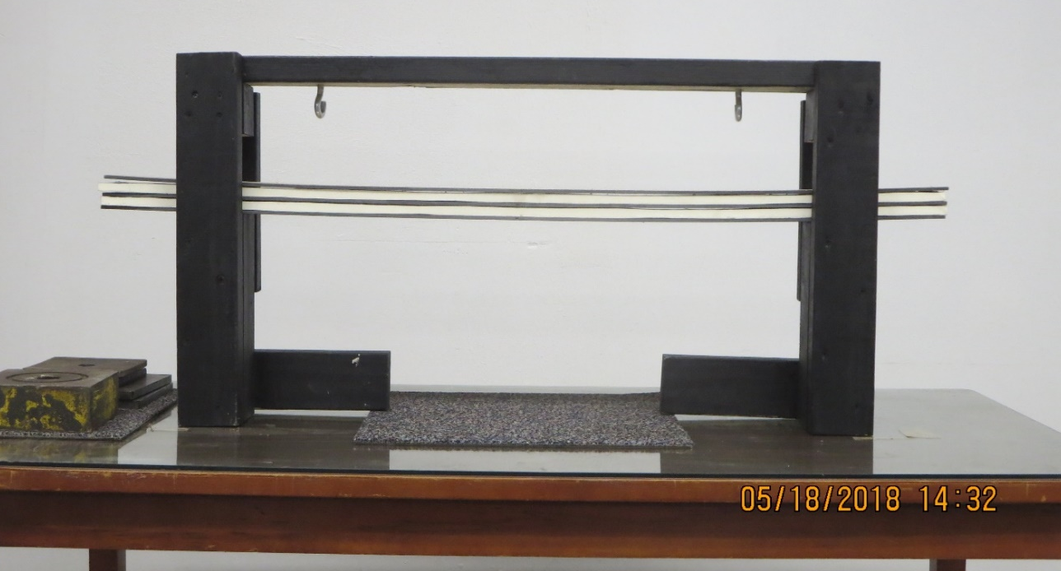
Roof Beam Deflection Example

Slide 39
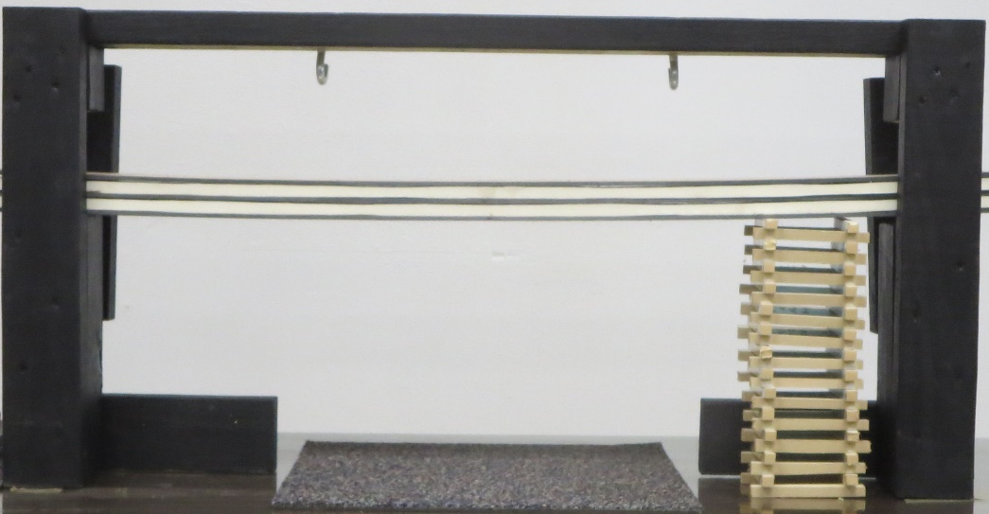
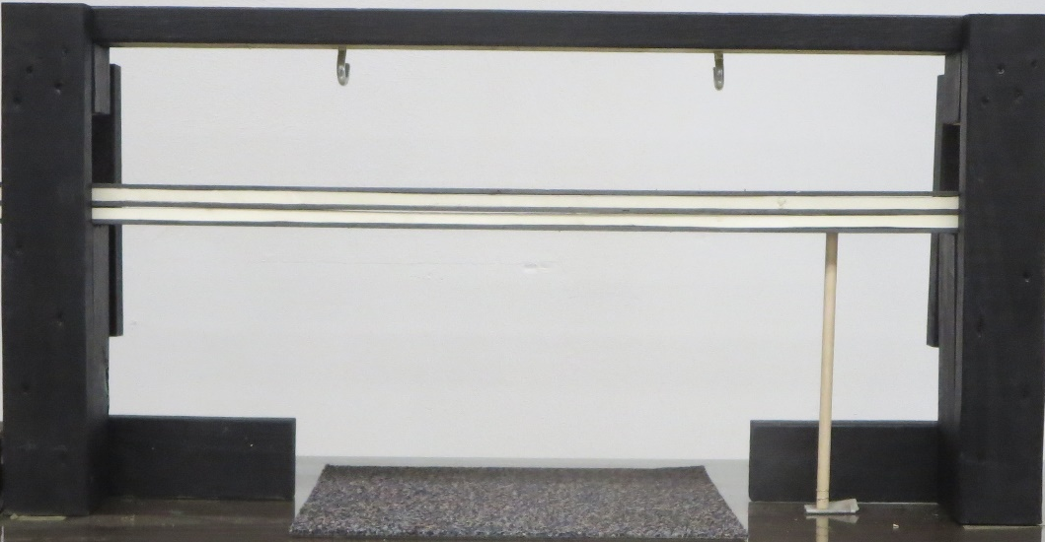
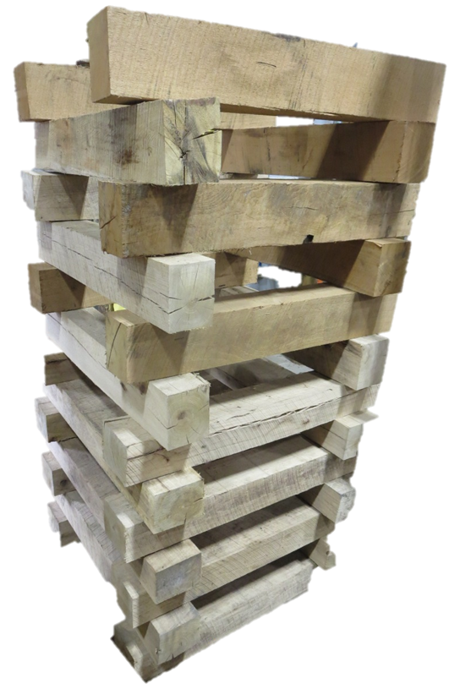
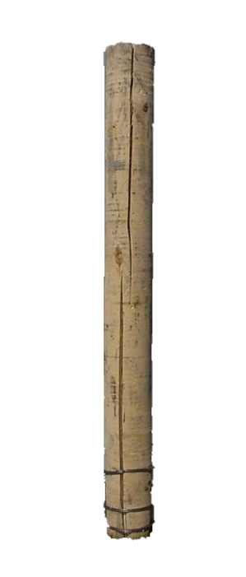
Standing support – Soft vs stiff
Soft Support
Stiff Support

Slide 40
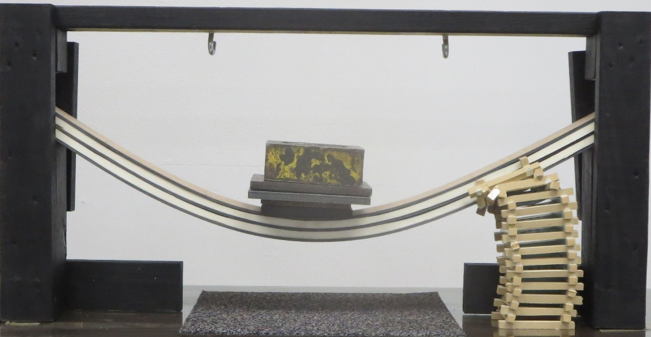
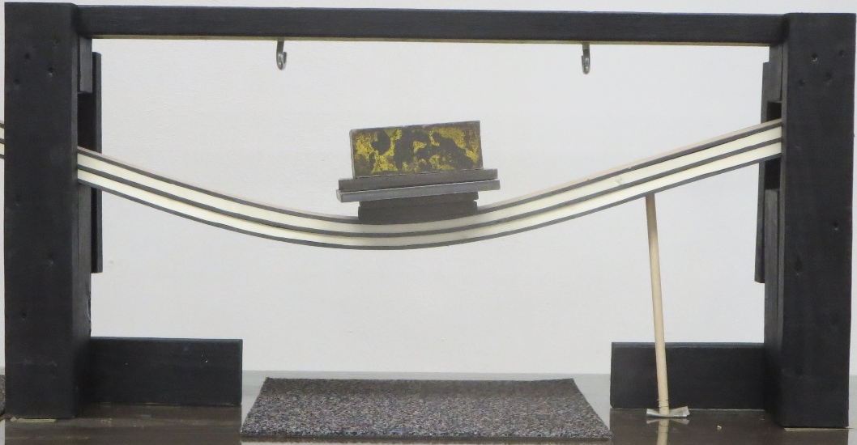
Standing support – Soft vs stiff
Soft Support
Stiff Support

Slide 41
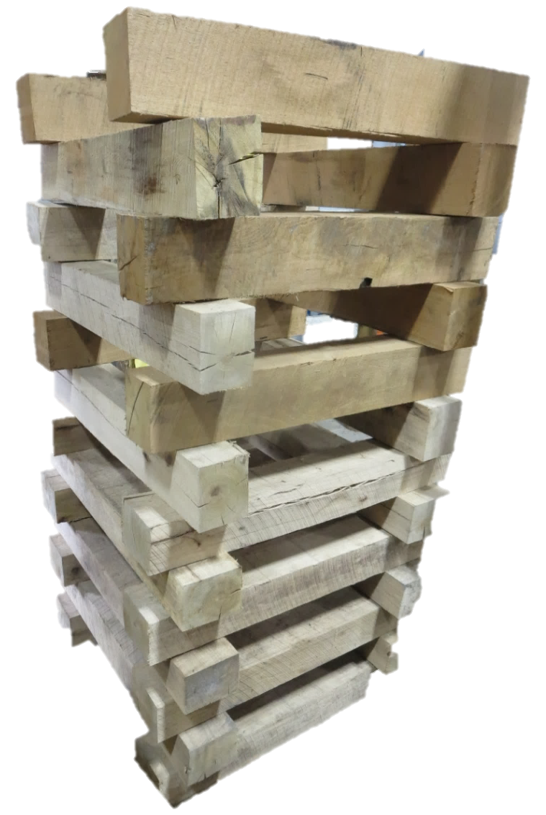
Summary
Load Expectations
Standing Support Characteristics
Wood Crib Best Practices
Pumpable Crib Best Practices
New Standing Support Product
Roof Beam Deflection Demonstration

Slide 42

Questions
Ryan C. Stephan, P.E.
stephan.ryan@dol.gov
412-386-6314

