Slide 1


VCEA / MCPA’s ANNUAL
2020 PE SEMINAR
OCT 29, 2020
MSHA: General Update
David G. Zatezalo
Assistant Secretary of Labor Mine Safety and Health Administration

Slide 2

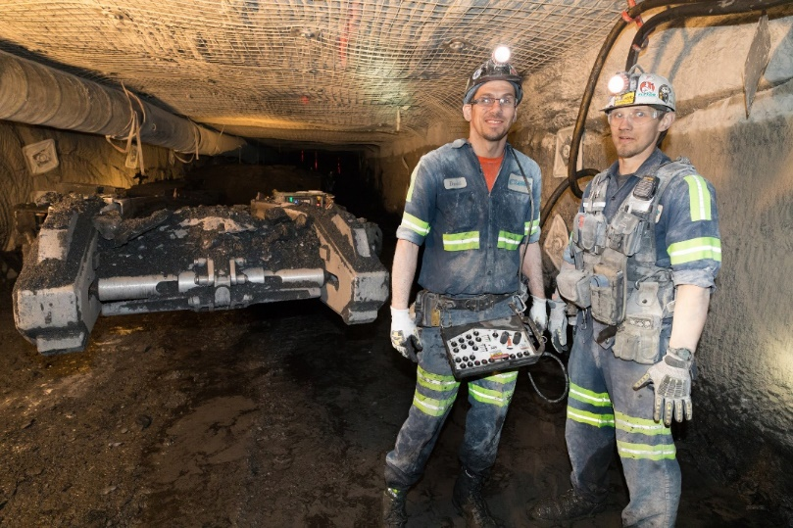
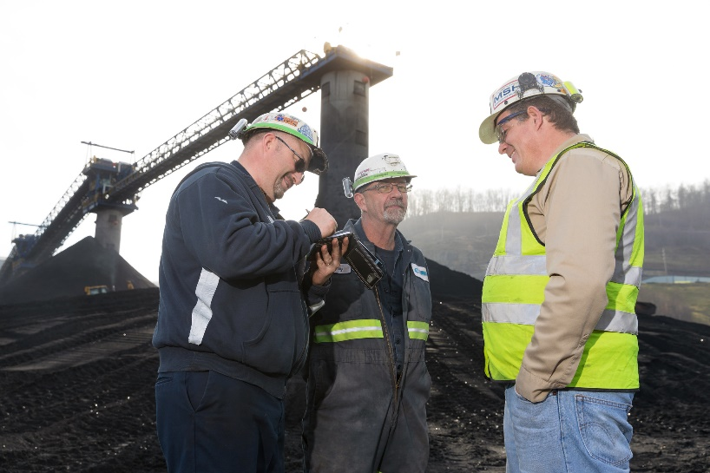
The MSHA Mission
“to prevent death, illness, and injury from mining and promote safe and healthful workplaces for U.S. miners”

Slide 3
MSHA’s Tools
Fair and consistent enforcement, including mandated inspections
Compliance and technical assistance
Training and education
Rulemaking and policy guidance

Slide 4
U.S. Mining Fatalities 1912-2020 YTD
3,679
22 Fatalities in 2020

Slide 5

Mining Injury Rates & Fatalities
2008-2020 YTD
* 2020 Injury Rate for Q1-2 2020 only

Slide 6
MSHA Data for 2019
# of Mines Reporting Employment | 12,928
- Coal Mines Only | 1,131
- Metal/Nonmetal Mines Only | 11,797
Total Industry Employment (Operator & Contractor) | 330,872
MSHA Inspections/Employees | 38,258/1,790
Citations & Orders Issued | 99,617
Dollars Assessed (millions) | $51.4

Slide 7

MSHA’s Mine Portfolio (CY 2019)*
Mine Type | Number of Mines | Share of Total
UG Coal Only | 388 | 2.8%
UG MNM Only | 241 | 1.7%
UG Total | 629 | 4.5%
All Surface | 12,493 | 89.5%
Facilities Only | 841 | 6.0%
* Includes mines that either reported employment or an injury; or received an inspection or citation.

Slide 8
Coal - Number of Valid MSHA & Operator Respirable Dust Samples
1.5 mg/m³ standard in effect 8/1/16
* 2020 figure is a proration from 8/31/2020 count of 73,343
Data as of 9/1/2020

Slide 9
Average DO* Dust Concentration in Underground Coal Mines, by MSHA and Operator Samples
* Designated occupations (DO) exposed to the highest levels of respirable coal mine dust.

Slide 10
Coal - MSHA & Operator Respirable Dust Samples % > Standard

Slide 11
Coal - Number of Valid MSHA Quartz Samples
* 2020 figure is a proration from 8/31/2020 count of 7,404
Data as of 9/1/2020

Slide 12
UG Coal -MSHA Average Designated Occupation*
Quartz Concentration (µg/m3) by Calendar Year
* Designated occupations (DO) exposed to the highest levels of respirable coal mine dust.

Slide 13
Coal - MSHA Quartz Samples % >100 µg/m³

Slide 14
Black Lung Claims Paid
Source: https://www.dol.gov/owcp/dcmwc/

Slide 16
One MSHA Initiative
Blurring the distinction between Coal and MNM enforcement for more efficient use of resources
Cross-training inspectors and updating systems to accommodate change where it makes sense
Specialized inspector expertise still required for certain mines
213 mines “blurred”
Phasing in 3 Regions and corresponding Regional Administrators

Slide 17
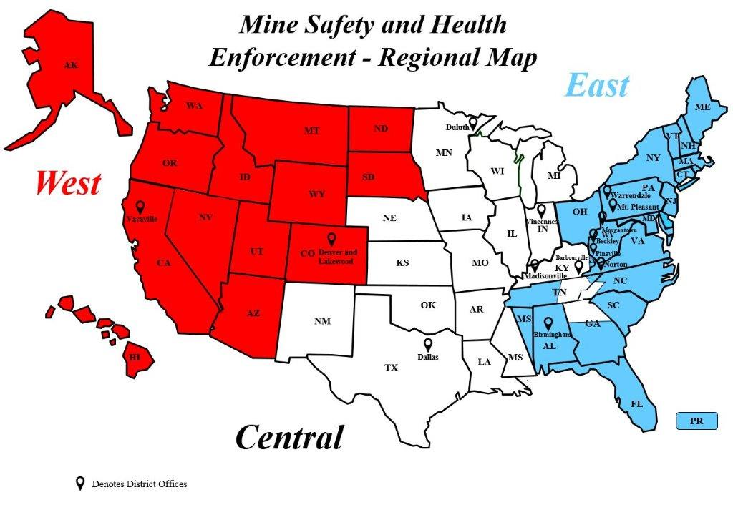
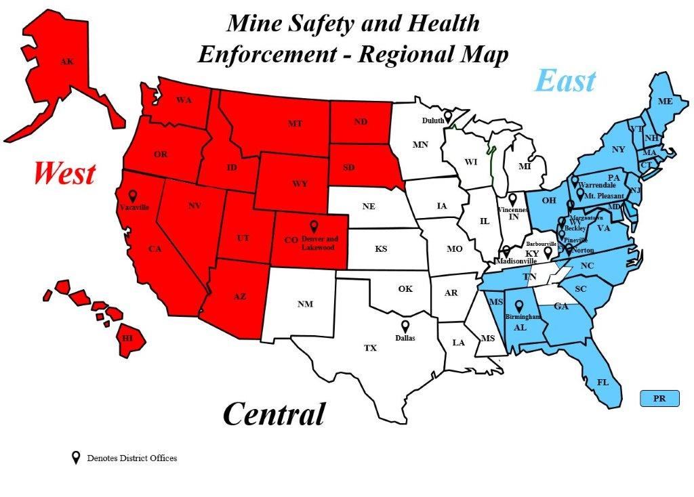

Mine Safety and Health Enforcement - Regional Map
AK
East
WA
ME
MT
ND
Duluth
VT
MN
NH
OR
MN
NY
MA
West
ID
SD
WI
MI
CT
WY
PA
Warrendale
NJ
NV
NE
IA
OH
New Stanton
Vacaville
Vincennes
MD
IL
IN
Morgantown
WV
VA
UT
CO
Denver and Lakewood
Beckley
CA
KS
MO
Barbourville
Pineville
KY
KY
Norton
Madisonville
NC
TN
AZ
OK
AR
SC
TN
NM
MS
Birmingham
GA
AL
HI
TX
Dallas
LA
MS
FL
Central
PR
Denotes District Offices
17

Slide 18
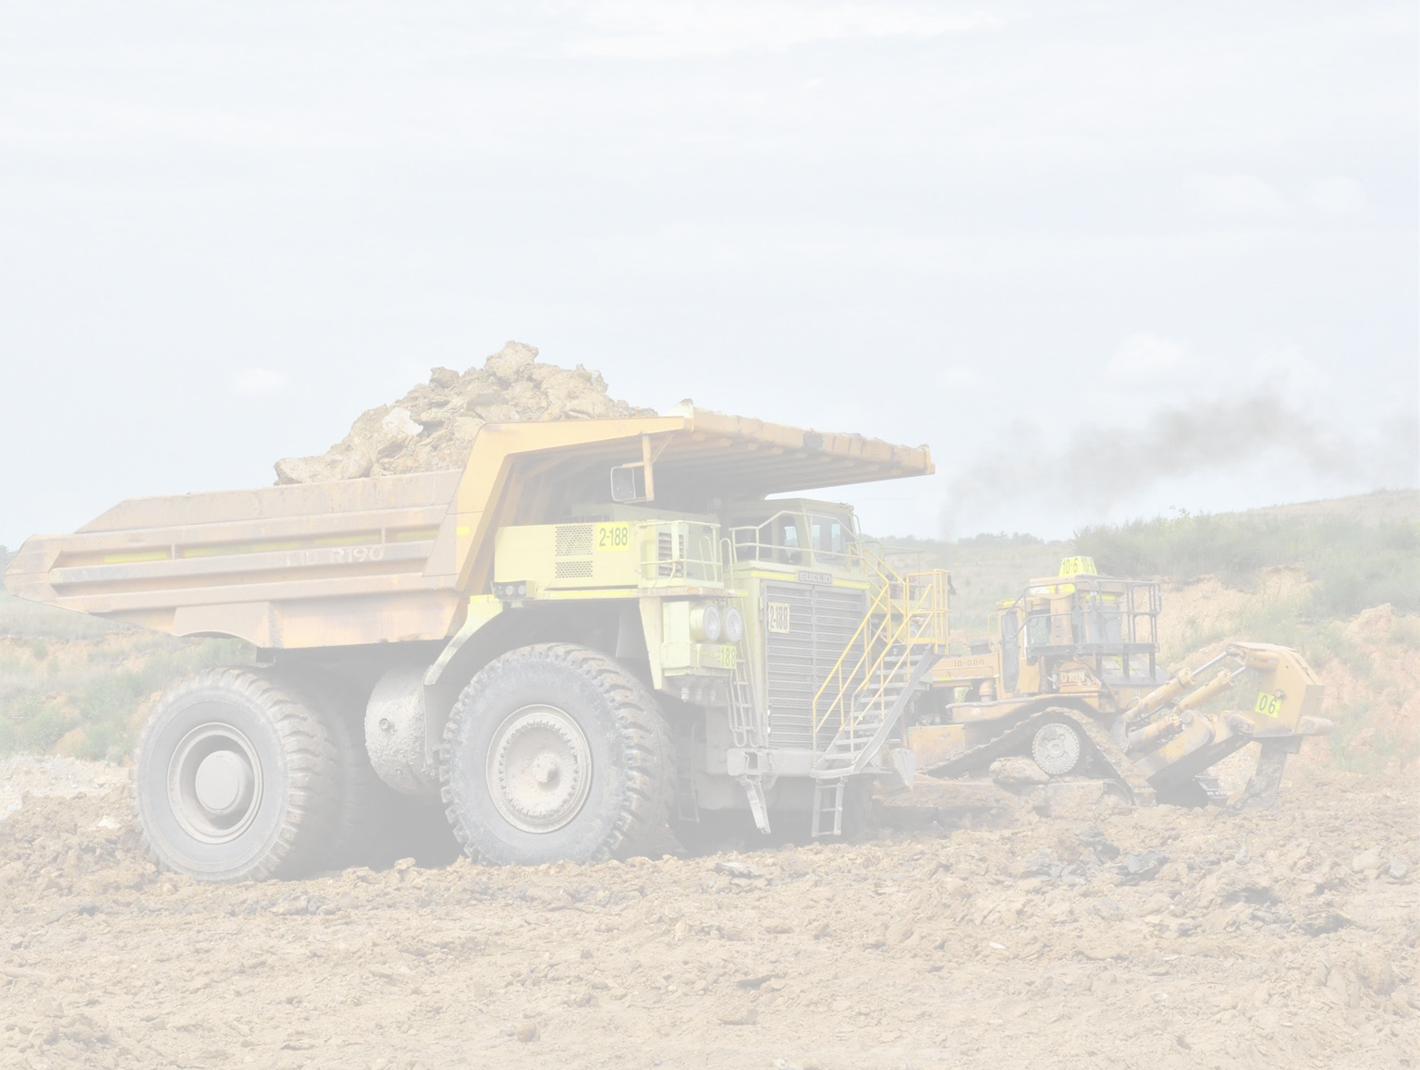
Powered Haulage Safety Initiative
Powered Haulage accidents were responsible for 50% of fatalities in recent years; 7 of 27 (26%)
in 2019 and in 2020, 5 of 22 (23%) which continues the trend of improvement
Preventing these accidents is a priority for MSHA, with a focus on:
Mobile Equipment
Belt Conveyors
Seat Belt Safety

Slide 19
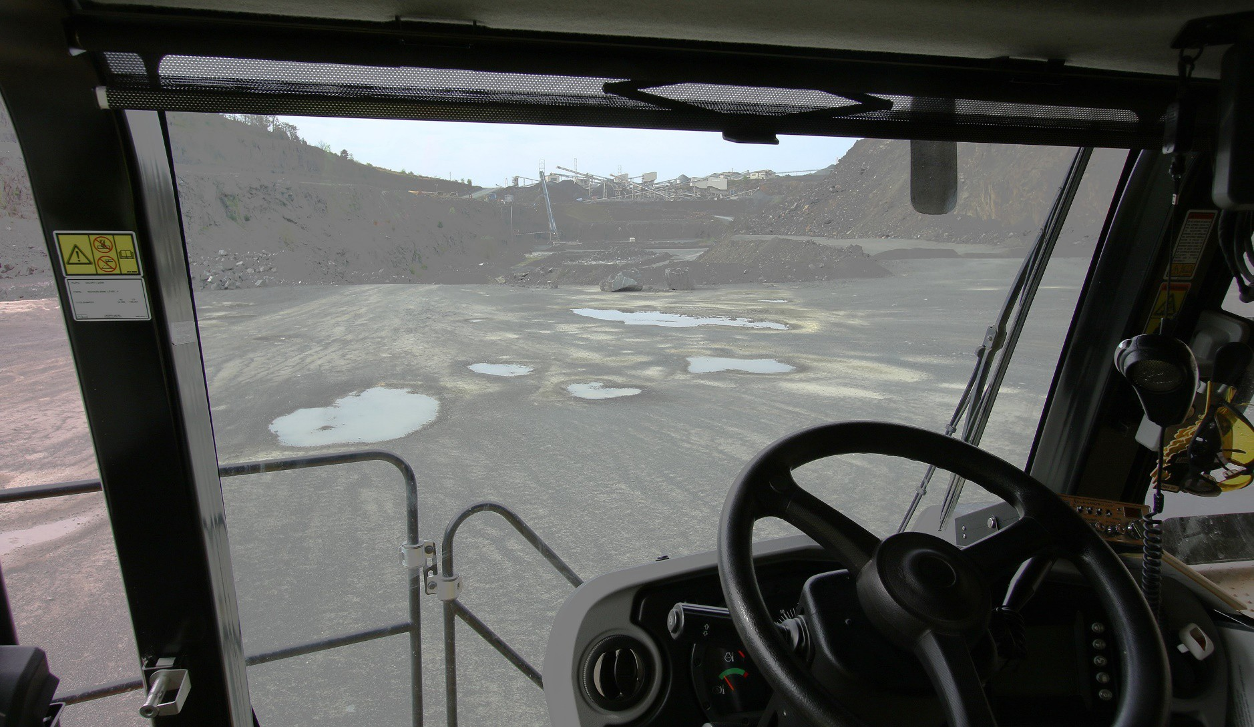
View from the Operator’s Cab
|

Slide 20
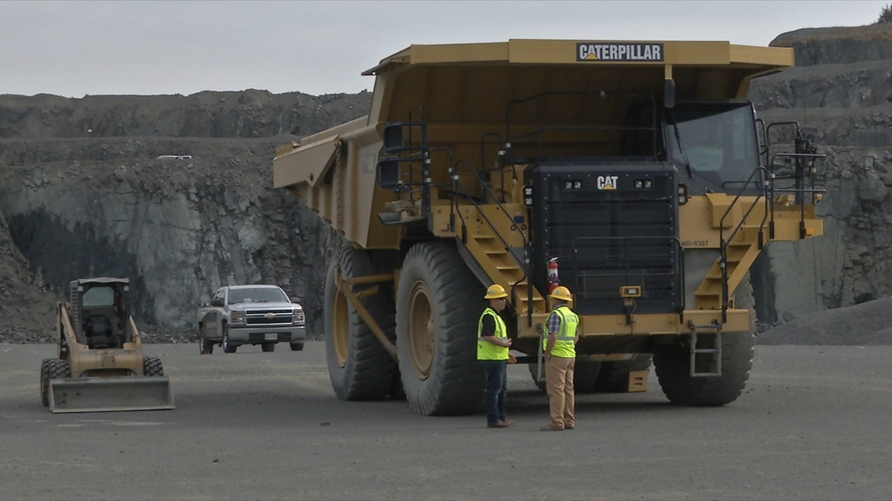
Actual Activity on the Ground
Large vehicles striking other vehicles or pedestrians have killed 24 miners since 2003
|

Slide 21
Belt Conveyors
Eight miners killed working around belt conveyors since January 2017;
Since 2008, 20 fatalities and more than 40 permanent injuries
Guarding, lock-out tag-out, properly using crossovers - all essential for safety

Slide 22
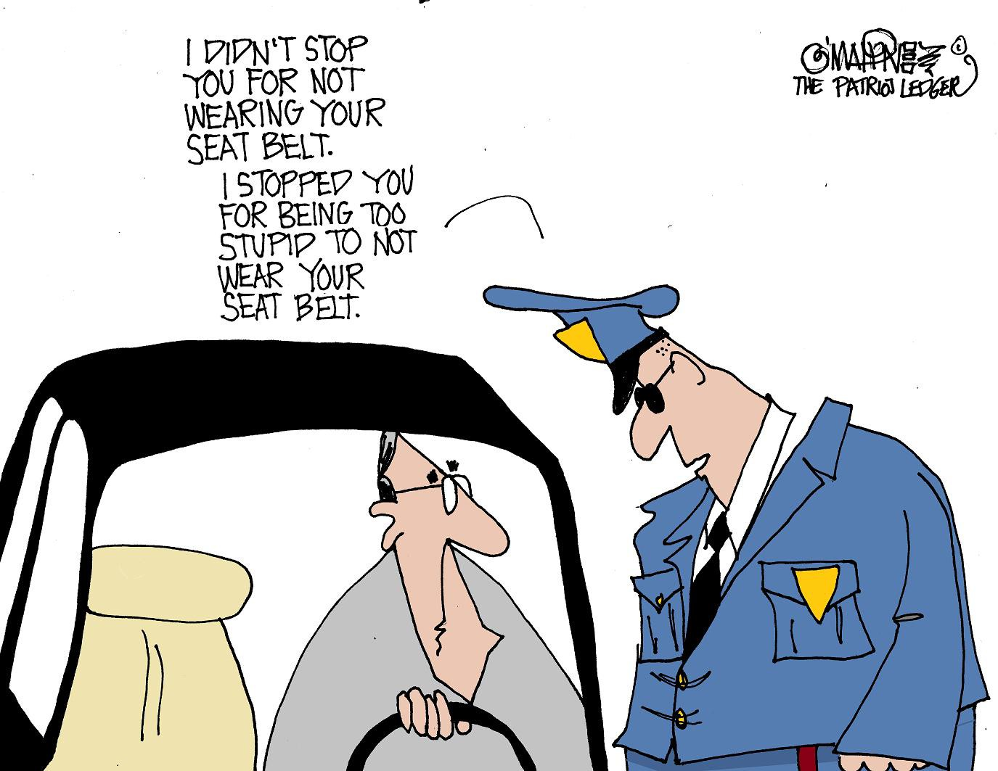
Seat Belt Safety
Three fatalities in 2017 and 2018, 3 more in 2019, no incidents in 2020 and 41 fatalities since 2007, involved miners not wearing seat belts
6000+ MSHA citations issued for failure to wear seatbelts since 2007 (most in MNM mines)
|

Slide 23
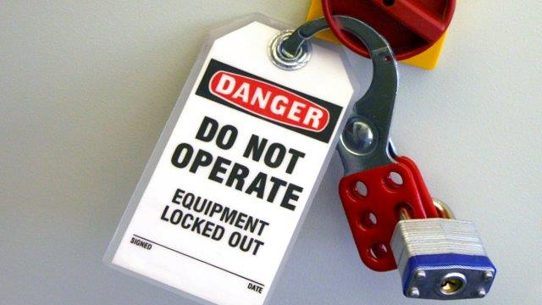
ELECTROCUTIONS of 2020
Three FATAL ELECTROCUTIONS In Over SIX WEEKS in 2019:
Two in West Virginia (Coal – District 04)
One in Louisiana (M/NM – South Central)
Near miss situations such as “victim in Florida contacted high voltage by placing head in electrical box”
Most recent in 2020, One in Georgia (SE)
All have somethings in common:
No Lock Out/Tag Out
Not protected with appropriate PPE
Working on electrical equipment without Certified or Qualified persons present
Working – Not Troubleshooting

Slide 24

Fall from Equipment Fatalities
From 2015 to present, there have been seven fatalities involving miners falling from equipment.
Three were attempting to mount/dismount equipment.
One victim was not tied off in an aerial lift while doing maintenance.
Three of these fatalities have occurred this year.
  Two involved closing the hatch of a bulk tanker truck.
  One involved falling from the top of a trailer while installing a tarp.
Root causes include not providing safe access, not wearing PPE, inadequate policies and oversight, and inadequate training.
24

Slide 25

Contractors
15 of 37 (41%) Fatalities in 2019 & 2020 combined were contractors
Contractors represent approx. 25% of workforce
Mine Act defines “operator” to include both owner /production operators and independent contractors
Operator & Contractor have equal responsibility for compliance with laws, standards & regulations
Most (if not all) contractor fatalities correlate with training deficiencies

Slide 26
Regulations and Guidance
  1. Powered Haulage – proposal projected in 2020.
  2. Permissible Survey Eq – working on proposed rule-estimated for 2020.
  3. Part 18 Approvals - Streamlining for Electronic product approvals proposed rule in 2020.
  4. Guidance – updating and streamlining MSHA program handbooks is underway to comply with Executive Order and best practices.
  5. Respirable Quartz – had public session w/ NIOSH. Spring regulatory agenda will detail next action. Workshop held October 22 & 23, 2020.

Slide 27
STEPS INTO FUTURE
Revision of dust rule is being worked on now
Standards should be common, where applicable, between MNM and Coal
PPE should be utilized (and credited) to drive further improvements
Dust sampling should move to a “targeted” approach for operations with a poor history of compliance, example 103i
Sampling frequency increase – MNM 5 4 3

Slide 28

Questions?

