Slide 1
Steven Winberg
Assistant Secretary
Office of Fossil energy
MCPA/SSEB
October 26, 2020
Notes:
I appreciate the opportunity to talk to you today about what the Department of Energy is doing to address the challenges to coal – and to expand the opportunities for that vast resource.
I want to start by thanking the MCPA and the SSEB for the work you do to support coal and the coal industry. That work – and your consistently strong voice for coal – is more important than ever as we look at where coal is today, and we see the global trends for coal.
This challenging environment requires a clear-eyed response if coal is to have a bright future in the 21st century. And that response must be two-fold. We need to address the challenges to coal as a power source, but we also need to explore ways to utilize coal beyond power generation and steel production.
So, at the Department of Energy, we’re pursuing four technical pathways to secure the future of coal in the 21st century.

Slide 2
21st Century Coal
The future of coal in the 21st Century depends on four technical pathways
Coal FIRST
Carbon Capture, Utilization, and Storage
Hydrogen
Coal to Products
Notes:
Developing the Coal FIRST power plants of the future;
Advancing CCUS;
Using our massive coal resources to advance a hydrogen economy; and
Developing valuable products, including a valuable domestic supply of critical minerals and rare earth elements.
So, I’d like to focus my discussion today on these pathways.

Slide 3
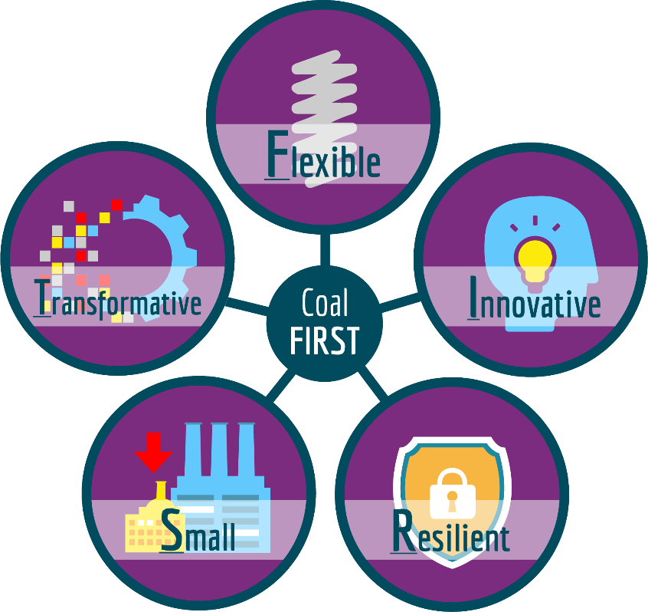
Coal FIRST: The Future of Power Generation
(Flexible, Innovative, Resilient, Small, Transformative)
Provides a zero or near zero CO₂ emissions
Provides low cost power generation; economically competitive
Uses advanced materials and processes; maximizes efficiency
Meets IEA solution for CO₂ emissions -- carbon capture
Only zero or near zero CO₂ emissions power plant R&D effort in the world
Potential to revive the US coal industry; provide a source of high value exports
Provides stability and reliability to the grid of the future, and offer both “firm and flexible” operations
Per International Energy Agency (IEA), coal will be the largest source of electricity production in the world by 2040, and likely beyond
Near-Zero Emissions
Secure, Stable, Reliable Power
Flexible coal plant operations to meet the needs of the grid
Transforms how coal technologies are designed and manufactured
Innovative and cutting-edge components; improved efficiency and near-zero emissions
Smaller than conventional utility-scale coal plants
Resilient power generation
Notes:
The fundamental changes to the operating and economic environment in which coal plants function are expected to persist into the next decade and beyond.
First things first – it’s critical that baseload power sources like coal continue to provide grid stability and reliability. That’s why my office – the Office of Fossil Energy – is focused on developing the smaller, modular coal-fired power plants of the future through an initiative we call Coal FIRST (Flexible, Innovative, Resilient, Small, and Transformative).
Through Coal FIRST, we’re working to develop plants that are:
• Small – in the range of 50 to 350 MW;
• Highly efficient – north of 40 percent, which, by the way, would make carbon capture easier and less expensive;
• Nimble and flexible, and capable of load-following to meet the demands of an evolving grid, with the ability to ramp up and down as demand dictates; and
• Modular – which will lower costs, reduce project cycle time, and allow for standardization of design.
Because of their modularity, size, and flexibility, these plants can be sited wherever they’re needed – near coal mines or near industrial facilities, for instance.
And one other thing, our Coal FIRST initiative is the only R&D effort in the world that is attempting to develop a coal-fired powered plant of the future that will have near-zero or net negative CO2 emissions when using biomass.
Why Coal FIRST?
Coal FIRST (Coal Plant of the Future) is a flagship initiative for FE that will provide zero/near-zero CO₂ emissions for coal power plants. A recent report from the International Energy Agency (IEA) indicates that coal will be the largest source of electricity production in the world by 2040, and likely well into the future. IEA also has stated that any solution for CO₂ emissions must include carbon capture, one of the key traits for a Coal FIRST unit. The need for considerable dispatchable generation, critical ancillary services, and grid reliability—combined with potentially higher future natural gas prices and energy security concerns, such as onsite fuel availability during extreme weather events also creates the opportunity for advanced coal-fired generation in both domestic and international markets.

Slide 4

Coal FIRST Adapts to the Needs of Tomorrow
Coal FIRST will deliver advanced technologies that serve as building blocks to meet the variety of evolving energy needs across the globe.
Transportation Fuel—Hydrogen
Energy Storage
Power Generation
Transportation Fuel—Hydrogen
Power Generation
Power Generation
Transportation Fuel—Hydrogen
Notes:
Coal FIRST is versatile and it can meet the 21st century’s evolving energy needs – not only here but around the world, where it can help reduce energy poverty and provide affordable electricity and opportunities for economic prosperity to people worldwide.
In Africa, it can power communities that currently have little or no electricity.
Australia has plenty of coal, so they can easily transfer their fuel source and power industry through Coal FIRST technologies to achieve significant reductions in their carbon footprint.
In Asia-Pacific, coal can be used for both power and hydrogen production.
In the US and Western Europe, it can also be used to produce hydrogen for transportation and storage.
So, we see an export opportunity for Coal FIRST technologies. At the same time, exporting these technologies to countries that import coal could strengthen and expand the markets for American coal.

Slide 5
Coal FIRST Solicitations and Timeline
As of June 2020
Coal FIRST
Pilot Plant
Operation
FOA – Accelerated FEED Studies
Up to 3 FEED studies in 4 Areas of Interest (AOI)
AOI 1: Flexible Ultra Supercritical (USC) Coal-Fired Power Plant
AOI 2: Pressurized Fluidized Bed Combustor with Supercritical Steam Cycle Power Plant
AOI 3: Hybrid Natural Gas Turbine / USC Coal Boiler Power Plant
AOI 4: Flexible Gasification of Coal and Biomass to generate Electric Power and carbon free Hydrogen
FOA – Pilot Plant
Detailed Design, Construction, & Operation
Up to 1 project
13 Conceptual Designs
2027
Commissioning
7 Pre-FEED Studies
FOA – R&D of Critical Components
Up to 20 awards in 7 Areas of Interest (AOI)
AOI 1: Pressurized Fluidized Bed Combustion with USC power Cycle
AOI 2: Indirect Supercritical Carbon Dioxide Power Cycle
AOI 3: Direct-fired Supercritical Carbon Dioxide Power Cycle
AOI 4: Gasification Based Poly-generation
AOI 5: Coal-Fired Direct Injection Combustion Engine & Gas Turbine Compound Reheat Combined Cycle
AOI 6: Modular Staged Pressurized Oxy-combustion
AOI 7: Flameless Pressurized Oxy-combustion
FOA - Pilot Plant FEED Study & NEPA
Up to 2
Pilot Plant
Detailed Design, Construction, & Operation
Up to 1 project – Completion after 2030
Dec ’26
Complete
2019
2020
2021
2022
2023
2024
2025
2026
2027
2028
Notes:
We’re moving rapidly on the Coal FIRST initiative. This year:
We selected 7 Pre-FEED Studies from 13 Conceptual Designs
In February 2020 - Up to $64 million in federal funding for Critical Components for Coal FIRST plants
In May 2020 – Draft FOA committing approximately $81 million in federal funding for Design Development and System Integration Design Studies for Coal FIRST concepts. Final FOA during third quarter of 2020.

Slide 6
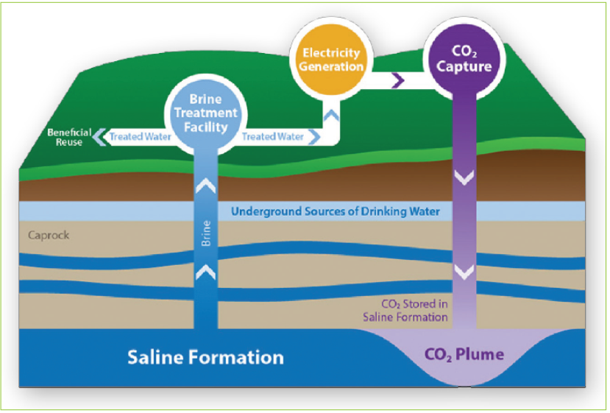
CCUS R&D Program Goals and Challenges
Reduce the cost of capture by 50%
  Capital cost
  Energy penalty
  Integration or process intensification
Develop viable carbon utilization alternatives
  Reduce Capital cost
  Reduce energy requirements
  Lifecycle assessment better than existing products
Reduce the risk of geologic storage – improve monitoring and simulation
  Higher resolution and quantification (e.g., accurate characterization of faults and fractures)
  Geomechanics (pressure and state of stress)
  Costs/uncertainty/enabling real-time decision making
2012:$80/tonne
2016: $60
2018: $45
2020: $40
2030: $30
Sources: NETL, Cost and Performance Baseline for Fossil Energy Plants, Revision 3, July 2015; NETL Cost and Performance Baseline for Fossil Energy Plants, September 2019.
* Sources: Global CO2 Initiative; https://www.cslforum.org/cslf/sites/default/files/documents/tokyo2016/Dairanieh-TransformingCO2-TG-Tokyo1016.pdf: C2ES, https://www.c2es.org/site/assets/uploads/2019/09/carbon-utilization-a-vital-and-effective-pathway-for-decarbonization.pdf
Notes:
Now, the fact is that coal plants will have to operate with lower CO₂ emissions. And the only realistic path to getting there is by commercializing and deploying carbon capture, utilization, and storage technologies – or CCUS.
As we look across the energy and environmental landscapes, we see that developing and commercially deploying CCUS is more important than ever. This is a global imperative, so we continue to work with our international partners, including Australia, Norway, Saudi Arabia, and a number of others, to advance CCUS.
But, I want to make an important point here. CCUS isn’t just about coal anymore. For those who understand the enormity of the challenge, you know that it never was just about coal. It’s also about capturing CO₂ from natural gas power generation and numerous industrial processes. And, at the Department of Energy, we’re even leveraging our R&D to develop Direct Air Capture technologies.
So, I’d like to talk for a few minutes about our CCUS R&D program; we’ve invested more than $800 million in the program during the Trump Administration.
We’ve had some impressive successes, and we’ve moved a number of cutting-edge CCUS technologies to market.
But, as with any transformational technology, we’ve had some bumps along the way. There are still some technical hurdles to commercializing these technologies – the most significant being the costs associated with carbon capture. We’ve reduced it from around $60 a ton to about $45 a ton, and our ultimate goal is to get the cost to $30 a ton. And our Carbon Capture R&D is moving us closer to that goal.
We’re also developing pathways to safely store CO₂.

Slide 7
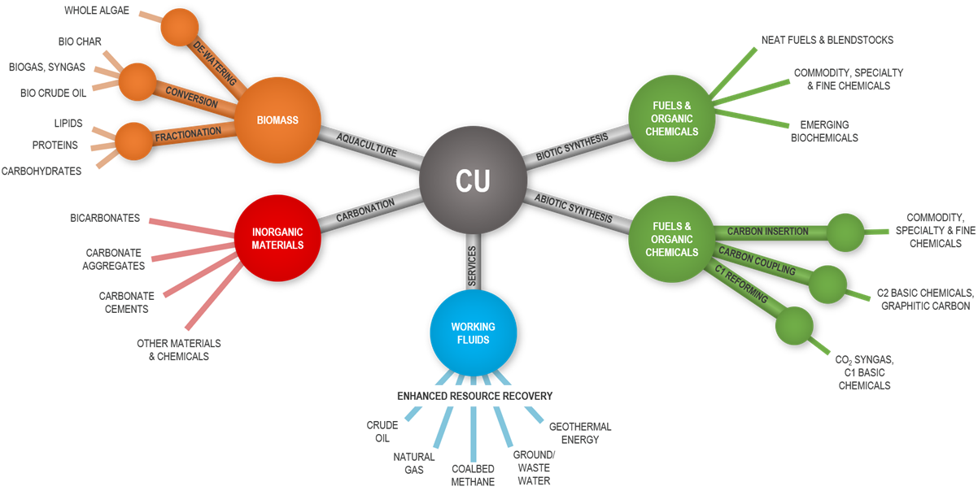

Getting Additional Value from CO₂
Carbon Utilization R&D Program
Algae Conversion
(7.5 projects*)
Synthesis of Fuels and Organic Chemicals
(30 projects)
$9M
$19M
$9M
Production of Inorganic Materials (9.5 projects*)
*Some projects incorporate multiple conversion pathways
Mission: Develop technologies to recycle CO₂ into economy by transforming carbon waste streams into value-added products. Areas of research include, but are not limited to, catalytic conversion to chemicals and polymers; mineralization to building products; generation of solid carbon products; and algal conversion platforms designed to integrate into large CO₂ point sources.
Notes:
We’re investigating ways to extract an economic benefit or additional value from CO₂. Of course, EOR is the most near-term application.
But, in addition to EOR, we’re also investing in novel catalysts and other physical conversion technologies to open up a number of possibilities to use CO₂ to make commercial products, including carbon fibers, high-value chemicals, and plastics.
Look at plastics as an example. We’ve funded multiple projects at various technology readiness scales to develop novel ways to produce plastics or intermediate feedstocks for plastic production.
For example, researchers at our lab, the National Energy Technology Laboratory, have developed a new catalyst that can selectively convert syngas from CO₂ and other agents into olefins – which are widely used as building blocks in the manufacture of plastics. And one aspect of that research is the development of nano-catalysts to convert CO₂ to materials, including polymers.
So, we have an exceptional opportunity to reduce CO₂ emissions and realize the full potential of carbon utilization, and cutting edge R&D will help us get there.

Slide 8
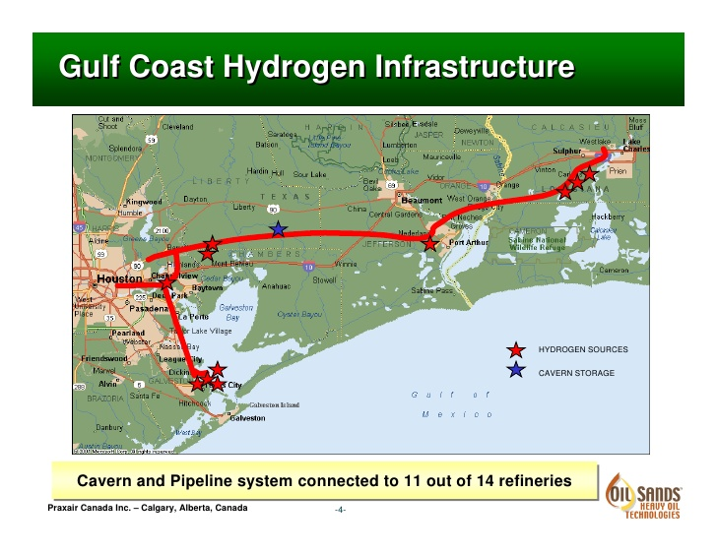
Carbon Capture Can Help Enable a Hydrogen Economy
Hydrogen enables a number of clean energy and transportation platforms using hydrogen from fossil energy, including oil and gas – AND coal.
Steam methane reforming primary source of H₂
(~ 95% of global production).
Hydrogen production from gas and coal with CCUS can reduce emissions to near zero at lowest cost.
Market opportunities:
Transportation vehicles
Clean energy
Energy storage
Clean products
R&D Opportunities:
Materials embrittlement
Autothermal and gasification
Electrolysis, turbines, SOFC
Hydrogen storage
Conversion technologies
Hybrid Systems
Notes:
One more thing – CCUS can also help enable a hydrogen economy. In fact, one of our major CCUS projects – in Port Arthur, Texas – combines carbon capture with steam methane reforming to produce hydrogen.
Hydrogen plays a key role in the Department of Energy’s strategy to ensure affordable, secure and clean energy from all of our domestic resources.
But no other fuel requires more integration of our energy systems – fossil, nuclear, and renewable – and it will take an integrated approach from all energy sectors to realize the full potential and benefits of hydrogen.
To meet this challenge, the Department of Energy has developed a Hydrogen Program Plan. This Plan provides a strategic framework that incorporates the research, development, and demonstration efforts across the Department – including the work being done in the Office of Fossil Energy – to advance the production, transport, storage and use of hydrogen across all sectors of the economy.
This Plan represents DOE’s commitment to develop the technologies that can enable a hydrogen transition in the United States. And it underscores the importance of collaboration with our stakeholders in industry, academia, and the states to achieve that goal.

Slide 9
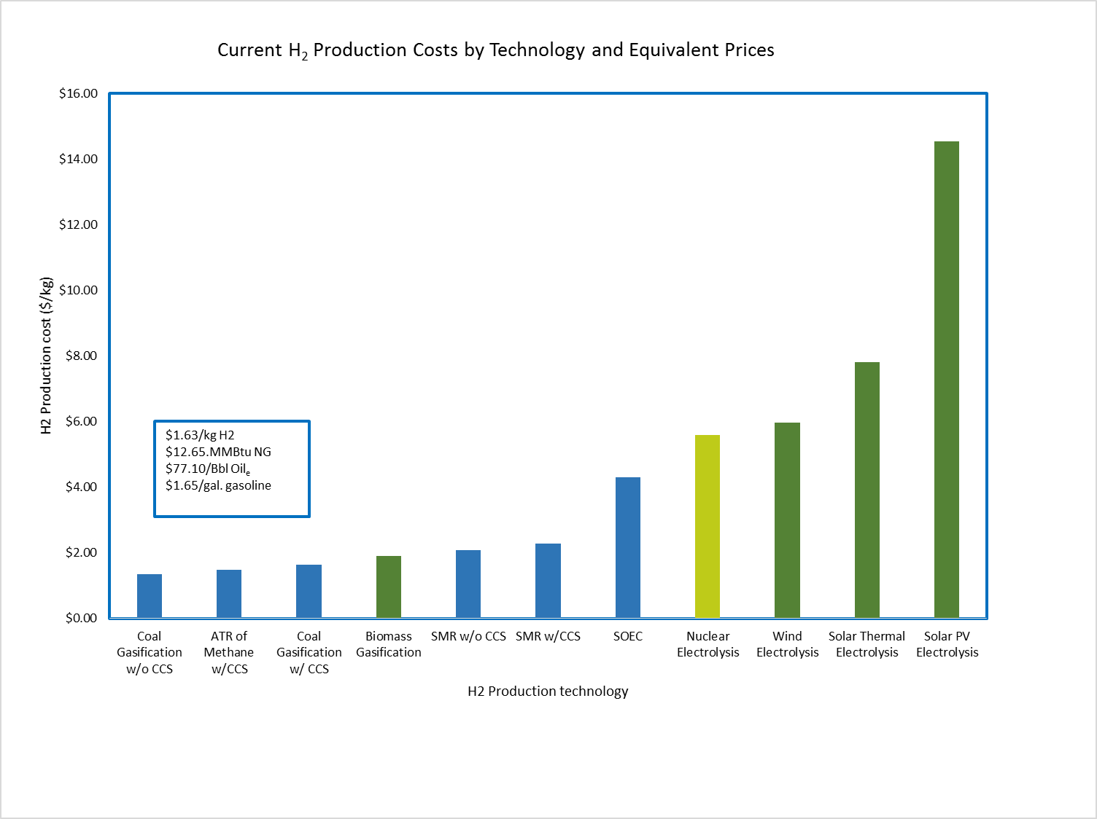

Cost of Hydrogen from Fossil Energy Sources
Fossil Energy is the lowest cost source of hydrogen, even with CCUS
$14.53/kg H2 $112.77/MMBtu NG $687.27/Bbl Oil_{e} $14.68/gal. gasoline
Fossil Energy
Renewables
Nuclear
$5.96/ kg H2
$46.26/MMBtu NG
$281.91/Bbl Oil_{e}
$6.02/gal. gasoline
$2.27/kg H2
$17.62 MMBtu NG
$107.37/Bbl Oil_{e}
$2.29/gal. gasoline
Notes:
Production of hydrogen from gas and coal with CCUS can reduce emissions to near zero – and at the lowest cost.
So, we’re leveraging our investments – as well as the low cost of natural gas and our expertise in the production, transportation, storage and use of hydrogen – to jump start a low cost and carbon free H2 economy with CCUS.
And, as I mentioned, this is where we see additional benefits of Coal FIRST technologies – particularly modular gasification combined with CCUS, which can advance hydrogen production from coal, with near-zero emissions and at the lowest cost.

Slide 10
U.S. Coal Consumption By End Use Sector (2019)
The vast majority of U.S. domestic coal consumption occurs within the Electric Power Sector (92%)
47
Source: EIA, Short Term Energy Outlook
Notes:
Currently, almost all the coal utilized in this country is in the electric power sector. Utilization of metallurgical coal is a small percentage of total coal consumption.

Slide 11
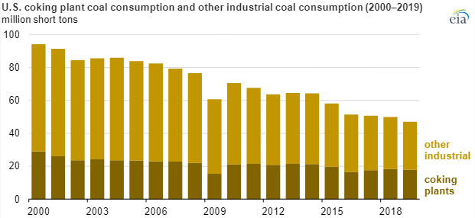
Industrial Coal/Coking Coal Consumption
Notes:
Here is a closer look at metallurgical coal consumption. As you know, demand for metallurgical coal is correlated with the demand for steel.
Our U.S. steel industry was a target of President Trump’s “Buy American, Hire American” Executive Order, and played a role in his efforts to streamline and improve the regulatory process for energy infrastructure development.

Slide 12
2019 U.S. Coal Exports, Million Short Tons (Mmst)
Total: 92.9 MMst
Europe: 33.3 (36%)
Asia: 32.5 (35%)
Americas: 18.3 (20%)
Africa: 8.8 (10%)
Coking Coal: 55.1 MMst
Brazil: 7.3 (13%)
Japan: 6.6 (12%)
Netherlands*: 5.1 (9%)
India: 4.7 (9%)
Ukraine: 4.6 (8%)
Canada: 4.2 (8%)
S. Korea: 2.6 (5%)
Morocco: 2.3 (4%)
Austria: 2.2 (4%)
Italy: 2.1 (4%)
Croatia: 1.8 (3%)
Turkey: 1.6 (3%)
France: 1.2 (2%)
China: 1.2 (4%)
Steam Coal: 37.7 MMst
India: 8.1 (22%)
Netherlands*: 5.0 (13%)
S. Korea: 4.7 (12%)
Japan: 4.3 (11%)
Egypt: 4.1 (11%)
Mexico: 2.1 (6%)
Morocco: 1.2 (3%)
Germany: 1.2 (3%)
Canada: 0.9 (2%)
Chile: 0.8 (2%)
*Netherlands data include transshipments throughout Europe.
Source: EIA, Quarterly Coal Report (April 2020 edition)
Notes:
Other countries, especially those utilizing metallurgical coal for steelmaking, want our coal exports. Take a look at this list.
53 percent of US coal exports went to just 5 countries, India, Japan, the Netherlands (Europe), Brazil and South Korea.
But it is interesting to note that Brazil imports the greatest amount of US coking coal. Brazil is incidentally the third-largest energy consumer in the Americas, behind the United States and Canada.

Slide 13
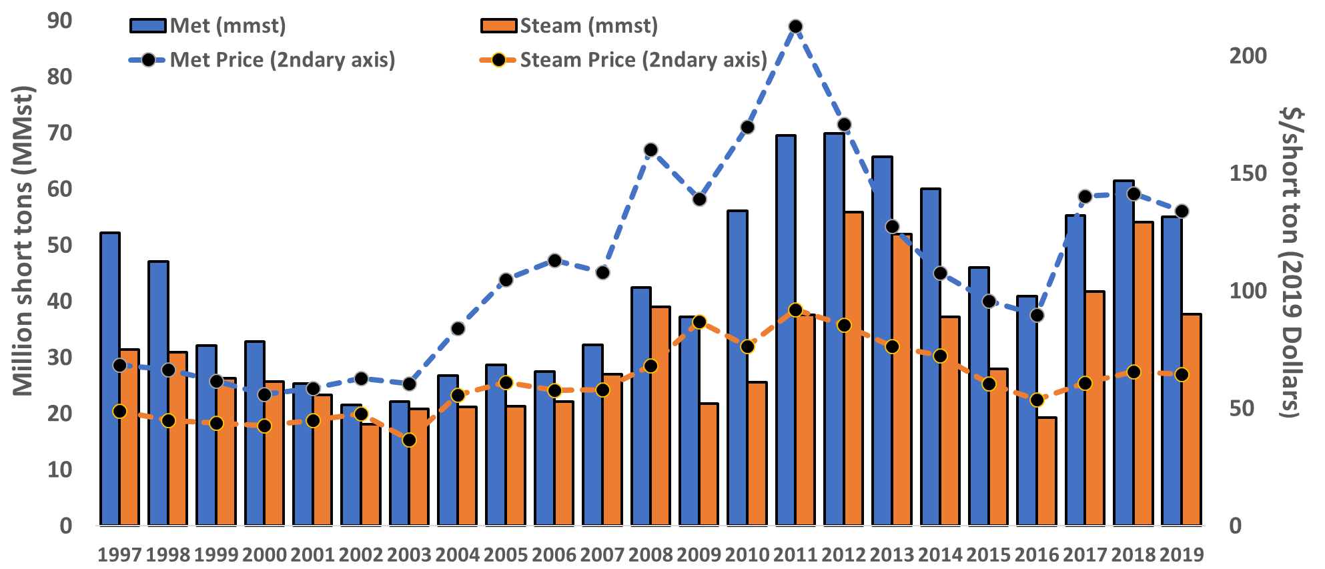
U.S. Coal Exports: Metallurgical And Steam
U.S. currently exports ~75% of its met coal production
Sources: EIA, Short Term Energy Outlook (STEO); Quarterly Coal Report; industry experts at a Platts conference stated ~75% of U.S. met/coking coal production is exported, which is consistent with EIA data that show the U.S. consumed 17.9 MMst of coal in coke plants in 2019, while it exported 55.1 mmst of metallurgical coal.
Notes:
And to sum up, with a key fact for your group today – the US currently exports three-quarters of its metallurgical coal. Our coal is much in demand in other countries.

Slide 14



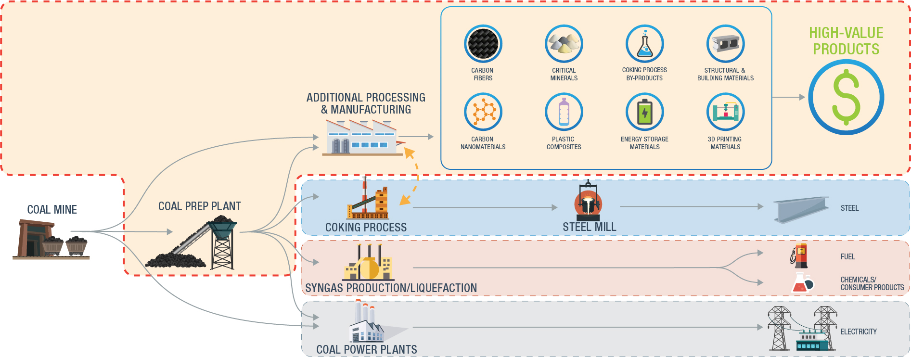
R&D to Expand the Coal Value Chain
COAL TO CARBON PRODUCTS
FEEDSTOCK UPGRADING
COAL PROPERTIES DATABASE
Coal Beneficiation Program
New processes to maximize coal’s value as a feedstock
New technologies for value-added products from coal
Notes:
I want to turn now to other markets and other opportunities we’re pursuing to utilize coal.
Last year, the National Coal Council released a report titled, “Coal in a New Carbon Age.” This report outlines the growing opportunities to utilize coal in ways that go beyond fueling power plants or steel production – opportunities that include the development of advanced materials and advanced manufacturing, which can provide a strong future for coal.
Building out these markets could have enormous benefits for our national and energy security, in addition to economic growth for the coal industry and for industrial and manufacturing sectors.
The opportunities opened up by coal-to-products are compelling.
The U.S. currently produces about 750 million tons of coal per year, more than 90% of which is used for power generation.
The global market for coal-to-products is estimated to consume 300-400 million tons of coal annually. Utilization of domestic U.S. coal for coal-to-products applications has the potential to be on the same order of magnitude as that projected for coal power generation applications.
The Office of Fossil Energy has an active research and development program focusing on the value of coal as a feedstock and developing new high-value products derived from coal.
Research includes testing of laboratory and pilot-scale technologies that produce upgraded coal feedstocks and additional revenue producing products including: nanomaterials, carbon fiber, battery/electrode materials, carbon materials for 3D printing applications, carbon additives for manufacturing composites, and carbon-based construction materials.

Slide 15
Coal Foams
Coal Foams
Notes:
For examples of coal-to-products – take a look at coal foams. The carbon from coal is permanently captured in these foam products, incidentally.

Slide 16
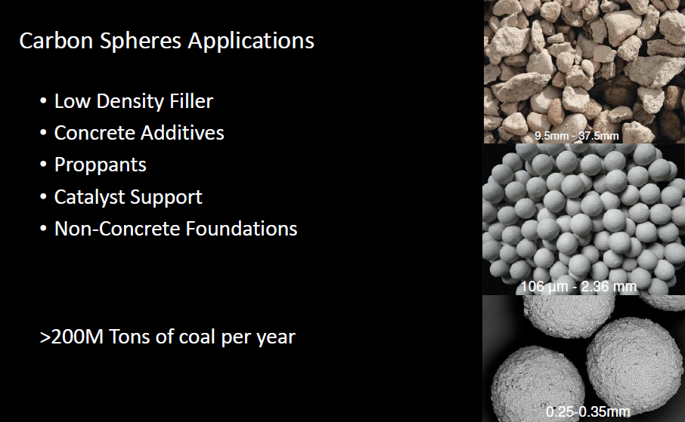
Carbon Spheres
Notes:
Other examples of coal-to-products are the carbon components of a new building industry, exchanging lumber and cement for coal-based products.

Slide 17

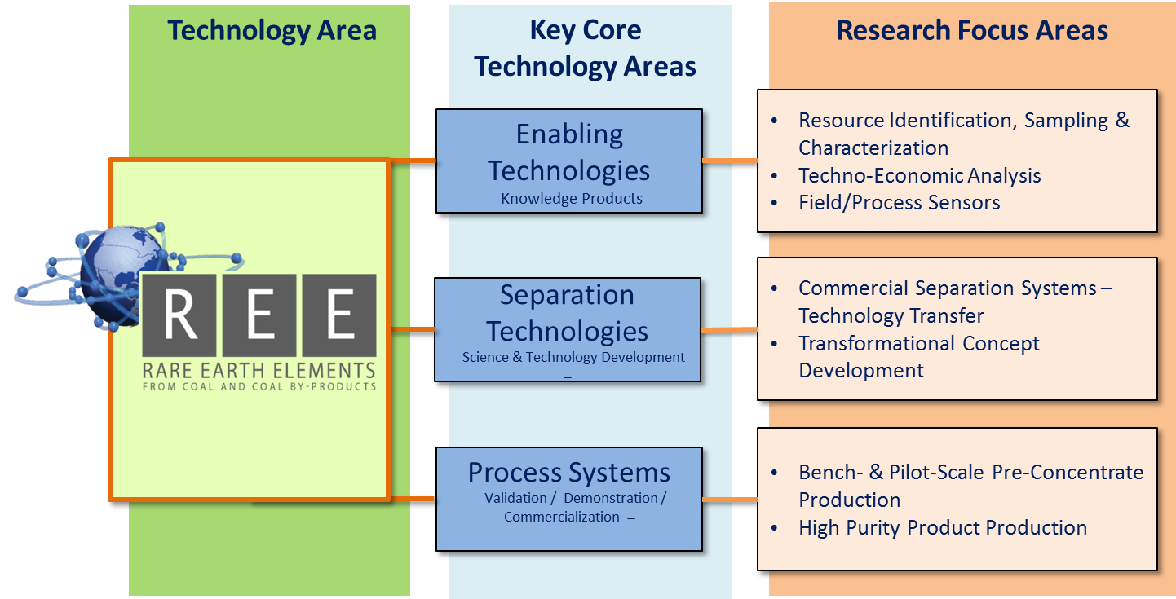
Rare Earth Elements/Critical Minerals from Coal
Office of Fossil Energy
Development of an economically competitive and sustainable domestic supply of rare earth elements (REEs) and critical materials (CMs) to assist in maintaining our Nation’s economic growth and National Security
Notes:
Perhaps the most important use of coal as a product right now is as a domestic supply of critical minerals – including rare earth elements – from coal and coal by-products.
America’s vast coal resources are an extremely promising source of domestic rare earth elements and critical minerals.
In fact, we’ve already found that recoverable coal reserves in basins in Appalachia could produce nearly 5 million metric tons of REEs. And our initial assessments estimate that coal deposits in western state basins in Montana, Wyoming, Utah, New Mexico, Arizona, and Colorado could produce 6 million metric tons of REEs.
And there could be several million additional tons of REEs available in coal ash and coal mine refuse.
So, we know the resources are there. The challenge, of course, is that extracting, separating, and processing REEs is difficult, and new technologies are needed to help us take advantage of this tremendous potential.
That’s where our critical minerals research and development program comes in. It’s a vitally important initiative at DOE right now.
Our ultimate goal is to validate the commercial domestic production of critical minerals, including rare earths, from coal and coal by-products in the 2030 to 2035 time frame.
We currently have a number of other bench- and pilot-scale projects focused on rare earth recovery and production. We’re also moving forward with projects to develop conceptual designs for commercially viable extraction technologies.
We also recently announced a $122 million regional initiative to produce rare earths and critical minerals from U.S. basins.

Slide 18
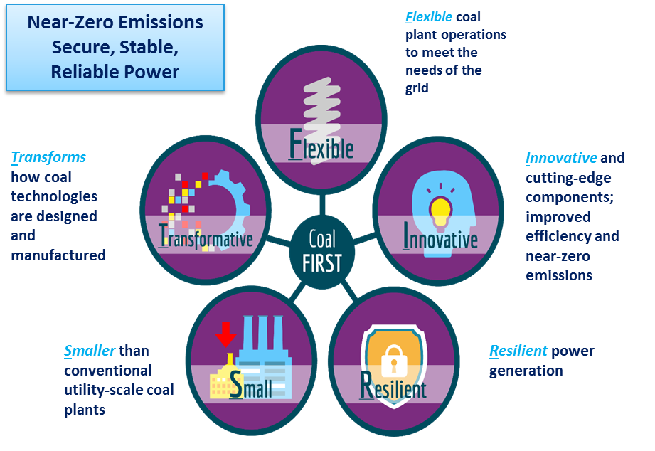

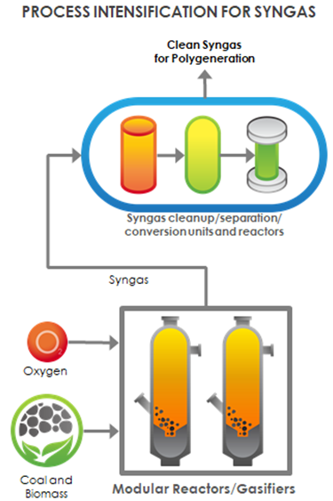
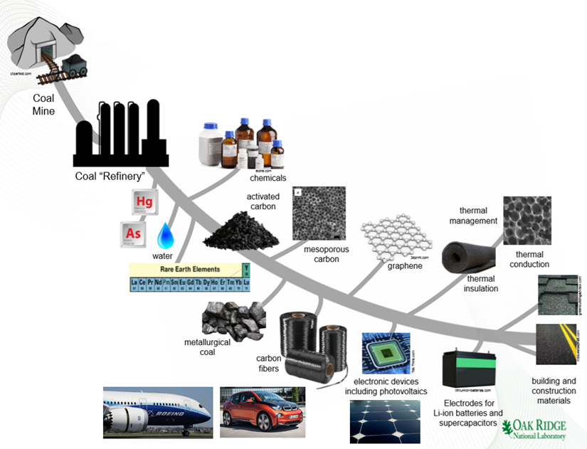
Summary
Technical Pathways for 21st Century Coal
Hydrogen Production
Power Generation &Transportation
Coal FIRST CCUS
Coal to Products
Notes:
So, technology development will continue to drive global energy transformation, and it will help us address the environmental challenges to coal.
It will also open up opportunities to use coal to produce high-value products and fuels, like hydrogen – and to provide consumers around the world with cleaner, affordable choices across the power and transportation sectors.
But, to get there, new technologies need to be tested and proven. Innovative processes need to be refined. The groundwork for the next generation of power plants needs to be laid. CCUS technologies need to be commercialized and deployed. And new markets for coal need to be explored and developed.
Our research will help do this. But collaboration with industry and with researchers is critical to achieving these goals. Your leadership will continue to be essential to securing a bright 21st-century future for coal. So, we look forward to working with you to realize coal’s full potential – and to write the next chapter for this abundant and versatile resource.
Thank you.

Slide 19




For More Information
www.energy.gov/fe
https://www.netl.doe.gov
facebook.com/FossilEnergy
twitter.com/fossilenergygov

